Slide 1
EC/b+ Experiment with CaMoO4 crystal.
WoonGu Kang, Yeongduk Kim
Sejong University
4th Amore Meeting
2011. 9. 28

Slide 2
Motivation of EC/EC
Though the detection of 0nbb decay would prove the existence of massive Majorana neutrinos, the possible mechanisms giving rise to 0nbb decay would be uncertain.
  exchange of light Majorana neutrinos.
  Heavy neutrino exchange
  right-handed currents
  R-parity violating supersymmetry.
It would be possible to disentangle the possible mechanisms by comparing the half-lives of 0nbb and 0nb+/EC DBD.

Slide 3
Some best 2ε, εβ⁺, 2β⁺ experiments
Even 2νECEC Not detected for any nucleus !
Nuclide | Channel | Experimental limits T_{1/2} (yr) | Technique
⁴⁰Ca | 2ε | > (3-6) ×10²¹ | CaF₂(Eu) scintillators
⁵⁴Fe | 2ε | > (4-5) ×10²⁰ | HPGe γ spectrometry
⁵⁸Ni | 2ε, εβ⁺ | > (0.2-7)×10²⁰ | HPGe γ spectrometry
⁶⁴Zn | 2ε, εβ⁺ | > (0.06-7)×10²⁰ | ZnWO₄ scintillators
⁷⁸Kr | 2ε, εβ⁺, 2β⁺ | > (1-5)×10²¹ | Gaseous detector
⁹²Mo | 2ε, εβ⁺ | > (0.06-9)×10²⁰ | HPGe γ spectrometry
⁹⁶Ru | 2ε, εβ⁺, 2β⁺ | > (0.2-1.3)×10¹⁹ | HPGe γ spectrometry
¹⁰⁶Cd | 2ε, εβ⁺, 2β⁺ | > (0.01-4)×10²⁰ | HPGe γ spectrometry, NaI(Tl) γ spectrometry CdWO₄ scintillators CdZnTe semiconductor
¹³⁰Ba | 2ε, εβ⁺, 2β⁺ | > 4×10²¹ = (2.2 ± 0.5) ×10²¹ | Geochemical Geochemical
¹³²Ba | 2ε | > 2.2×10²¹ | Geochemical
F.A. Danevich Workshop on Double Beta Decay Search, SNU 15 Oct 2009

Slide 4
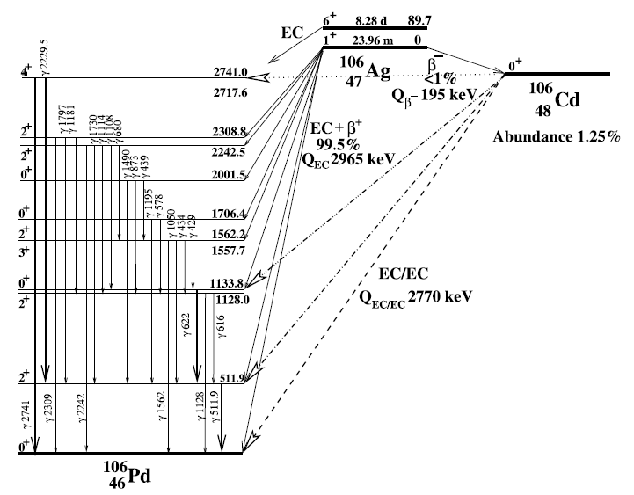
¹⁰⁶Cd EC/EC

Slide 5
TGV II
Location: Modane Underground
Laboratory (4800 m.w.e.)
Copper
> 20 cm
Airtight box
Lead >10cm
Boron filled polyethylene 16cm
HPGe
Cd
HPGe
Notes:
flux [1/s]
fluence [1/m2]
fluence rate = flux density [1/s.m2]
na povrchu je neutron flux cca 40 / m2.s

Slide 6
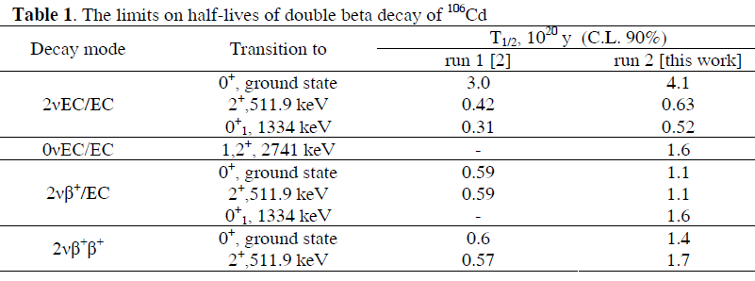
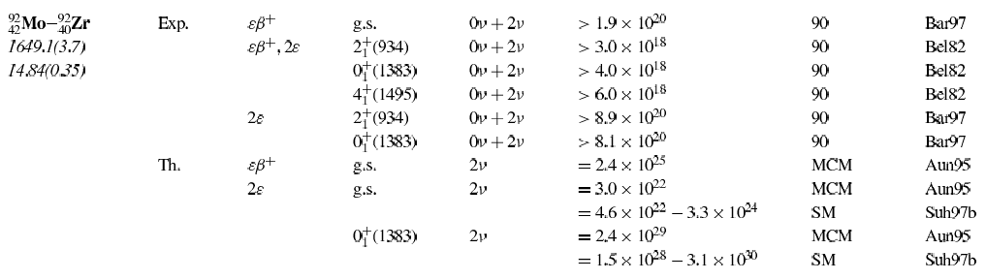

Slide 7

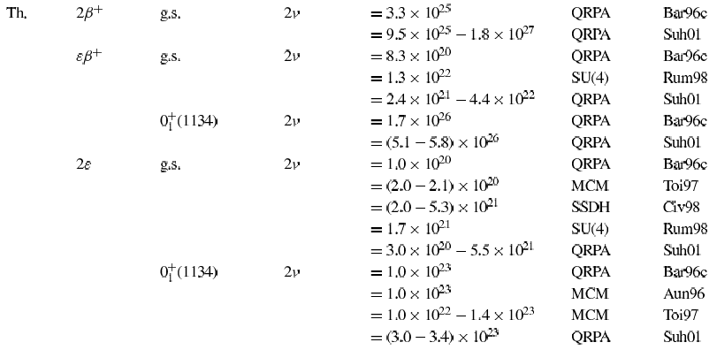

Slide 8
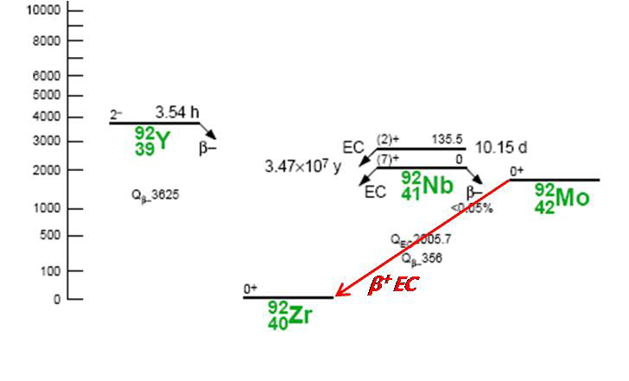
β⁺EC decay of ⁹²Mo
511keV γ
Gamma detector
Active crystal
with ⁹²Mo
511keV γ
⁹²Mo nucleus is EC/EC or EC/b+ isotope.
(A,Z) + e⁻ -> (A,Z-2 ) + e⁺ + 628keV
Conceptual setup
EC/β⁺ Q-value=628keV, ECEC = 1,650keV
Abundance = ⁹²Mo: 14.84%, ¹⁰⁰Mo: 9.63%
e⁺ stops in active(CaMoO₄) Crystal.
Notes:
Mo-92 nucleus is double EC and beta plus EC isotope.
And This is double beta decay scheme from mo-92 to Zr-92.
Q-value of the double EC is 1650keV and EC beta plus is 628keV.
If camoo4 crystal is used for mo-92 decay, we can use the triple coincidence with the 628keV of the camoo4 and 511keV in 2 CsI crystals.
So you can see here the conceptual setup.
If the positron stops inside camoo4 crystal, then two 511keV gammas emit b2b direction.
The abundance of Mo-92 is 14.84%.

Slide 9
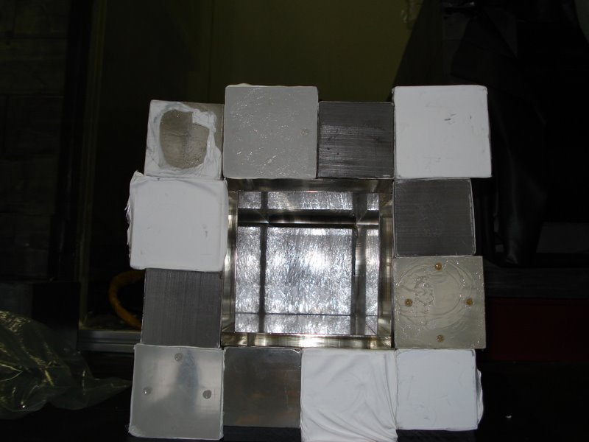
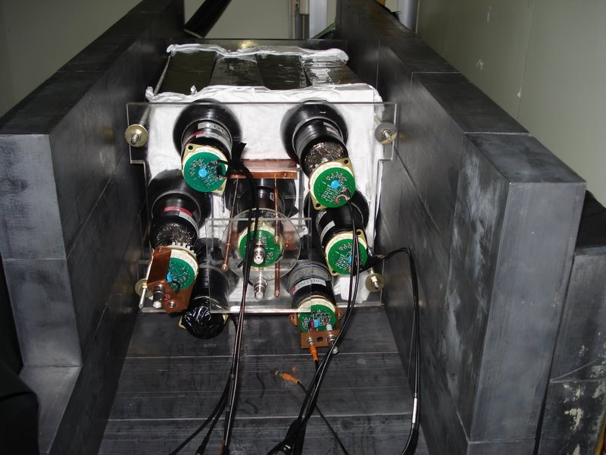
Experimental setup at Y2L
CsI10
CsI9
CsI8
CsI7
pmt
511keV
CsI11
CsI6
628keV(Q-value)
CaMoO4
e⁺
CsI12
CsI5
511keV
CsI1
CsI2
CsI3
CsI4
PMTs & CsI crystals are crossly connected.
Lead shielding(10 cm)
CsI detectors surround the CaMoO4 crystal
511keV signal is a opposite direction for momentum conservation.
(back to back cut)
CaMoO4 is surrounded by 14 CsI crystals & 14 PMTs.
CsI CaMoO4
  6.5x5.5x30cm(12) - 2.2x2.2x6cm (2)
  9x9x6cm(#13 & #14) - 255g
Notes:
This is a picture of detector setup at the y2l underground lab in korea.
Here photos are before and after attachment of the pmt. And lead shielding is 10cm.
Camoo4 is located in the center of the cavity and 14 csi detector array. And 511keV gammas are in opposite direction.
We are using b2b coincidence condition.
There are 12 csi crystals with a size….
And 2 of this crystals are coupled together and attached to pmt.
The total mass of camoo4 crystal is 255g.

Slide 10
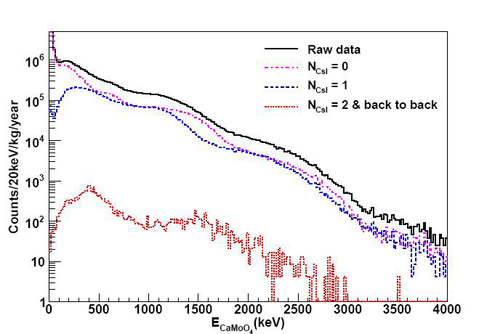
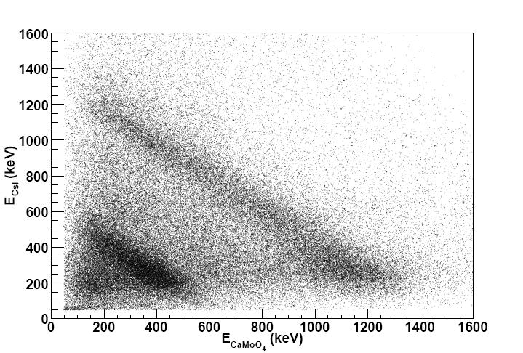
Background spectrum of CaMoO4 detector measured at Y2L
We used 1inch pmt in the middle of the experiment
for the other SrCl₂ crystal test.
40K contamination increased.

Slide 11
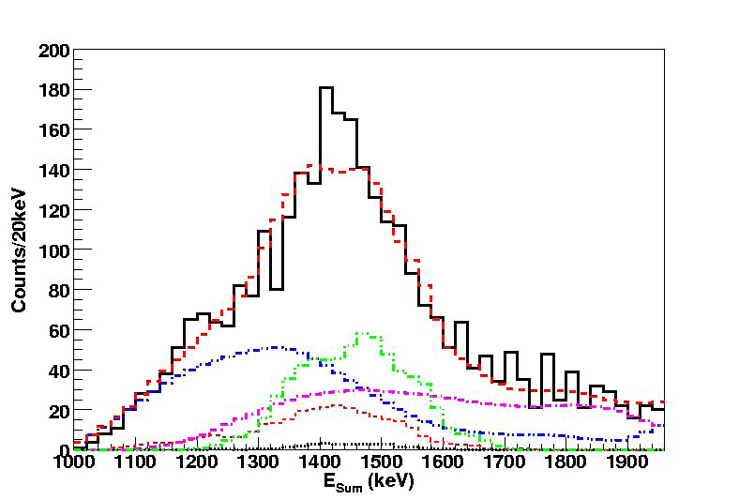
Background simulation
U - CsI(Tl) crystals
Th - CsI(Tl) crystals
K – 1inch PMT
K – CsI(Tl) crystals
K – CaMoO₄ crystal
CaMoO4
CsI(Tl)
PMT
External
(rock)
Uranium
Thorium
Potassium

Slide 12
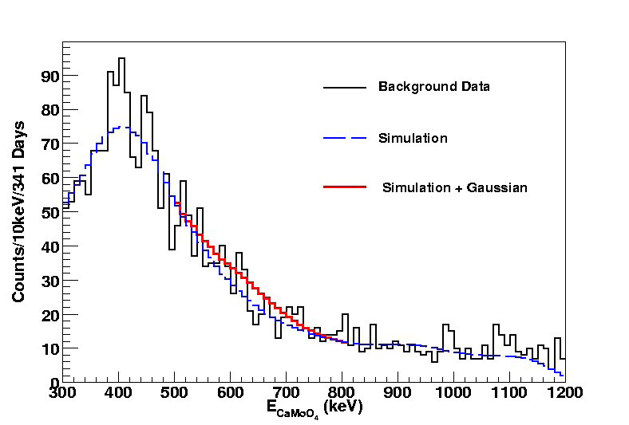

Background simulation & gaussian fit result
Log2=0.693,
m = 276.8g,
α = 0.1484,
A₀ = 6.02x10²³
η = 0.122,
T = 341day = 0.93year
A = 204g,
N₉₀ = 2.1 ± 25 counts
= 2.3 x 10²⁰y
Notes:
In the camoo4 and CsI spectrum with 2 511keV +-2sigma b2b coincidence gammas, we see 2.1events in the window of 628keV energy region by red fitted result. Then this number gives 2.3 x 10^20 years with 90%C.L. this limit is a comparable best.

Slide 13
Optimizing CaMoO4+HPGe
■ Double beta decay experiment using HPGe detector
■ Geant4 simulation ➔ find optimize size
thickness
100.0+thickness
thickness
thickness [mm]
10
20
30
40
50
78.36
100.0 +thickness
84.84
94.12
135.5

Slide 14
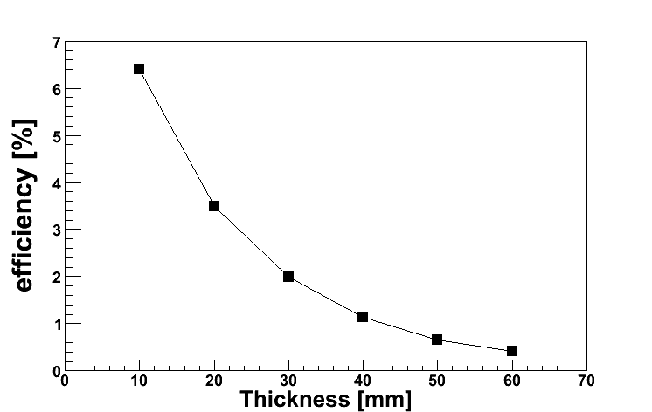
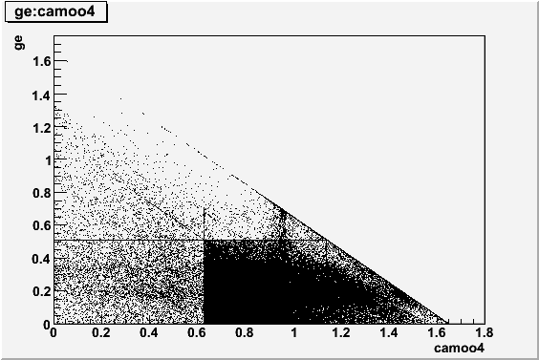
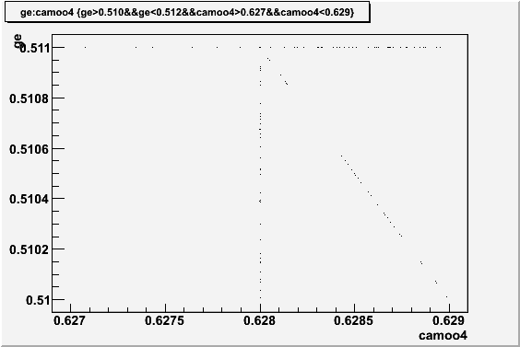
Simulation for Mo92 EC b+ Decay
627keV<628keV<629keV : camoo4
510keV<511keV<512keV : ge
➔±1keV region
Notes:
The left figure is efficiency curve for a correction between ge and camoo4 deposit energy
In figure, the x-axis is crystal thickness. And in this case of increase thickness,
the efficiency curve is decrease because decrease deposit energy probability for 628kev and 511kev

Slide 15
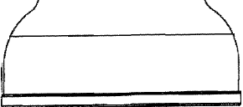
EC/ b+ w/ HPGe
PMT R0= 76mm
Photocathode R1= 64mm
1460keV gamma from 40K Compton scatters.
Background or 0v EC/b+
R0
e+ signal
25mm
R1
R1
50mm
511keV
105mm
HPGe
Detector
Crystal mass➔230g

Slide 16
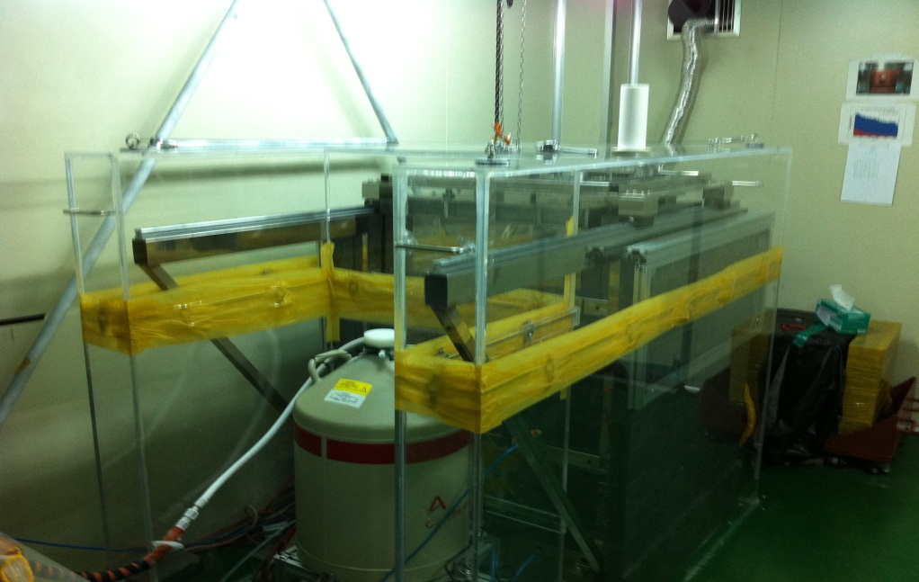
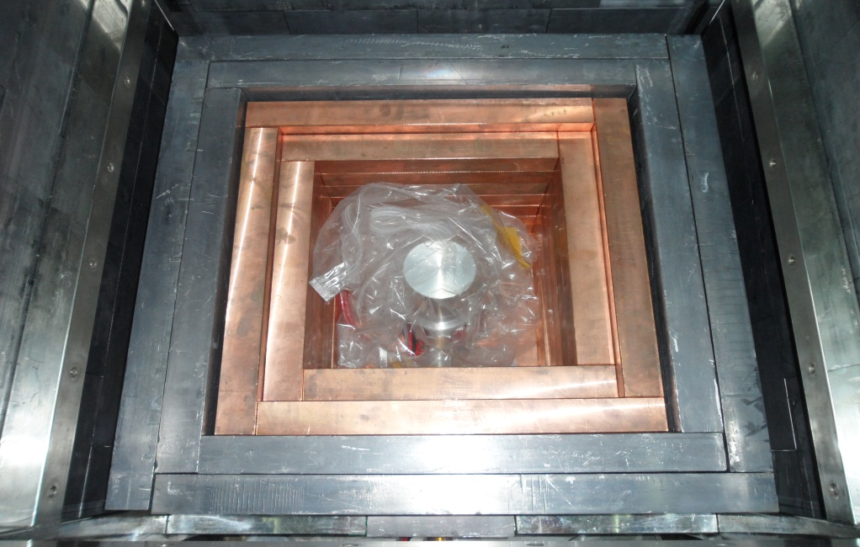
New HPGe detector Setup
Mass | Diameter | Height
2.8kg | 82.1 mm | 90.7 mm
100% relative efficiency

Slide 17
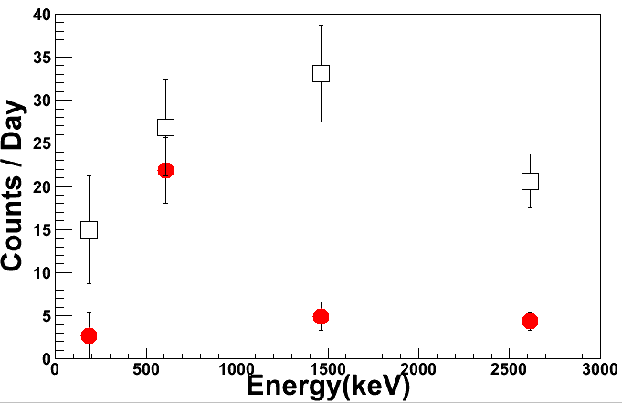
B.G comparison of ORTEC and CANBERRA
□ : ORTEC
● : CANBERRA
Bi214
U238
Th232
Tl208
Ra226
K40
CANBERRA is lower than ORTEC.

Slide 18
DAQ setup
CaMoO4 crystal
Pre-Amp
x10
e+ signal
511keV
Ch1
FADC400
Data
Acquisition
HPGe
Detector
Pre-Amp
Shaping
Amp
Ch2(1/3)
Ch3
Pre-Amp signal과 Shaping Amp signal
➔FADC

Slide 19
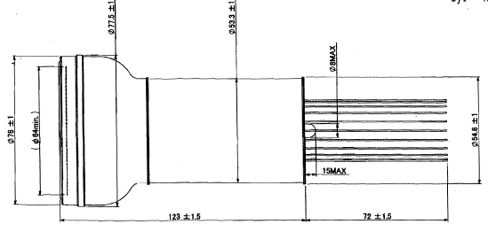
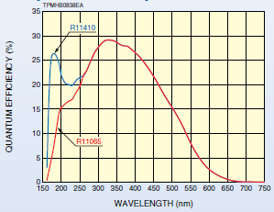
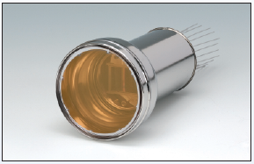
Hamamatsu 3” Metal PMT
■ The R11065 is 3” Metal PMT
➔extremely low radioactivity
■ High QE : 22% @ 450nm

Slide 20
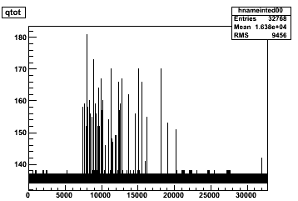
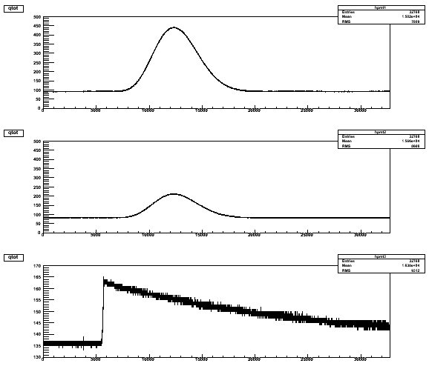
Typical Signals from FADC
CaMoO4 Signal
→0~700keV
HPGe Signal
→0keV~700eV
HPGe signal
→700keV~3000keV
HPGe Preamp Signal
→0keV~3000keV

Slide 21
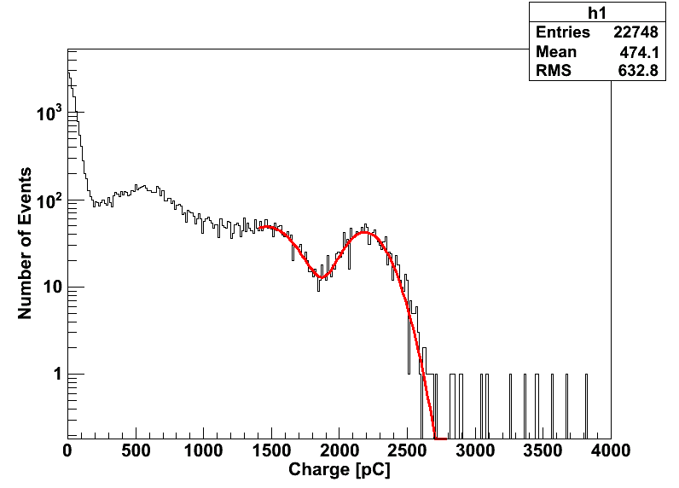
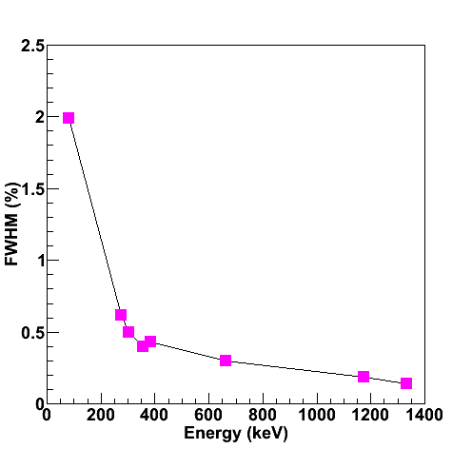
Energy Calibration
CaMoO4 Crystal
HPGe Detector
Ba133 Source
Cs137 Source
661.657 keV
FWHM : 18%
Co60 Source
Cs137 Source

Slide 22
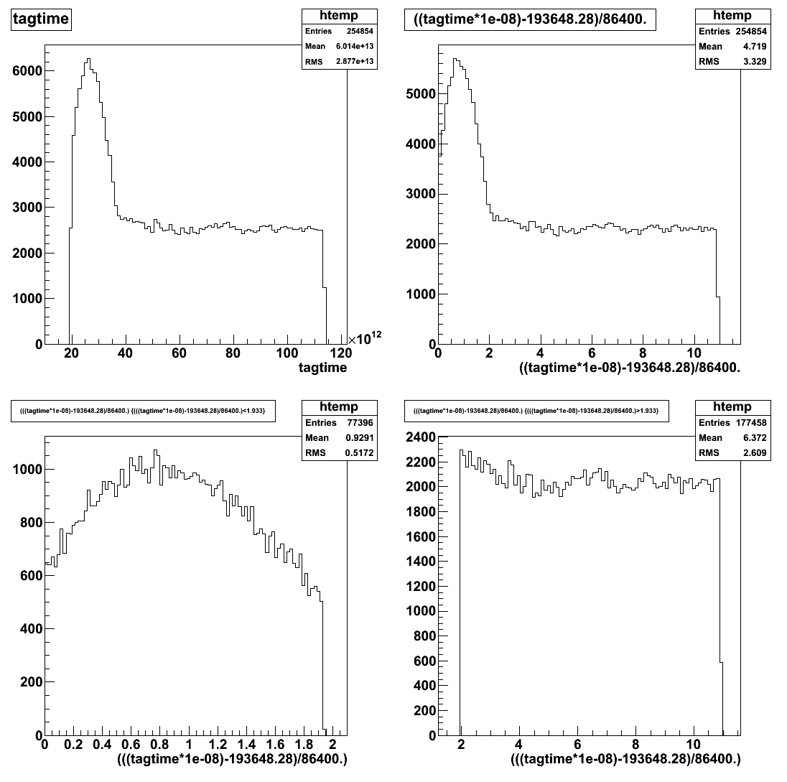
Rates
* After 2days, gets stabilized.
days

Slide 23
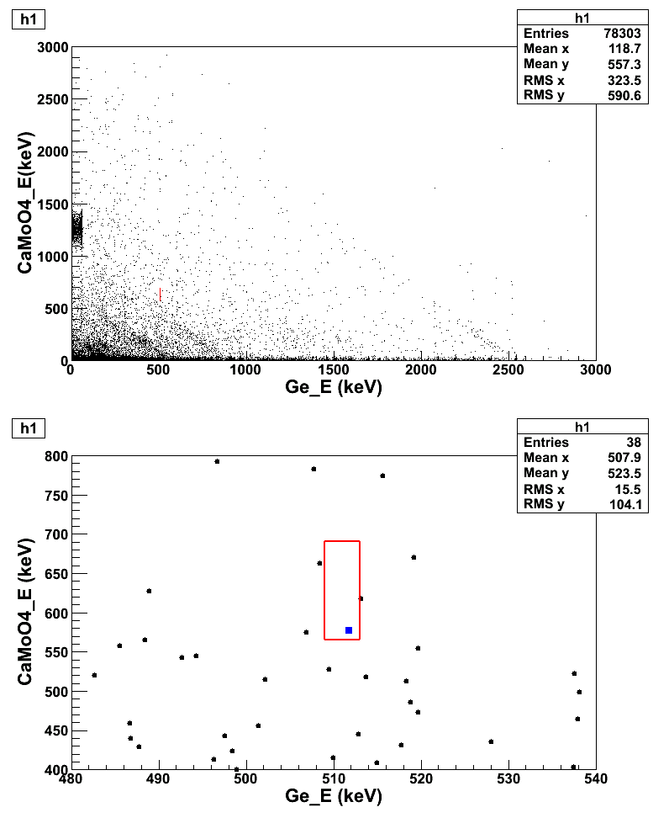
After energy calibration.
One event within 2 days, and no event until 11 days.
CaMoO4➔ 628.0 ±62.8 [keV]
HPGe ➔511.0 ±2keV [keV]
1 event /9 days in the gate

Slide 24
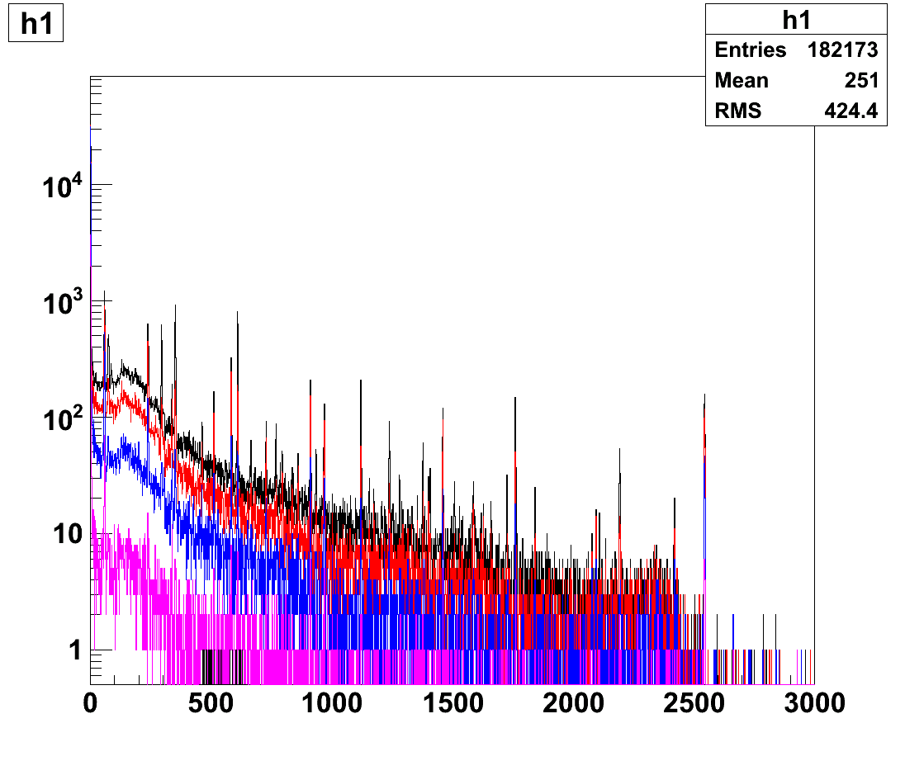
HPGe energy spectra
Black : total spectrum (0~11days)
rate = 0.19 Hz
Red : spectrum after 2days
rate = 0.16 Hz
Blue : w/ camoo4 crystal coincidence.
rate = 0.10 Hz

Slide 25
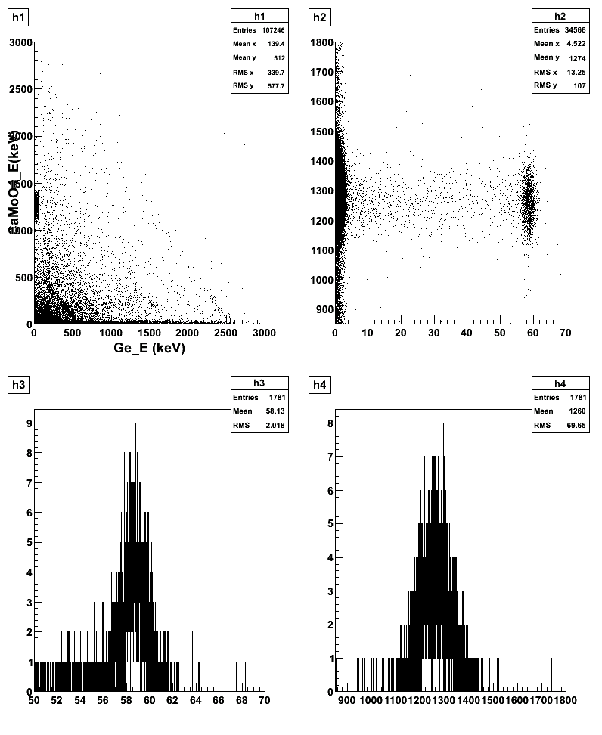
One strange coincidences : CaMoO4(1240keV) &
HPGe( 60keV )
CaMoO4
Ge

Slide 26
Conclusion & summary
Initial EC/b+ 0nbb limit is 2.3 x 10²⁰y with ⁹²Mo.
CaMoO4+HPGe data taken with a CaMoO4 crystal.
Scale-up should be studied by simulation.
Low-temperature option can be considered.

Slide 27
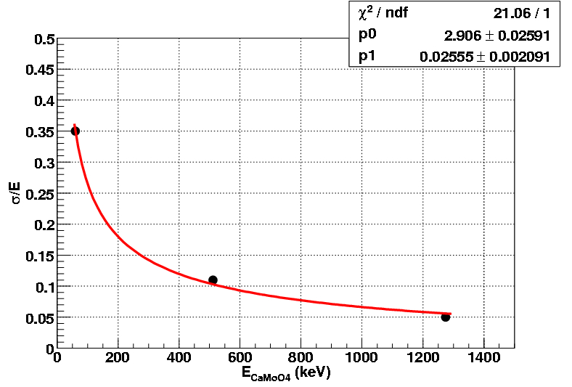

Resolution of CaMoO₄ crystal

Slide 28
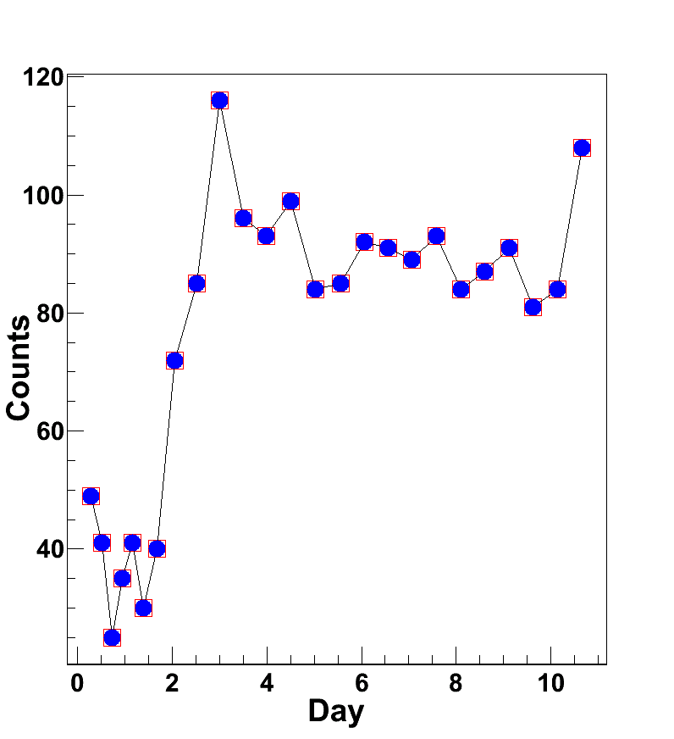
1240keV와60keV의 coincidence이벤트 count rate 변화
Blue->Ge, Red = CaMoO4

