Slide 1
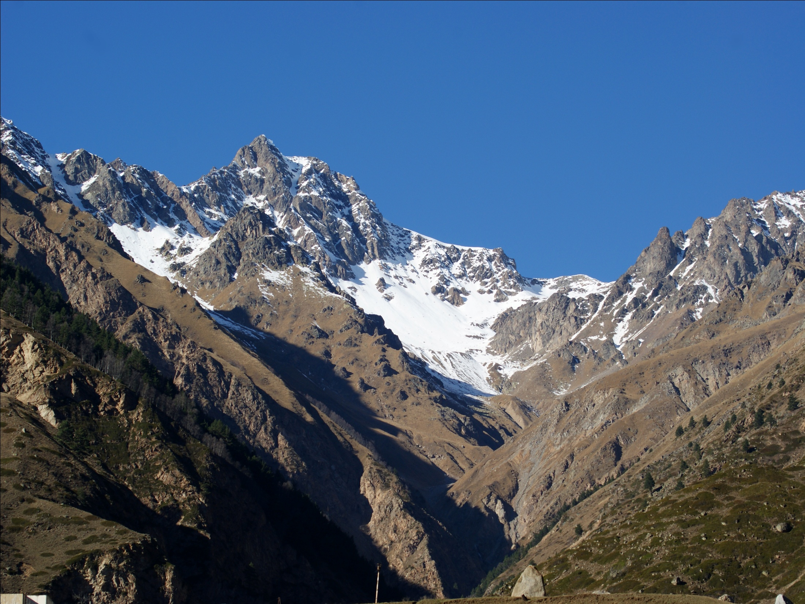
Search for
2K(2ν)-capture of ⁷⁸Kr
Vladimir Kazalov
Baksan Neutrino Observatory
INR RAS
Notes:
Vladimir Kazalov
Baksan Neutrino Observatory
INR RAS

Slide 2
Ju. Gavriljuk, V. Gavrin, A. Gangapshev,
V. Kazalov, V. Kuzminov, N. Osetrova
Institute for Nuclear Research of the Russian Academy of Sciences, Moscow Russia
A. Shubin, G. Skorynin, I. Pul`nikov, A.Ryabukhin
FSUE PA “Electrochemical Plant”, Zeleznogorsk, Krasnoyarsk Region, Russia
S. Panasenko, S. Ratkevich
Karazin Kharkiv National University, Kharkiv, Ukraine
The work is performing in the frames of a Presidium RAS
Fundamental Research Program “Neutrino Physics” and
Supported by RFBR grant №04-02-16037

Slide 3
Theory:
Notes:
Theoretical calculations based on different models give the following half-life times for this process in 78Kr: 3,7·10²¹ years; 4,7·10²² years; 7,9·10²³ years. The last two values were obtained from the estimation of half-life time in 78Kr with regard to the total number of 2e(2ν)-captures where 78.6% of events is due to 2K(2ν)-capture. Comparison of experimental and theoretical values shows that the sensitivity of the measurements has exceeded the lower limit of theoretical calculations. This fact allows us to test the approach carried out in model. The technique to search for 2K-capture used in our research is based on the following considerations.
----
The main modern achievements in studying processes of double beta decay (2β⁻-decay) can be attributed to detection of its two-neutrino mode. This process has been discovered in as many as ten nuclei. The data obtained for the two-neutrino mode offer a chance to directly compare different models of the nuclear structure, which form the basis for calculations of nuclear matrix elements ⎢⎢M^{2ν}⎟⎟, and to select the optimal one. Though direct correlation between the values of nuclear matrix elements for the two-neutrino and neutrinoless modes of 2β⁻ decay is absent lacking, the methods for calculating ⎢⎢M^{2ν}⎟⎟ and ⎢⎢M^{0ν}⎟⎟ are very close, and a chance possibility to estimate their accuracy in calculating ⎢⎢M^{0ν}⎟⎟ appears only when comparing experimental data and theoretical results calculations for the probability of 2β⁻(2ν) decay.
It can be expected that acquisition of experimental data on the other types of 2β transitions (2β⁺,Kβ⁺,and 2K processes) will make it possible to considerably increase the quality of calculations for both 2ν and 0ν decays. Much efforts have been currently made in searching for these processes in spite of the fact that the 2β⁺(2ν) and Kβ⁺(2ν) modes are strongly suppressed relative to 2β⁻(2ν) decay due to the Coulomb barrier for positrons, and a substantially lower kinetic energy attainable in such transitions. Positrons are absent in the final state of the 2K(2ν) decay, and the kinetic energy of the transition may be rather high (up to 2.8 MeV), which dictates determines an increased probability of a decay. However, this process is also difficult to detect, since it is only characteristic radiation that is detectable in it.

Slide 4
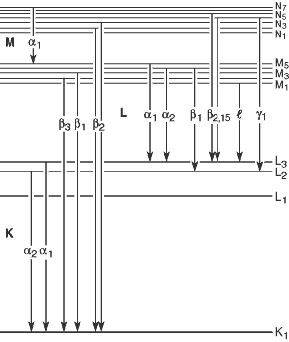
assumption
Se**-----------------------> Se*+ Se*
ω_{k}=0.596 x-ray
ω_{e}=0.404 e-Auger
K_{ab}=12.652 keV, 2K_{ab}=25.3 keV
K_{α1}=11.221 keV 0.574
K_{α2}=11.181 keV 0.298
K_{β1}=12.491 keV 0.120
K_{β2}=12.651 keV 0.005
Probability of deexcitation
Se* | Se* | 0.404² = 0.163 } = 0.481 0.596² = 0.355
е_{а} е_{а} к к | е_{а} к е_{а} к
Notes:
When two electrons are captured from K-shell in 78Kr daughter atom of 78Se** is formed with two vacancies on the K-shell. The technique to search for this reaction is based on the assumption that the energies of characteristic photons and the probability that they will be emitted when double vacancy is filled are the same as the respective values of the case when two single vacancies of the K-shell in two singly ionized Se¤ atoms are filled. In such a case, the total registered energy is 2K_{ab} = 25,3 keV, where K_{ab} is the binding energy of a K-electron in a Se atom (12.65 keV). The fluorescence yield upon filling a single vacancy of the K-shell in Se is 0.596. The energies and relative intensities of the characteristic lines in the K-series are K_{α1} = 11,22 keV (100%), K_{α2} = 11,18 keV (52%), K_{β1} = 12,49 keV (21%), and K_{β2} = 12,65 keV (1%). The probability of deexcitation of a doubly ionized K-shell through the emission of Auger electrons (ea; ea) only, or through a single characteristic quantum and an Auger electron (K; ea), or through two characteristic X-rays and low-energy Auger electrons (K;K; ea) is p1 = 0,163, p2 = 0,482 and p3 = 0,355, respectively. A characteristic photon can pass a long distance in the gas from the point of its origin to the point of its absorption. For example, 10% of characteristic photons of 12.6 keV energy are absorbed on a length of 2.42 mm (P_{gas} ~ 4:36 Bar). Auger electrons of the same energy will be absorbed on a length of 0.44 mm, which produce almost pointwise charge clusters of primary ionization in the gas. In the case of emission of two characteristic photons absorbed in a gas the energy release will be distributed between three pointwise regions. It is these events that have a number of unique features and are the subject of study in my report.

Slide 5
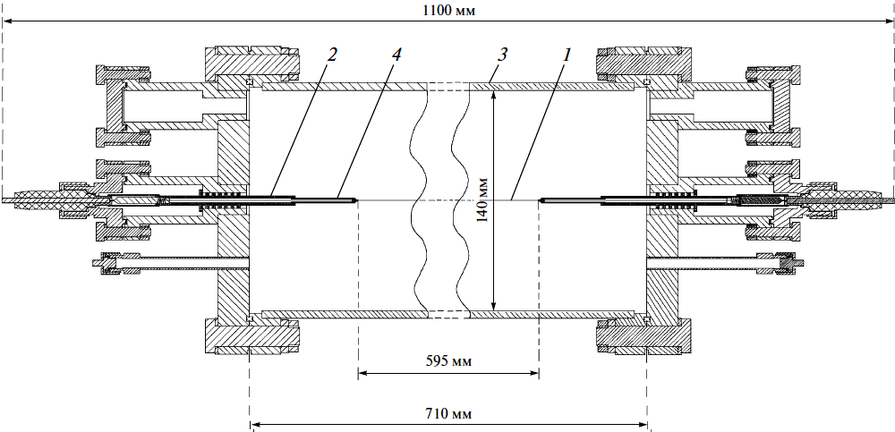
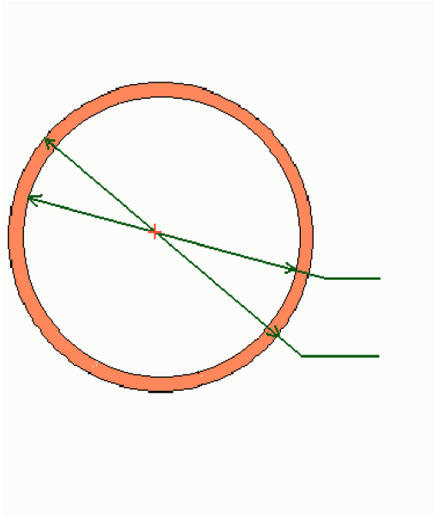
Schematic view of Proportional Counter
1. Body’s material | Cu
2. Total length, mm | 1160
3. Fiducial length, mm | 595
4. Outer diameter, mm | 150
5. Inner diameter, mm | 140
6. Central anode material, mm | g.p.tan., 0.010
7. Total volume, l | 11.0
8. Fid. Volume, l | 9.16
9. Pressure, at | 4.42
10. Capacity, pF | 31
11. Anode wire resistance , Ohm | 613
1.- Anode wire, 2.- Insulator, 3.- Cathode , 4. - Copper tubes.
∅ 140
∅ 150
Cross-section of the counter
+ - anode
Notes:
To register this process a large proportional counter (LPC) with a casing of M1-grade copper has been used. The LPC is a cylinder with inner and outer diameters of 140 and 150 mm, respectively. A gold-plated tungsten wire of 10 μm in diameter is stretched along the LPC axis and serves as an anode. The potential of +2400 V is applied to the wire, and the casing (the cathode) is grounded. Both ends of the anode are electrically connected to the to the corresponding end cap flanges via high-voltage pressure-sealed ceramic insulators with a central electrode taken from spark plugs. To reduce the influence of the edges on the operating characteristics of the counter, the end segments of the wire have been passed through the copper tubes (3 mm in diameter and of 38.5 mm length) electrically connected to the anode. Gas amplification is absent on these segments, and charge is collected in an ionization mode. Taking into account teflon insulator dimensions, the distance from the working region to the flange is 70 mm. The length of the LPC operating volume is 595 mm (the distance between the butt ends of the tubes), and the LPC operating volume is 9,159 L. The total capacitance of the counter and outlet insulator is ~ 30,6 pF. The total resistance of the anode and two output electrodes is ~ 600 Ohm. Indium wire was used to seal all detachable joints, and teflon gaskets were used to seal all nipple joints. The inner insulators are made of teflon, and their thickness was minimized to improve the degassing conditions during the vacuum treatment of the counter and to stabilize its operating characteristics.

Slide 6
Low background shield
← 1760 мм →
↑
↓
970 мм
18 cm copper
15 cm lead
8 cm borated polyethylene
Notes:
The LPC was placed inside the shielding of 18 cmthick copper, 15 cm thick lead, and 8 cm thick borated polyethylene layers. The installation is located in one of the chambers of the underground laboratory of the Gallium Germanium Neutrino Telescope experiment at the Baksan Neutrino Observatory, INR RAS at a depth of 4700 m.w.e. where cosmic ray flux is lowered by ~10⁷ times down to the level of (3,03 ±0,10) × 10⁻⁹ cm⁻²s⁻¹.

Slide 7
⁷⁸Kr – sample
1. Old ⁷⁸Kr – sample, (48.64 l)
Isotopes | 78 | 80 | 82 | 83 | 84 | 86
Content (atomic percents) | 94.070 | 5.910 | < 0.005 | < 0.005 | < 0.005 | < 0.005
⁸⁵Kr – activity ≈0.1Bk/l
Preliminary measurements: Bkg. (20÷100 keV) = 3700 h-1
(V=9.16 l, p=4.55 at)
2. New ⁷⁸Kr – sample, (47.65 l)
Isotopes | 78 | 80 | 82 | 83 | 84 | 86
Content (atomic percents) | 99.810 | 0.170 | < 0.005 | < 0.005 | < 0.005 | < 0.005
⁸⁵ Kr – activity ≤1.8· 10⁻³ Bk/l
Preliminary measurements: Bkg. (20÷100 keV) = 67 h⁻¹
(V=9.16 l, p=4.55 at)
Bkg. = Bkg._{own} + Bkg._{Kr-85}
| → ?
Notes:
The counter was filled with pure krypton gas up to 4.42 Bar having no quenching or accelerating gaseous additions. The krypton had been purified in Ni/SiO2 absorber from electronegative admixtures. Two samples of krypton were used in this work: one of 48.6 l volume enriched in ⁷⁸Kr up to 99.8% and natural krypton (100l ) left after ⁷⁸Kr isotope extraction. Both samples have been specially cleared from radioactive ⁸⁵Kr, present in atmospheric krypton.

Slide 8
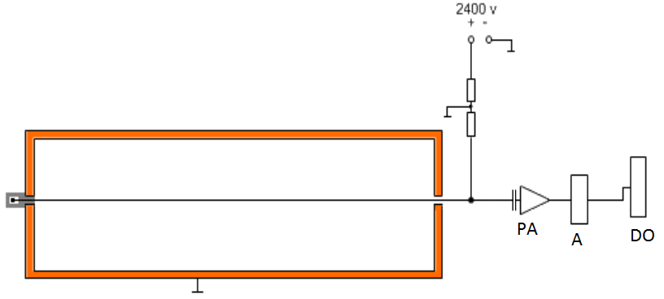
Electric scheme of the setup
PA – preamplifiers, A – amplifiers, DO – digital oscilloscope.
Notes:
The detector signals were passed from the anode wire to the charge-sensitive amplifier (CSA) directly attached to the high-voltage insulator. The CSA parameters have been optimized for transmission a signal with minimum distortions, and information on the of primary-ionization charge spatial distribution in its projection to the counter radius was fully represented in the pulse shape. After amplification in an auxiliary amplifier the pulses were collected by the LA-n20-12PCI digital oscilloscope. The oscilloscope, integrated with personal computer, records the pulse waveform as the numerical vector digitized with a frequency of 6.25 MHz. The length of the scanning frame is 1024 points (163.8 μs) with a resolution of 160 ns, ~ 50μs is "prehistory" and ~ 114μs is "history".
Processing of digitized pulses in "offline" mode is carried out using the technique developed in this work. This technique rejects pulses of non-ionized nature, determines the type of event and its relative coordinate along the anode wire, and finally selects useful events according to chosen characteristics.

Slide 9
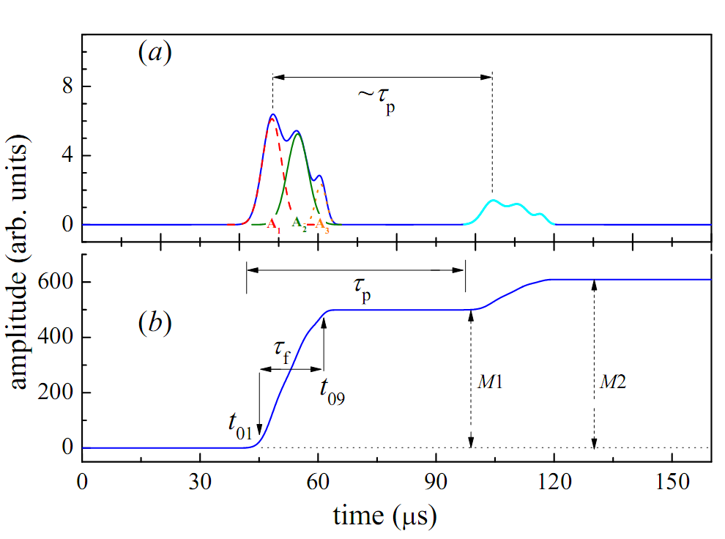

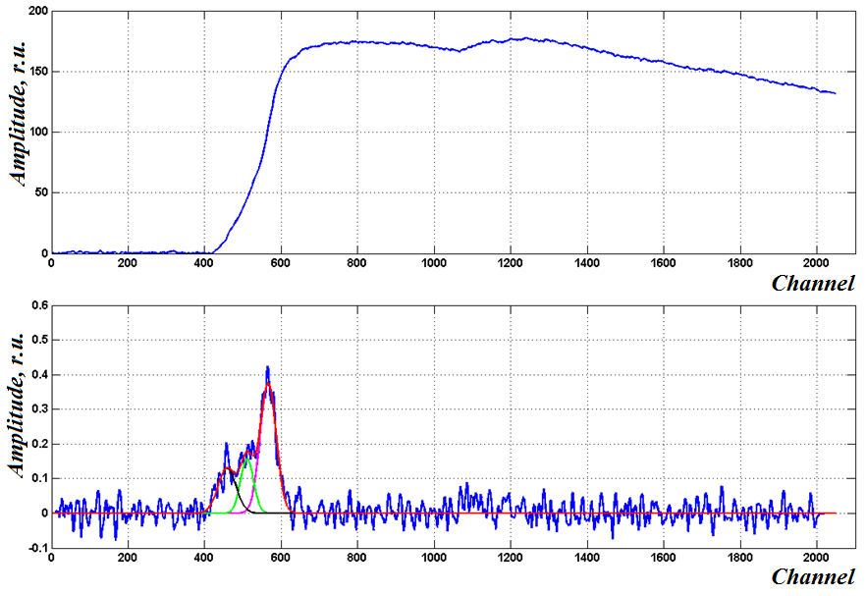
Three-point pulse
Notes:
Fig. illustrates a model version of a shape of a current pulse i(t): (a) from LPC and corresponding to it CSA pulse (b) from three-point event expected from 2K-capture in case of registering two characteristic X-rays and a cascade of low energy Auger electrons. In Fig. ,in addition to the primary pulse there is a secondary pulse, smaller in amplitude, due to the photoelectrons knocked out of the copper case by photons produced in the electronic avalanches in the gas amplification process. Photoeffect on the cathode is probable enough because of absence of quenching additions in the krypton gas. The delay between pulse and after-pulse is determined by the total drift time of the electrons to move from the cathode to the anode. It presets the duration of the time interval to allocate totally any single event regardless of its primary ionization distribution over the LPC volume.
Also on pict. shown parameters of CSA pulse which has been used for separated useful (events with special parameters) event.

Slide 10
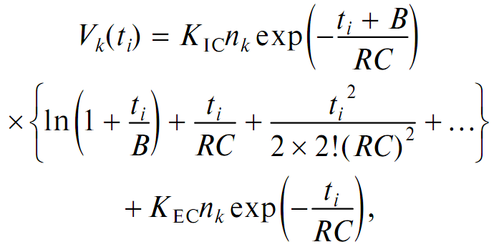
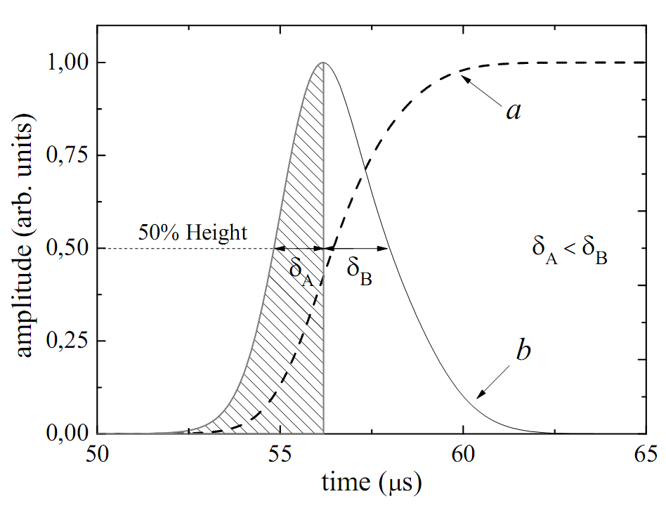
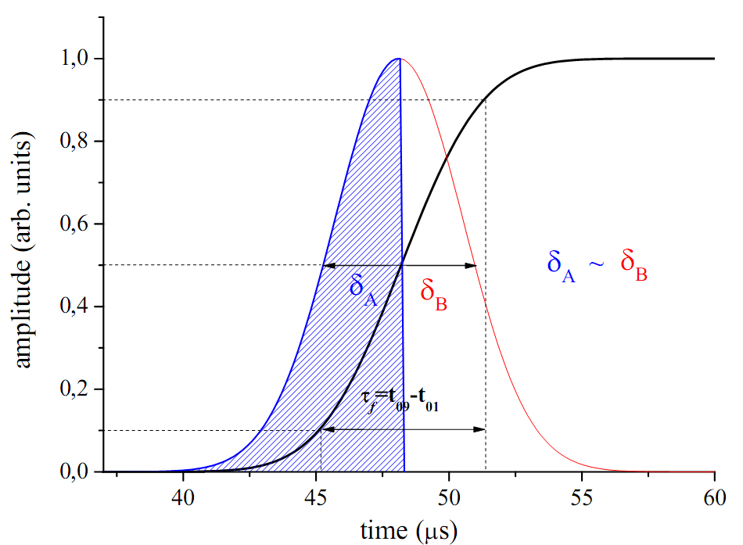
Current pulse normalizing
The current signal produced as a result of gas amplification has an asymmetric form.
The output pulse shape is defined by the superposition of induced charges from single electron avalanches distributed in time and intensity according to: the shape of the current pulse from primary ionization electrons, the shape of a pulse from an individual avalanche, and a finite time of the CSA self-discharge. The last two parameters are responsible for the asymmetry of the output current pulse. The output current pulse can be transformed to a symmetric shape by taking into account the analytical dependence of the amplitude of the output voltage pulse generated by a point (in projection onto the radius at the boundary of the gas amplification region) group of primary ionization electrons as a function of time and discharge constant of the output storage capacitor.
The obtained form of a signal one can describe by a set of Gaussian curves and thus determine the charge that was deposited in separate components of a multipoint event. The calculated area of an individual Gaussian should correspond to the charge (energy) of the corresponding point-like ionization.

Slide 11

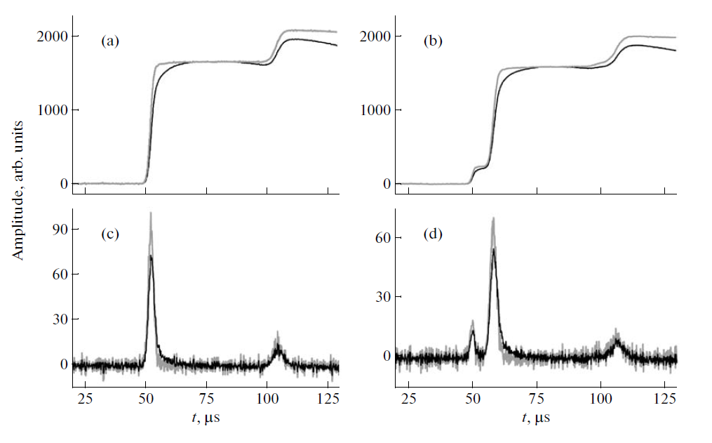
Examples of pulses (dark lines) of two types of events: (a) for photoabsorption of an 88-keV photon with an escape of electrons only (a single-point event), (b) simultaneous escape of a 12.6-keV characteristic photon Kr and a photoelectron [88.0 keV-12.6 keV = 75.4 keV (a two-point event)]. The calculated, area-normalized current pulses of primary ionization electrons are shown with light lines in Figs. c and d, while the respective voltage (charge) pulses obtained by integrating these current pulses are depicted with light lines in Figs. a and b.

Slide 12
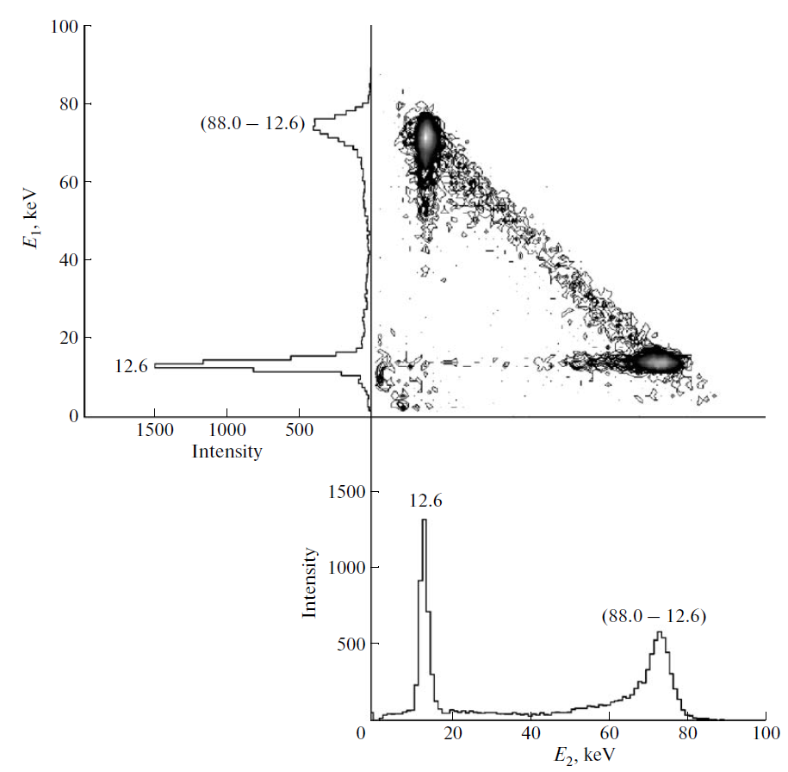
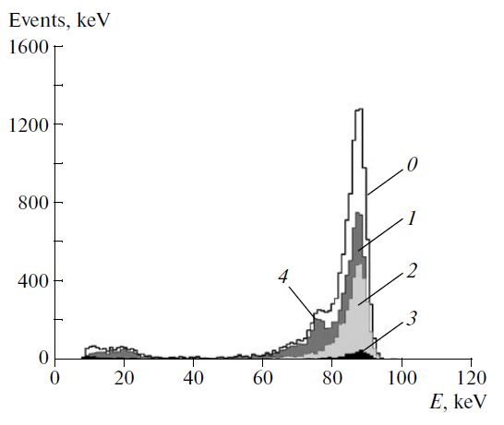
Amplitude distributions of energy deposits of individual components for two-point events from the source placed in the middle of the LPC length (¹⁰⁹Cd).
Pulse amplitude spectrum from the external ¹⁰⁹Cd source located in the middle of the LPC length: (0) all events, (1) single-point events, (2) two-point events, (3) three-point events, and (4) escape peak of characteristic photons.
Notes:
On the slide spectrum from 109Cd calibr. source and Amplitude distributions of energy deposits of individual components for two-point events from… Determining the parameters of individual components in a compound event, it is possible to perform energy calibration in the energy range-under-investigation and determine the energy resolution of single-point components which form multipoint event. The energy distributions of individual components of two-point events from the ⁸¹Kr and ¹⁰⁹Cd sources are shown in Slaid.13 and 14, respectively

Slide 13
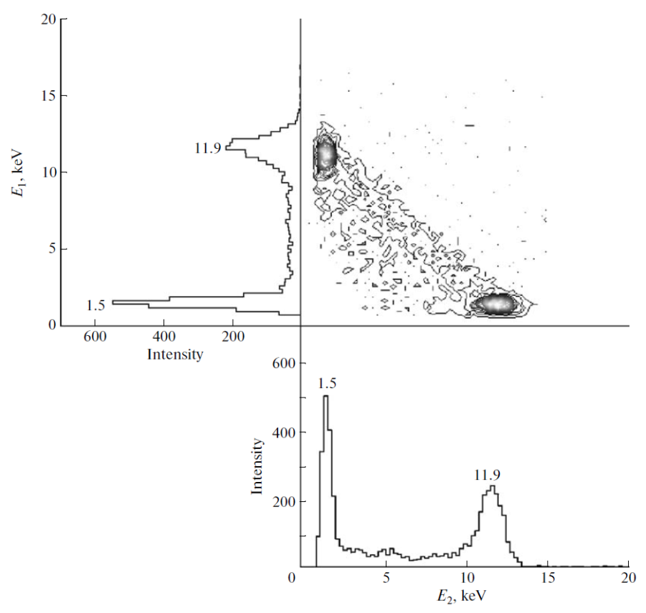
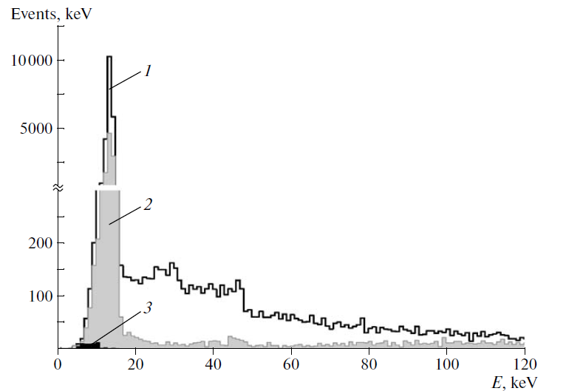
Amplitude spectra (1) of single-, (2) two-, and (3) three-point events that form the total analyzed pulse amplitude spectrum of the counter detecting both background and ⁸¹Kr decays
Amplitude distributions of energy deposits of individual components for two-point events from the internal (⁸¹Kr) source with a total energy of 13.5 keV.
Notes:
On the slide spectrum from 109Cd calibr. source and Amplitude distributions of energy deposits of individual components for two-point events from… Determining the parameters of individual components in a compound event, it is possible to perform energy calibration in the energy range-under-investigation and determine the energy resolution of single-point components which form multipoint event. The energy distributions of individual components of two-point events from the ⁸¹Kr and ¹⁰⁹Cd sources are shown in Slaid.13 and 14, respectively

Slide 14
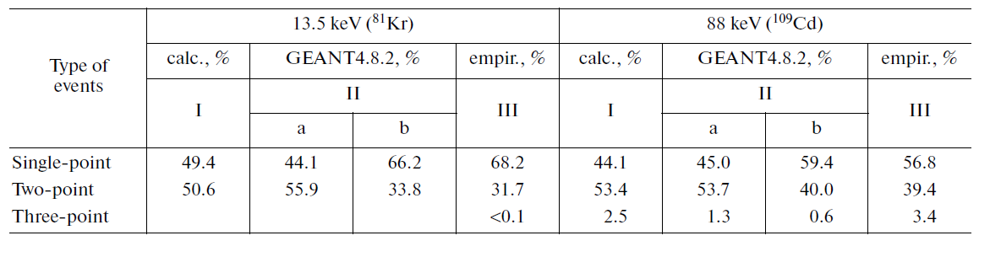
Relative composition of three types of events in the full-energy peaks with energies of 13.5 keV (⁸¹Kr) and 88 keV (¹⁰⁹Cd), obtained by estimation (column I); by simulation of processes in the LPC, ignoring the confluence of closely spaced point-like ionization regions (column IIa) and taking into account their confluence (column IIb); and by separation of the experimental spectrum into components after its wavelet purification of noise using hard threshold processing (column III)

Slide 15
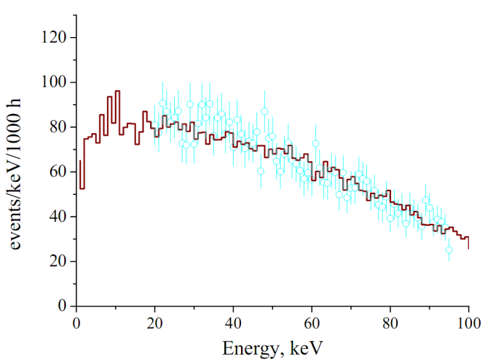
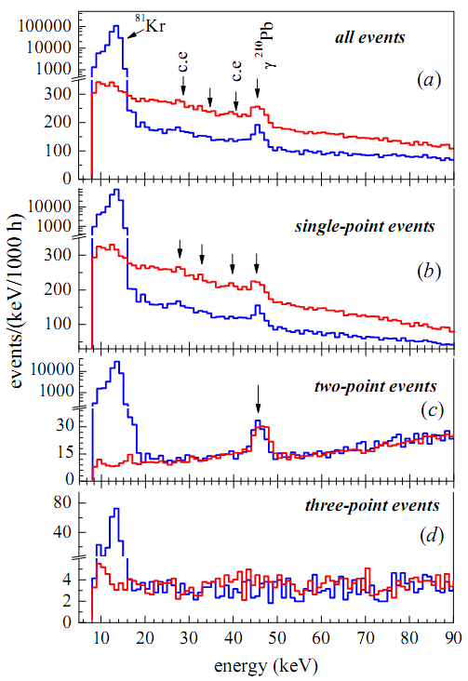
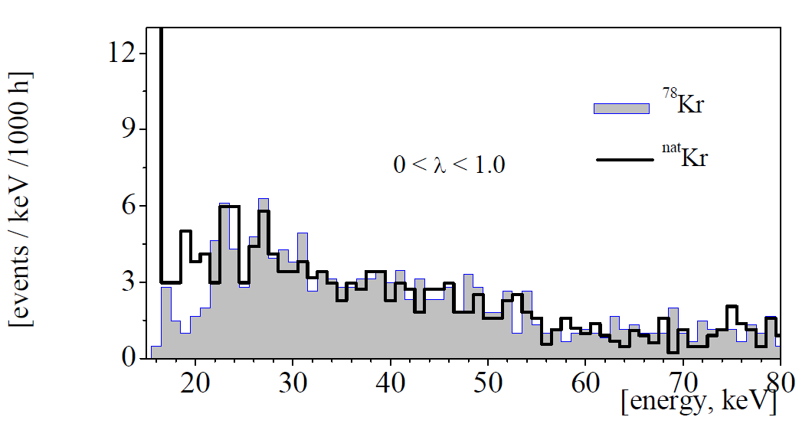
Comparison of ⁷⁸Kr with ^{nat}Kr:
[(A1.A2.A3)→(m₀≤m₁≤m₂)]
0.89 keV≤m₀≤ 4.5 keV
1.0≥m₁/m₂≥0.65
Notes:
Fig. 5(a) shows the total spectra of M1 amplitudes, normalized for 1000 h, obtained for the background of LPC filled with krypton enriched in 78Kr (total collection time is 8400 h; spectrum "1", dark line), and with natural krypton (total collection time is 5000 ; spectrum "2", light line). Comparison of these spectra shows that the background of the counter filled with krypton enriched in 78Kr exceeds the background with natural krypton at energy ¸ 18 keV. The shape of difference (subtracted) spectrum in the range of 20÷100 keV is described reasonably well by the model spectrum composed of β-spectra due to 85Kr and 14C decay in proportion 1:17. Background counting rates in this range are 56.3 h⁻¹ and 47.2 h⁻¹ for filled with 78Kr and natKr, respectively. Difference in 85Kr isotope activities in the samples is due to its different residual value achieved during the isotopic purification. 14C isotope comes into the krypton gas during the continuous usage of the counter, supposedly as a result of slow sublimation of organic molecules (ethyl alcohol and acetone were used to clean the details at the time of mounting the detector) from the surface of the body of the counter. Overactivity of 14C in the enriched krypton is due to the fact that this sample was measured first and the main portion of this organic vapour penetrated into it. Actually, all the events in the operating energy range produced by β-particles absorption can be considered as single-point ones. Except for those event where β-particles have lost partially their energy through generating bremsstrahlung photon.
At energies · 18 keV, the counting rate of events in spectrum "2 " is much higher than in spectrum "1 ". This is due to the presence, in the original atmospheric krypton, of cosmogeneous radioactive isotope 81Kr (T1=2 = 2:29 ·105 yrs) with volume activity of ~ 0,1 min⁻¹ -^{¡1}Kr; the signi¯cant part of which comes into the sample of natural krypton during the pro-cess of its production. 81Kr decays by electronic capture producing 81Br (K-capture 87.5% [24]). K-capture yields 13.5 keV energy release. One can see the peak of this line in spectrum "2 ". The resolution of the peak (FWHM) is 15.3%. Counting rate of events in (13:5±3:0) keV energy range is 220 h¡1, which corresponds to the volume activity of 81Kr (0:10 ± 0:01) min⁻¹ l⁻¹Kr.
The selected spectra are plotted in Fig. 6. They show that there are similar peaks in both spectra in the energy region of ~ 26 keV corresponding to the sought-for effect energy region. To find their nature the study of the distribution of the number of background events of various types along the anode wire has been performed.

Slide 16
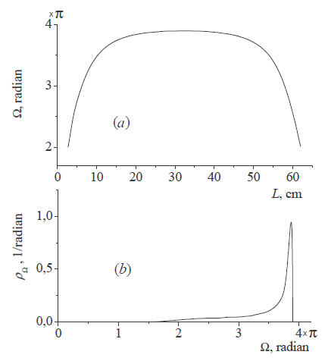
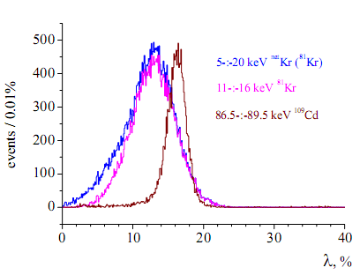
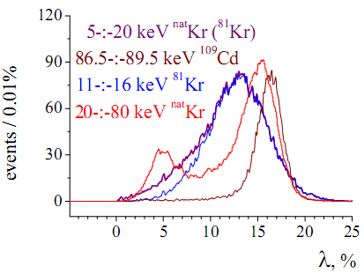
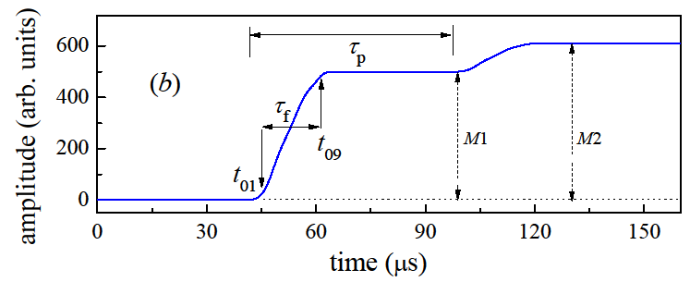
The solid angle under which the interior surface of the counter from different points of an anode wire is visible and the density of distribution of the solid angle for the points uniformly distributed along the anode wire.
Notes:
To find their nature the study of the distribution of the number of background events of various types along the anode wire has been performed. This distribution was plotted using the dependence of the relative amplitude of the first after-pulse on the distance between the point of origin of the main pulse and the middle point of the length of the anode wire. This distance defines the solid angle viewing the inner surface of the copper cathode cylinder. The solid angle through which the working surface of the cathode is viewed from the middle point of the anode wire and from the end points of the working length of the anode wire is ~ 3,9π and » 2π, respectively [Fig. ]. The density of distribution of the solid angle for the points uniformly distributed along the anode wire is presented in Fig. 7(b). There is a dependence of the relative number of photoelectrons, knocked out of the copper surface by the photons produced in the gas amplification of the primary ionization, on the value of the solid angle. First after-pulse is produced as a consequence of gas amplification of secondary photoelectrons generated on the cathode within the working length of the anode wire. It is ¸ parameter, equal to the ratio of after-pulse and pulse amplitudes, λ = (M2/ M1)=M1, accurate to the precision set by energy resolution of pulse and after-pulse, that determines the coordinate of the primary event with respect to the middle point of the anode wire. To calibrate the counter with respect to this parameter¸ one needs a radioactive source uniformly distributed over the LPC volume. ⁸¹Kr is well suited for this task. Alpha-particle can ionize K-shells of krypton atoms, and in this case the characteristic photons would have energy of 12.6 keV. These photons can penetrate into the fiducial volume of LPC where gas amplification occurs. Registration of two photons gives two points. The third point is produced
by ionization of alpha-particle collected in the ionization mode. Discarding pulses with ¸ λ< 0,225 one can completely eliminate such events from 'three-point' spectra.

Slide 17
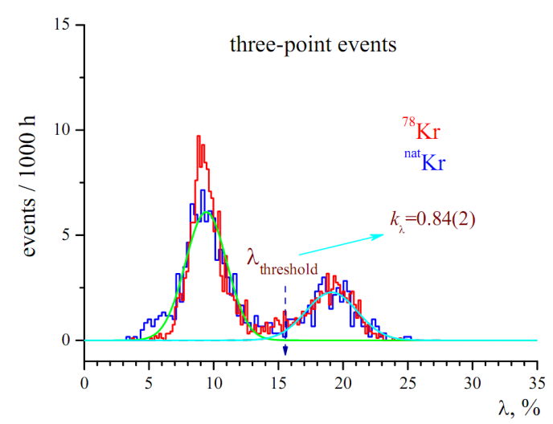
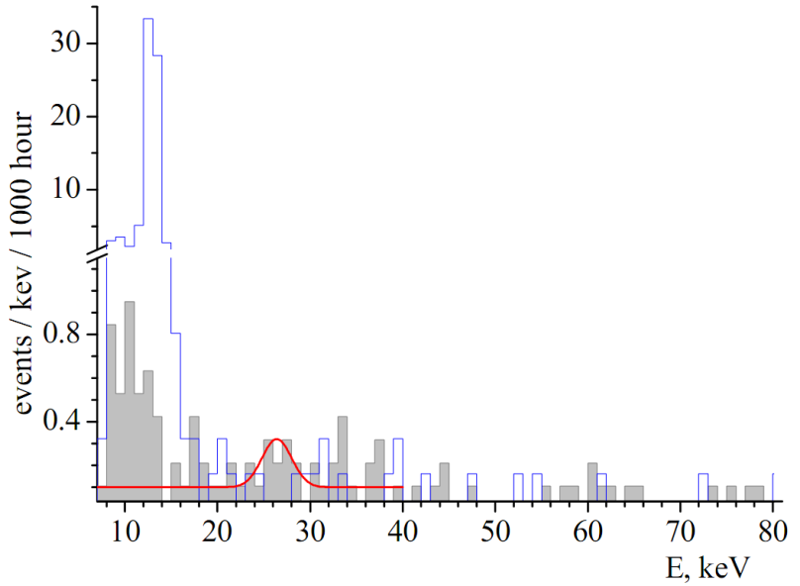

Three-point spectra selected under the conditions
[(A1.A2.A3)→(m₀≤m₁≤m₂)]
0.89 keV≤m₀≤ 4.5 keV
1.0≥m₁/m₂≥0.65
Three-point events selected by conditions
0.89 keV <m0<4.5 keV and m1/m2>0.65
⁷⁸Kr: number of events in the interval 22÷29 keV – 15 ev for 9457h.
Background in the interval 22÷29 keV – 4 ev for 6243h → 6 ev for 9457h .
From G.J. Feldman & R.D. Cousins, for n₀=15 and b=6
C.L. 90% μ=3.48÷16.52 →${ 9}_{−5.52}^{+7.52}$ for 9457h.→
→N_{eff}=8.33 yr ⁻¹
Notes:
In Fig. 9 shaded-to-zero the bar graph (78Kr) and the linear bar (natKr) are three-point spectra's selected under condition of ¸ λ≥0,225 from spectra's in Fig. 6. The background in energy region of (25,3 ± 3,0) keV in these spectra is n1 = (……) yr⁻¹ and n2 = (…….) yr⁻¹, respectively, which gives count rate of 2K-capture for ⁷⁸Kr to be nexp = n1 - n2 = (……)yr⁻¹. The obtained positive value does not exceed two standard deviations and in this case limit on the expected effect only was set for 90% C.L.: nexp≤.
Half-life limit has been calculated using formula T1=…¸=nexp, where N = 1:08 ¢ 1024 is the number of 78Kr atoms in the working volume of the counter, p3 = 0:355 is a portion of 2K-captures accompanied by the emission of two K X-rays; "p = 0:809 is the probability of two K-photon absorption in the working volume; "3 = 0:422 is the selection efficiency for three-point events due to 2K-capture in 78Kr; ®k = 0:985 is the portion of events with two K-photon that could be registered as distinct three-point events; k¸ = 0:840 is the useful event selection coefficient for a given threshold with respect to λ. The result obtained is …..

Slide 18
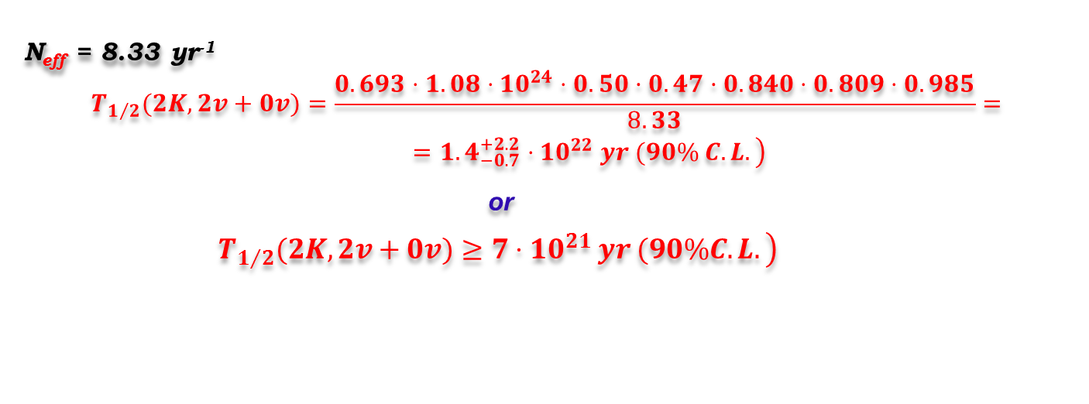
N – number of ⁷⁸Kr atoms - 1,08·10²⁴
p₃ – probability for 3(·) events - 0,47
ε_{п} - registration efficiency for 3(·) events - 0,809
4. ε₃ - selection efficiency for three-point events due to - 0,50
2K-capture in ⁷⁸Kr
a_{k} – portion of events with two K-quanta that could be - 0,985
registered as distinct three-point events
6. k_{β} – useful event selection coefficient for a given threshold - 0,840
with respect to β
N_{eff} = 8.33 yr⁻¹
$$\begin{matrix}T_{1/2}(2K,2v+0v)=\frac{0.693⋅1.08⋅{10}^{24}⋅0.50·0.47·0.840⋅0.809⋅0.985}{8.33}= \\ \begin{aligned}\left. ={1.4}_{−0.7}^{+2.2}⋅{10}^{22} yr (90\% C.L.\right) \\ \end{aligned}\end{matrix}$$
^{or}
$\left.T_{1/2}(2K,2v+0v)≥7⋅{10}^{21} yr (90\%C.L.\right)$
Notes:
In Fig. 9 shaded-to-zero the bar graph (78Kr) and the linear bar (natKr) are three-point spectra's selected under condition of ¸ λ≥0,225 from spectra's in Fig. 6. The background in energy region of (25,3 ± 3,0) keV in these spectra is n1 = (……) yr⁻¹ and n2 = (…….) yr⁻¹, respectively, which gives count rate of 2K-capture for ⁷⁸Kr to be nexp = n1 - n2 = (……)yr⁻¹. The obtained positive value does not exceed two standard deviations and in this case limit on the expected effect only was set for 90% C.L.: nexp≤.
Half-life limit has been calculated using formula T1=…¸=nexp, where N = 1:08 ¢ 1024 is the number of 78Kr atoms in the working volume of the counter, p3 = 0:355 is a portion of 2K-captures accompanied by the emission of two K X-rays; "p = 0:809 is the probability of two K-photon absorption in the working volume; "3 = 0:422 is the selection efficiency for three-point events due to 2K-capture in 78Kr; ®k = 0:985 is the portion of events with two K-photon that could be registered as distinct three-point events; k¸ = 0:840 is the useful event selection coefficient for a given threshold with respect to λ. The result obtained is …..

Slide 19
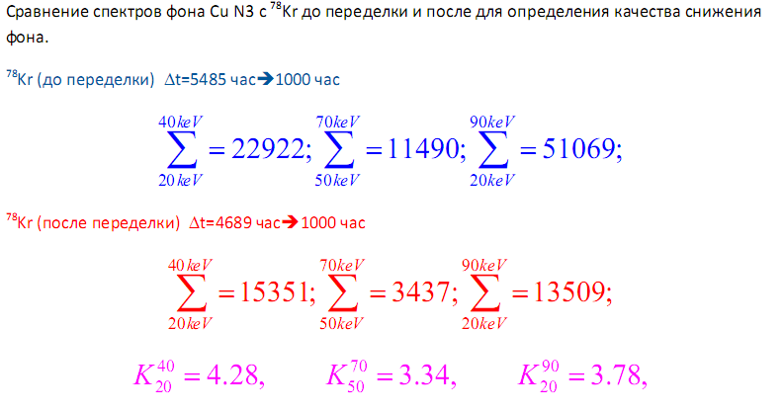
The total spectra, normalized for 1000 h, obtained for the background of LPC filled with krypton enriched in Kr-78 before redesign and after reconstruction

Slide 20
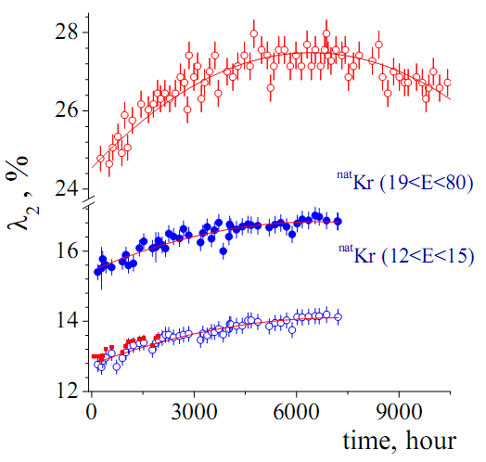
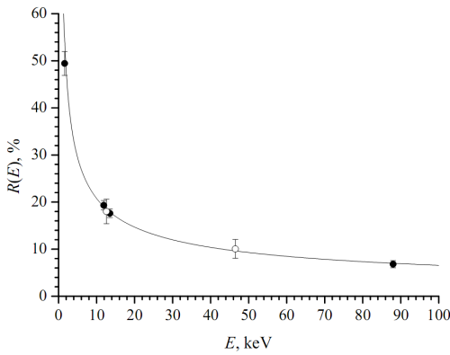
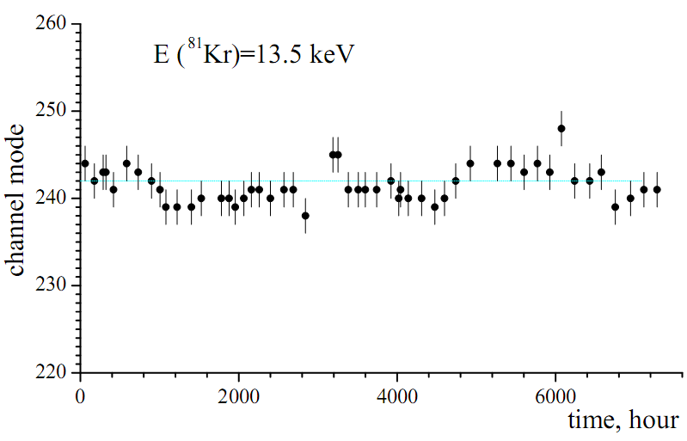
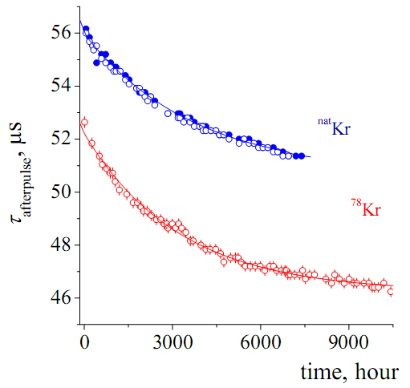
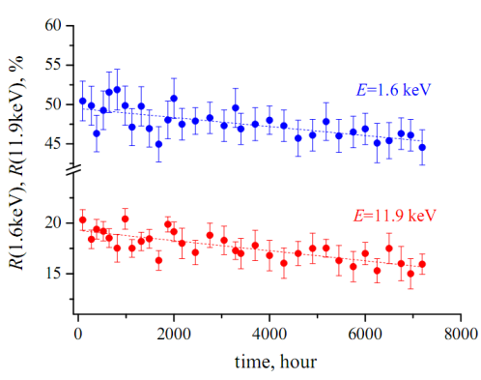
Data Parameters

