Slide 1
Radioactive isotopes content measurement in the starting material and scintillation crystal CaMoO₄ produced therefrom for AMORE experiment.
V. Kazalov
BNO INR RAS
AMORE meeting
Kiev, 27-28 October 2011
Notes:
В своем докладе я хочу рассказать о гамма-спектрометрах которые мы используем для измерения содержания естественных радиоактивных изотопов в различных образцах исходных материалов.
In my report I want to talk about the gamma-spectrometer that we use to measure the content of natural radioactive isotopes in various samples of raw materials.
Modern low-background experiments (such as neutrinoless double beta decay, dark matter search) require that when you create a low-background detectors and shields for these detectors, the use of materials with extremely low content of ra isotopes in these materials. Energy of the processes studied are in the energy range 0-4000 keV energy range which coincides with the decay of natural long-lived radioactive elements, ²³⁸U, ²³²Th and their progeny, as well as ⁴⁰K. Radiation from the decay of radioactive create (RA) for the main background measurements. As mentioned above ra elements are present in varying amounts in all materials, the only way to reduce the background below the natural level of protection is the creation of materials with minimal r.a.i. of impurities. The second source of background is a radioactive 222Rn, 226Ra daughter products of decay in a series of 238U. Radon gas - an inert gas, so he can get out of the material, which was born in the air. Radon itself is the parent element of the decay chains: 222Rn → 218Po → 214Pb → 214Bi → 214Po → 210Pb → 210Bi → 210Po → 206Pb. For low-background experiments, the main danger is 214Bi, which is emitted in the decay of the bulk of the gamma-ray of the uranium series with energies up to 2.45 MeV. The air-ventilated underground space volume activity of 222Rn is 40-200 Bq/m3. To prevent air from radon in the cavity around the detector is commonly used sealing protection and blowing the central cavity detector with liquid nitrogen vapors, practically do not contain radon. The third source of background are cosmic rays (cosmic rays). First, for the time of installation of all materials on the ground cosmic rays due to nuclear reactions give rise to radioactive isotopes with different half-lives. Radiation from their decay to produce the finished installing additional background to the test process. The main way to reduce the background in this case is to reduce to a minimum residence time of component units on the surface and the permanent storage of materials in underground conditions. Secondly, the cosmic rays themselves are a source of background. They create the ionization signal as it passes through the detector. As a result of their interaction with materials and environmental protection form secondary particles (neutrons, gamma rays) that can reach the detector and to increase its background. To suppress this component of low-background setup is placed deep in the ground and, if necessary, additional protection from cosmic rays active anticoincidence protection. In consequence of the above, the selection of structural materials is essential and very important stage in the creation of any low-background setup, because the current level of background determines the ultimate sensitivity of the experiment. Accumulated to date, comprehensive information (eg, [1]) on the content of ra elements in a variety of structural materials (metals, plastics, liquid dielectrics, etc.) and industrial goods (radio components, connectors, cables, etc.) is the orientation character. It allows you to select the type of low-background material. However, the deviation of ra contamination of the concrete material may be substantially different from the mean. Therefore, each time necessary to conduct additional input selection. The highest sensitivity for such measurements have low-background underground spectrometers built in compliance with the limit low-background requirements described above.

Slide 2
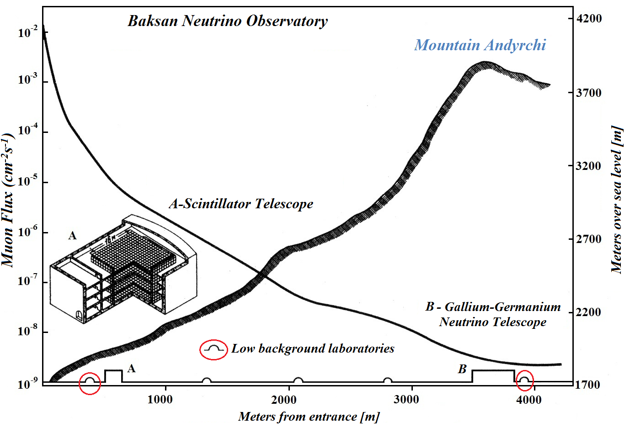
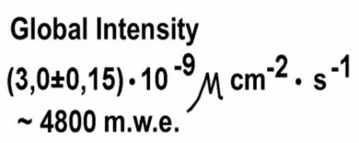
Dependence of the muon flux on the distance from the entrance to the tunnel of BNO INR RAS
Notes:
For this purpose, in our lab. we are used two instll. Base on Ge det. First one (of them) is located at a depth of 4800 m.w.e.
Shows location of our laboratories? And muon flux dependence on the distance from the entrance of the BNO’s tunnels. Location marked by red circle.
См. текст доклада

Slide 3
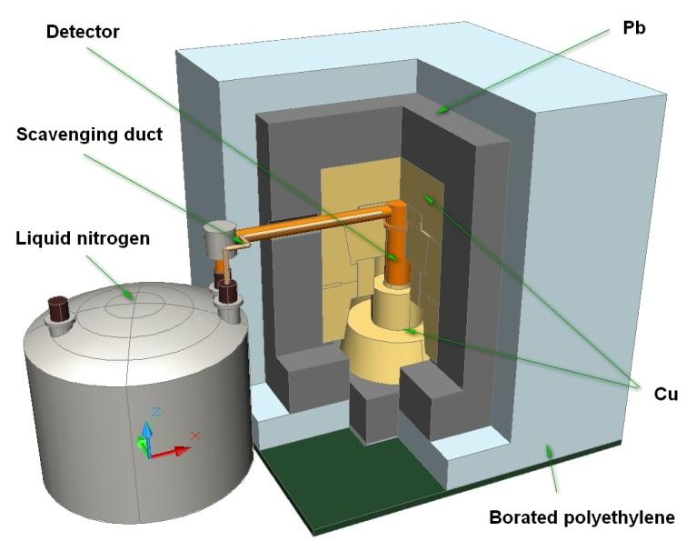
Ultra low background germanium gamma-spectrometer (СНЕГ)
Notes:
Thickness of the shield 50-80mm borated polyethylene, 1mm Cd, 150mm Pb, 180mm Cu

Slide 4
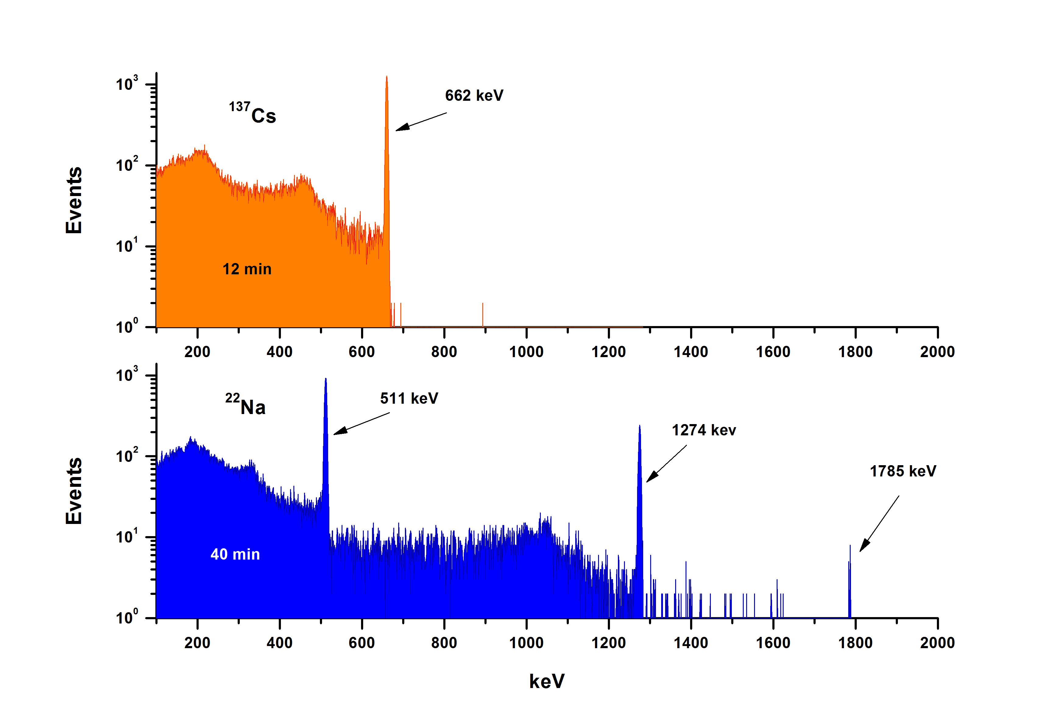
Calibration spectra of the sources ¹³⁷Cs and ²²Na (for SNEG)
Notes:
Sodium 22

Slide 5
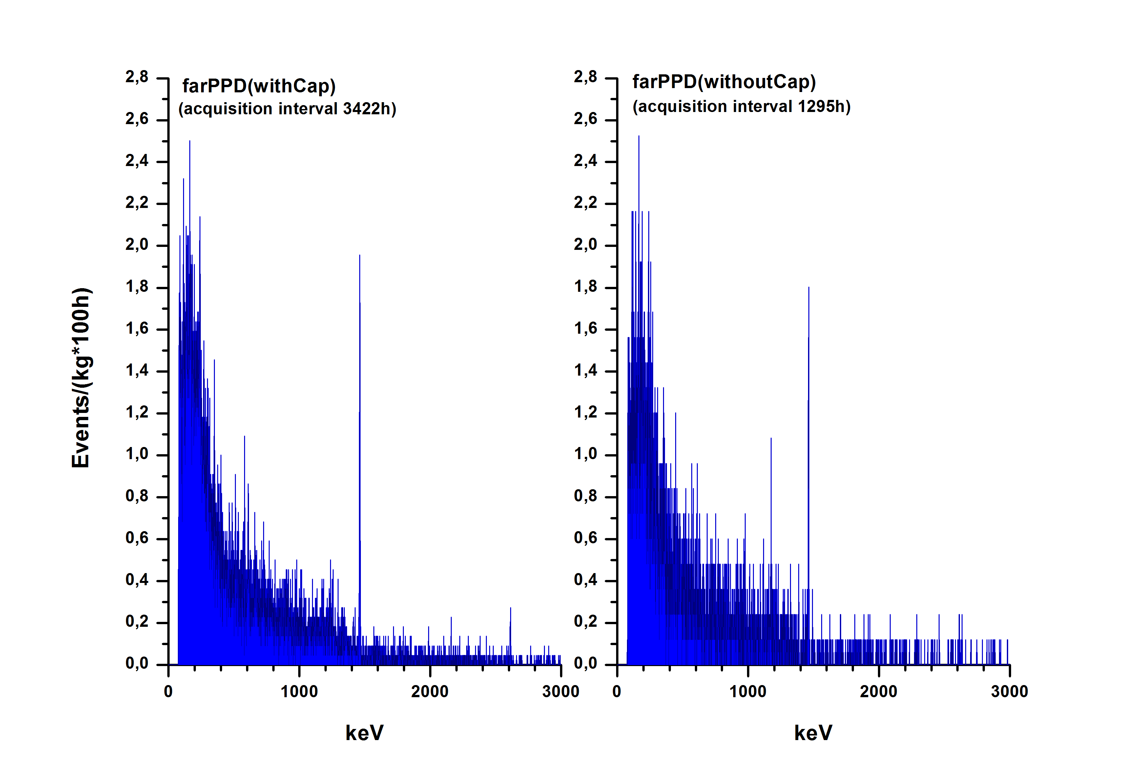
Background of SNEG with Cap and without Cap

Slide 6
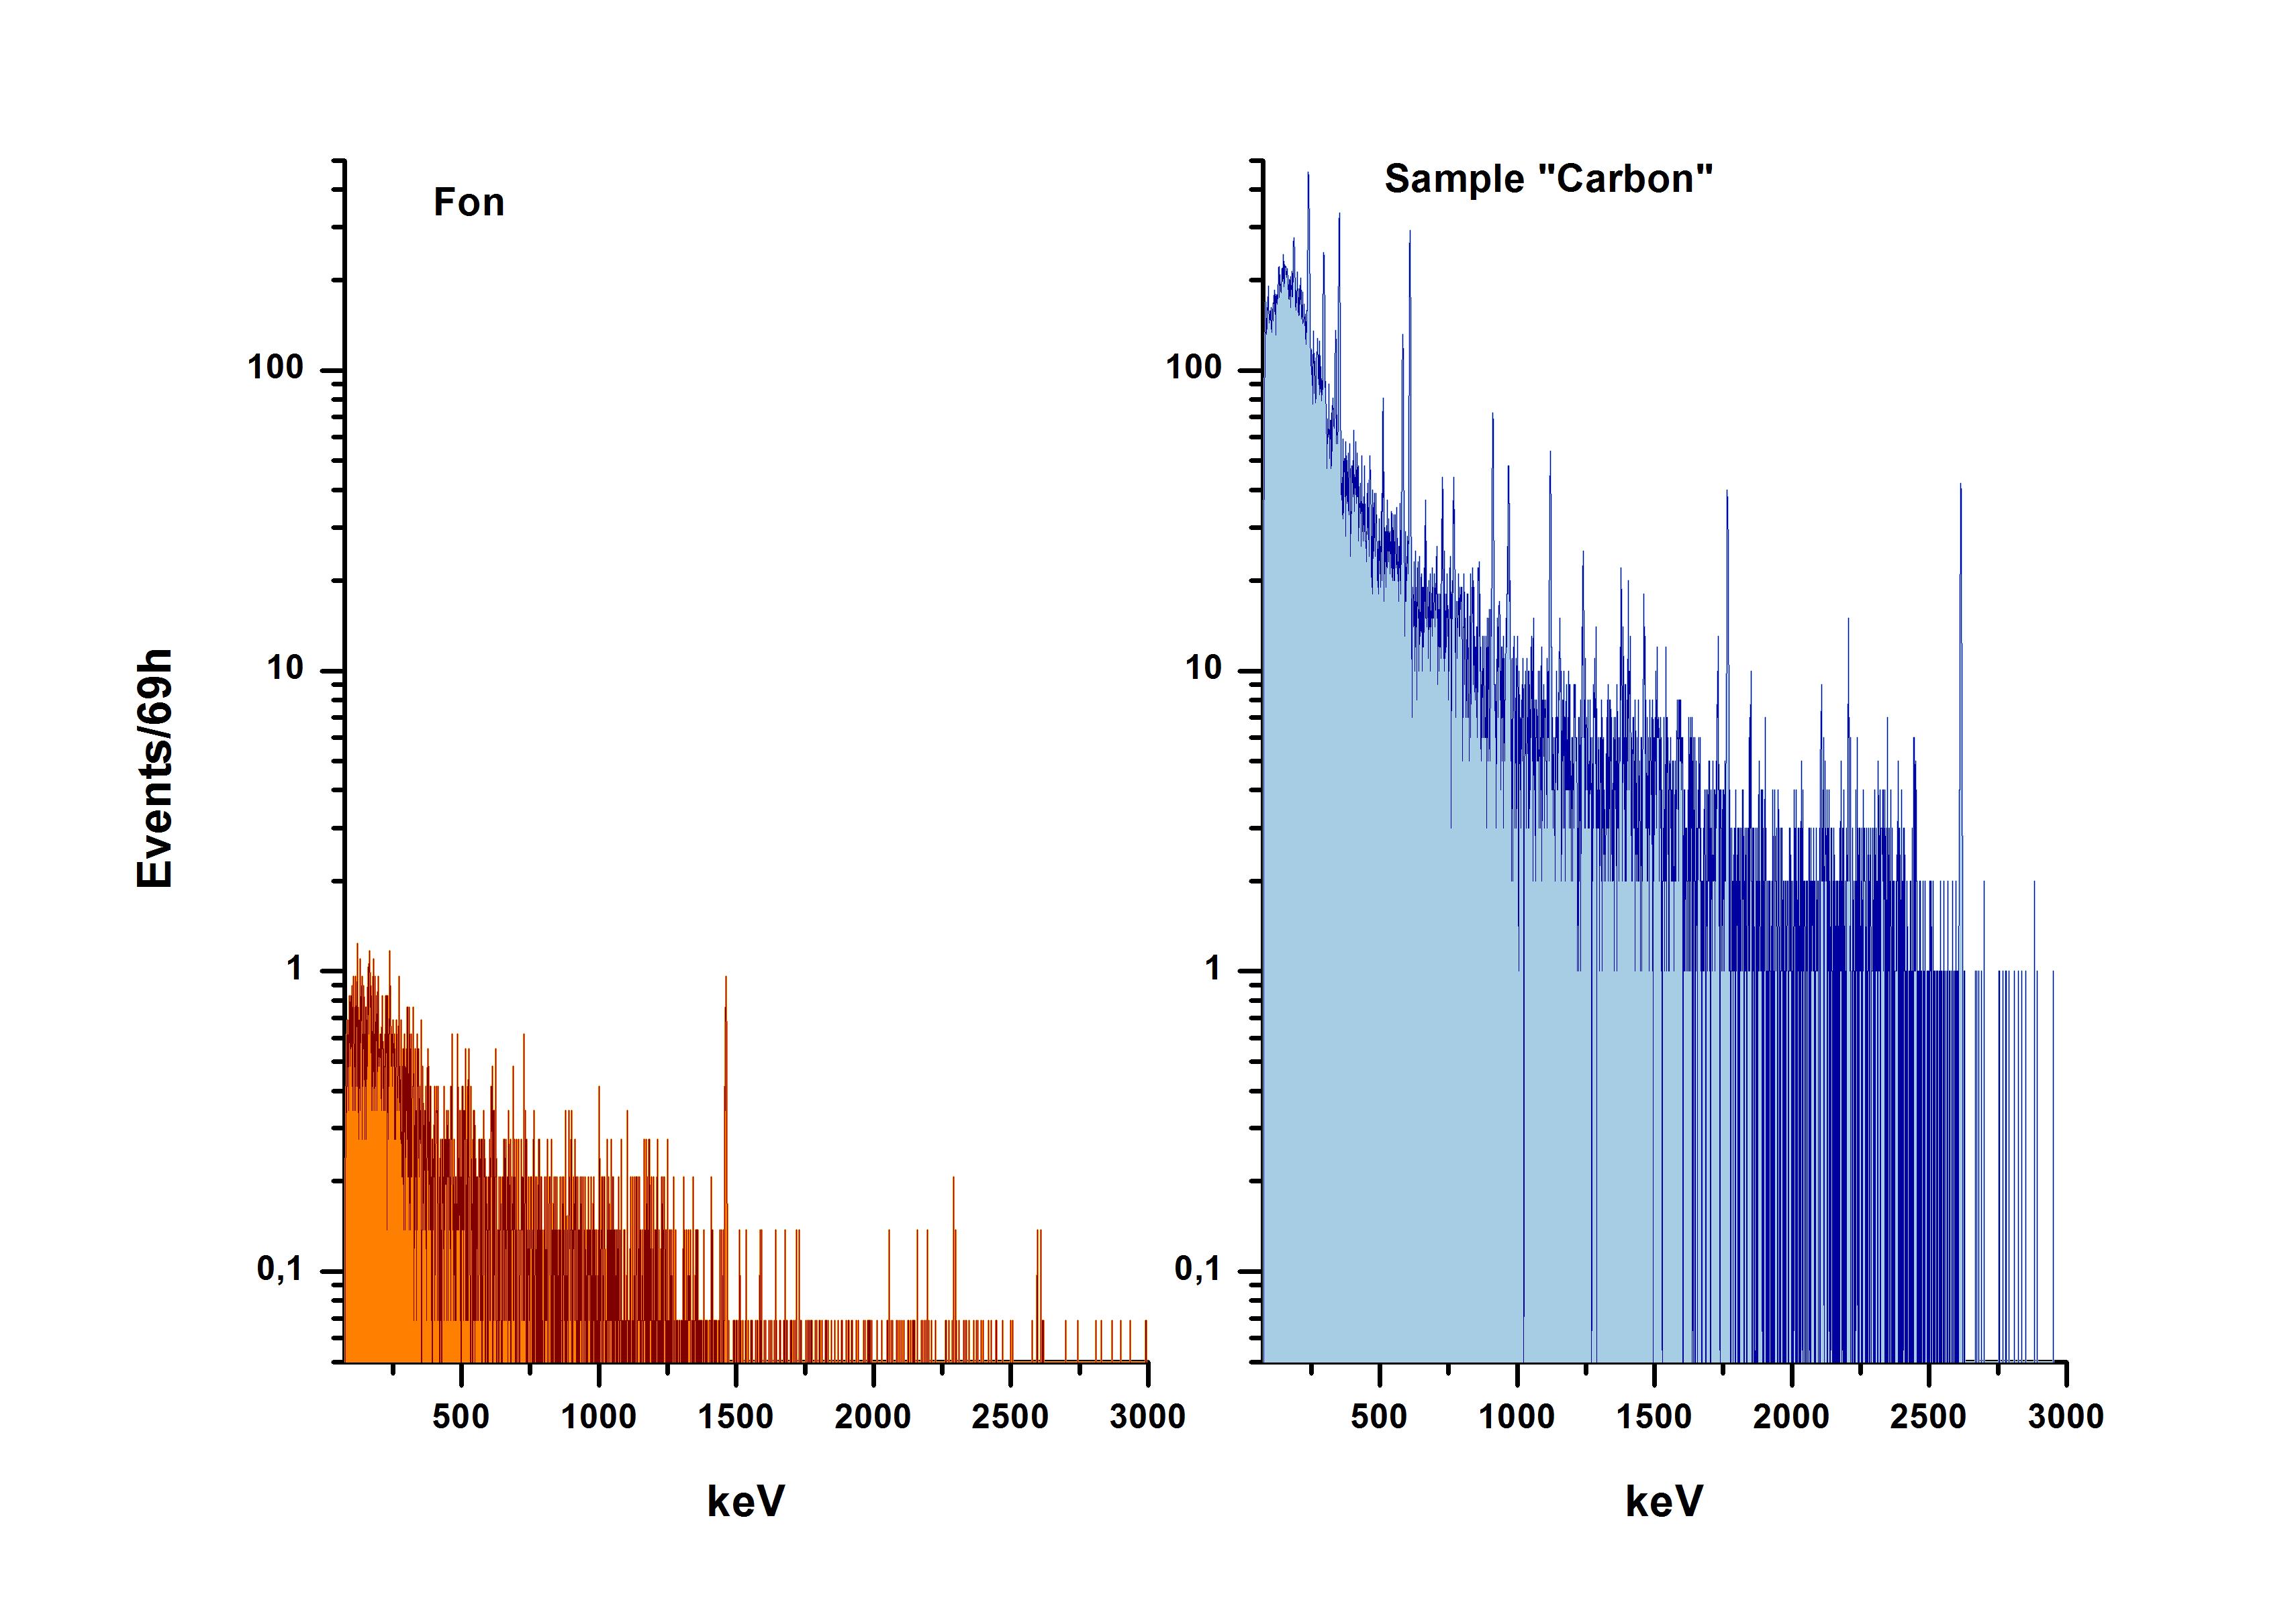
Spectrum of the sample “Carbon”
Notes:
Because we did not measure any samples for AMORE exp-t, in SNEG, I shows example of spectrum of Coal [keul], which was measured in SNEG
to represent the possibilities of this gamma-ray spectrometer.

Slide 7
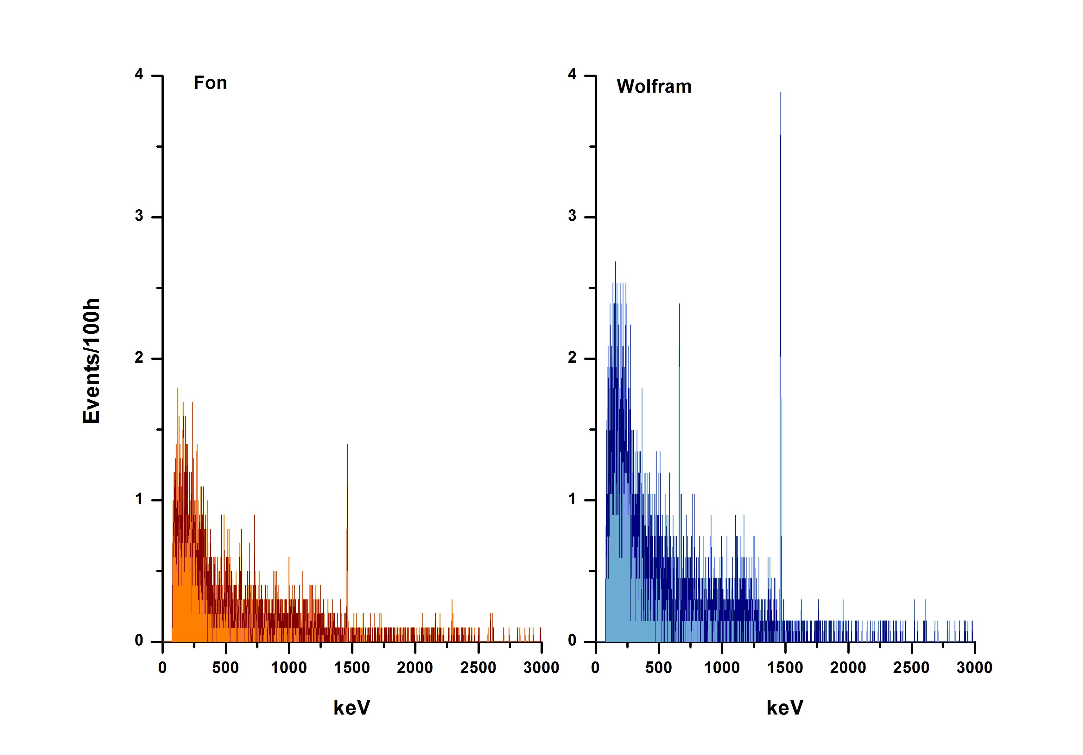
Spectrum of the sample “Wolfram”
Notes:
Another example of wolfram sample obtained in SNEG
this tungsten is used in one of our shield

Slide 8
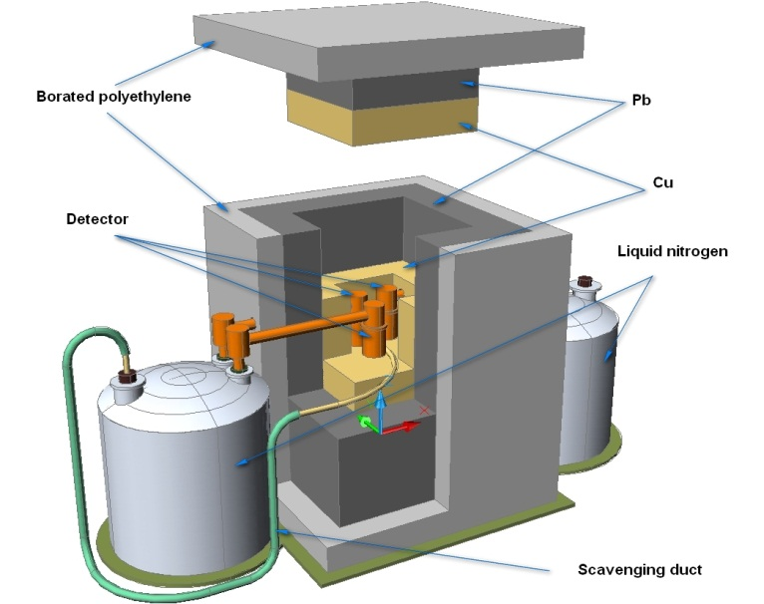
Low background chamber NIKA (former IGEX)
Notes:
Помещение Низкофоновой Камеры на глубине 660 м в.э. (НИКА), где фон к.л. снижен в ~2000 раз, в своей конструкции содержит элементы низкофоновой защиты. Её стены облицованы низкорадиоактивным бетоном толщиной 50 см на основе дунита – ультраосновной породы с низким содержанием естественных р.а. элементов. Объём рабочего помещения (4х4х3 куб.м) отделён от бетонных стен, потолка и пола засыпкой из дунитового щебня. Такая конструкция обеспечила снижение гамма-фона в 200 раз по сравнению с голой выработкой. В рабочем помещении размещена низкофоновая защита, состоящая из 8 см борированного полиэтилена + 23 см Pb + 12 см Cu. В центре медного блока защиты имеется прямоугольная полость размерами 30х30х30 куб.см, в которой располагались головные части четырёх сверхнизкофоновых полупроводниковых детекторов из сверхчистого германия. Масса каждого детектора около 1 кг. Защитные кожухи сделаны из высокочистой электролитической меди. Детекторы охлаждаются через хладопроводы, выведенные наружу защиты и опущенные в сосуды Дьюара с жидким азотом. Выходящие из сосудов пары жидкого азота используются для продувки рабочей полости. лов на р.а. чистоту.
Placing low-background chambers at a depth of 660 mwe (NIKA), where the background cosmic rays reduced to about 2000 times in its design contains elements of low-background protection. Its walls are lined (coated) with low-level concrete thickness of 50 cm on the basis of dunite - ultramafic rocks with a low content of natural r.e. the elements. The volume of working space (cubic m. 4x4x3) is separated from the concrete walls, ceiling and floor of the dunite backfill rubble. This design provided a decrease in gamma-ray background is 200 times as compared with bare formulation. In the working area available low-background protection, consisting of 8 cm borated polyethylene + 23 cm Pb +12 cm Cu. In the center of the copper block has a rectangular cavity protection 30x30x30 size cc, which is located in the head of four sverhnizkofonovyh semiconductor detectors of ultra-pure germanium.

Slide 9
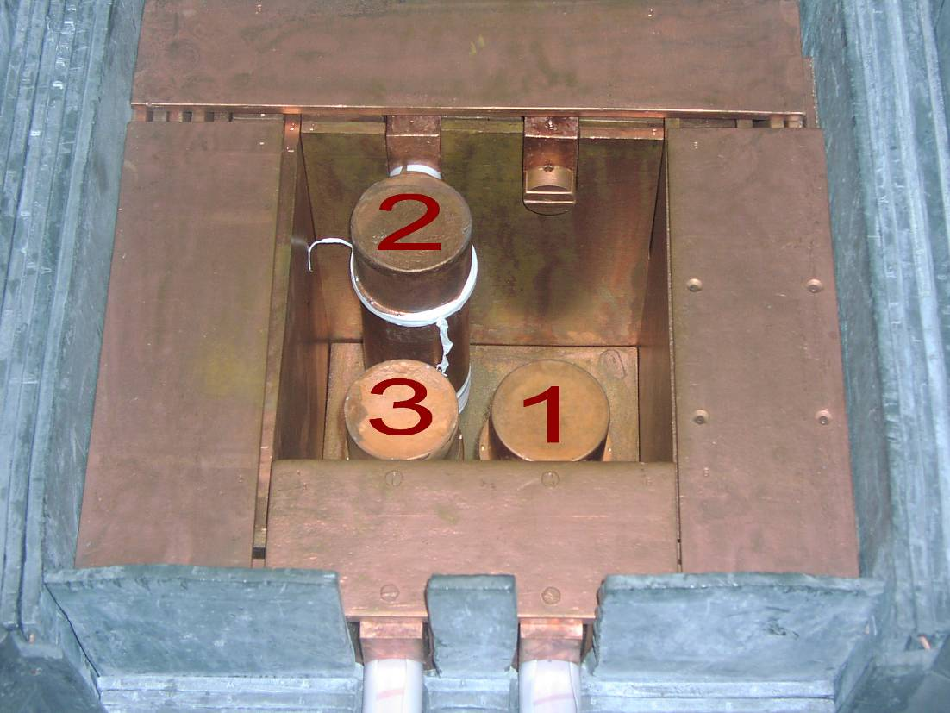
Geometry of the arrangement of Ge detectors in the working cavity
Detector № | №1 | №2 | №3 | №4
Characteristic
Material | ⁷⁶Ge | ⁷⁶Ge | ^{nat}Ge | ⁷⁶Ge
Total mass, g | 1006 | 896 | 1056 | 968
Effective mass, g | 630 | 680 | 980 | 642
Notes:
Масса каждого детектора около 1 кг. Защитные кожухи сделаны из высокочистой электролитической меди. Детекторы охлаждаются через хладопроводы, выведенные наружу защиты и опущенные в сосуды Дьюара с жидким азотом. Выходящие из сосудов пары жидкого азота используются для продувки рабочей полости. Три детектора изготовлены из германия, обогащённого по ⁷⁶Ge, и один – из германия природного состава (установка 4HPGe). Установка находится под землёй с 1992 года. На установке в рамках Российско-Испано-Американского проекта IGEX проводился поиск безнейтринного двойного бета-распада ⁷⁶Ge [3] и «тёмной» материи [4]. После окончания основных измерений один детектор (⁷⁶Ge) был извлечён из защиты с целью использования в составе низкофонового спектрометра, созданного в новой Низкофоновой Лаборатории Глубокого Заложения на глубине 4900 м в.э. (НЛГЗ-4900).
Оставшиеся три детектора в настоящее время используются, в основном, для проверки образцов материалов на р.а. чистоту.
The mass of each detector is about 1 kg. Housings are made from high purity electrolytic copper. The detectors are cooled through the cold finger, which are derived out of protection and lowered into the Dewar vessel with liquid nitrogen. Coming from vessels pair of liquid nitrogen used to purge the working cavity. Three detector made of germanium enriched in 76Ge, and one - of the natural composition of germanium (set 4HPGe). Installation is in the ground since 1992. The installation of the Russian-Spanish-American project IGEX a search for neutrinoless double beta decay of 76Ge [3] and "dark" matter [4]. After completing basic measurements a detector (76Ge) was extracted from the defense to use in low-background spectrometer created a new low-background laboratory deep-laid at a depth of 4900 mwe (NLGZ-4900). The remaining three detectors are now used mainly for testing of samples of materials to ra purity.

Slide 10
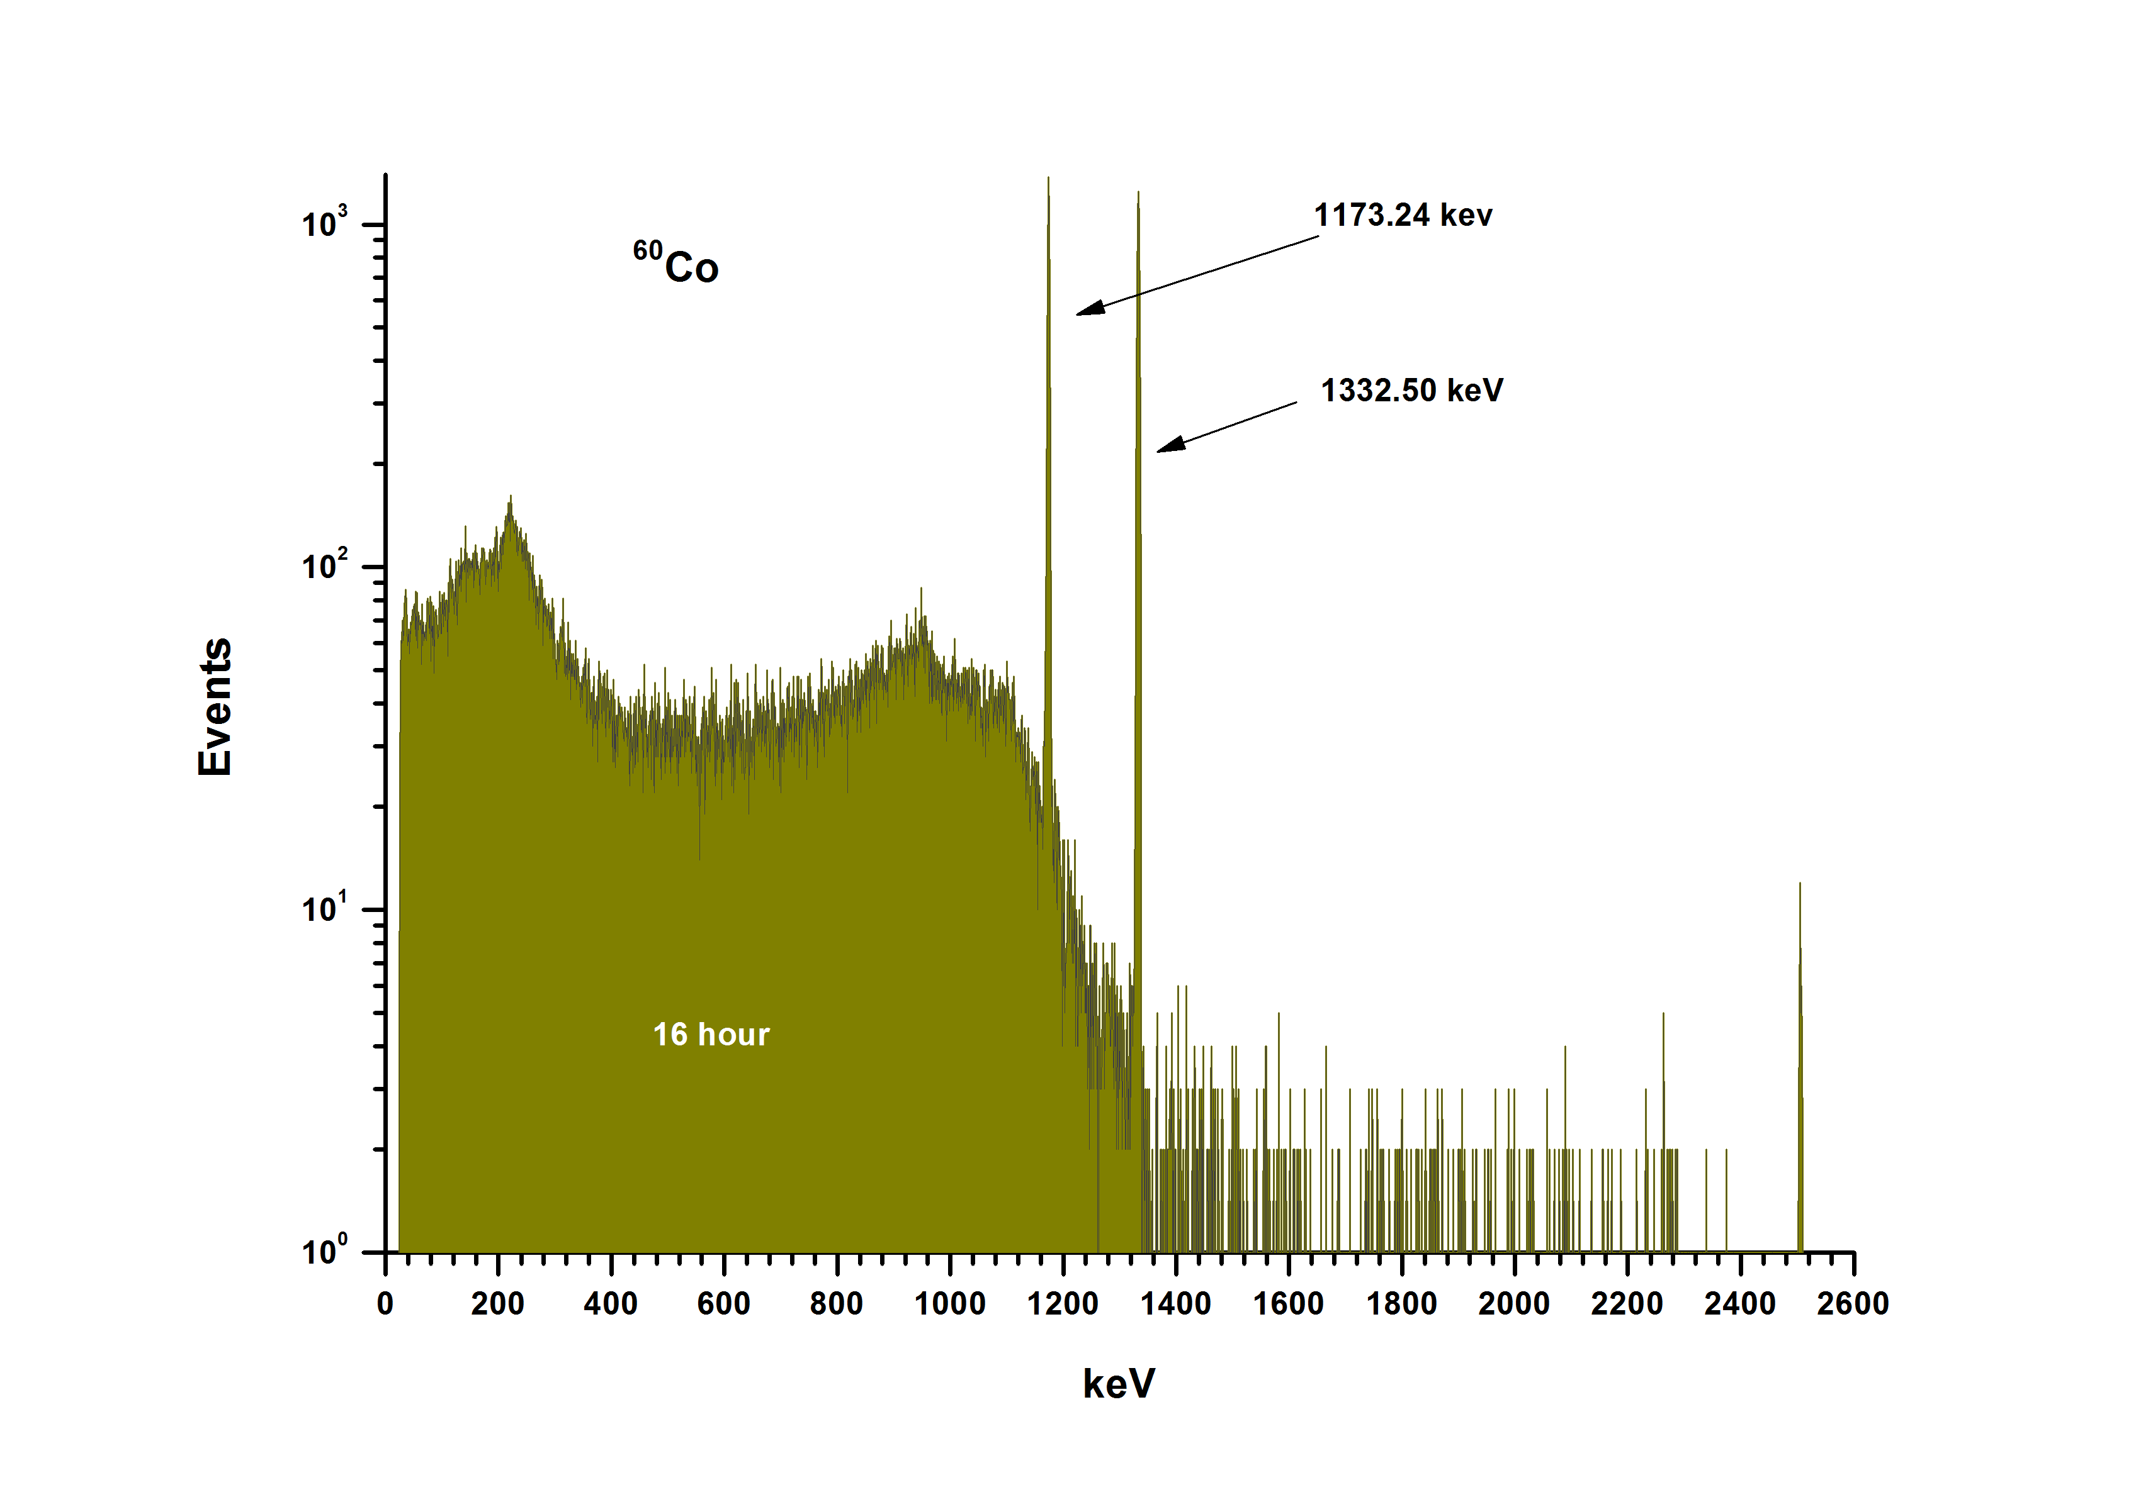
Calibration spectra of source ⁶⁰Co (NIKA)

Slide 11
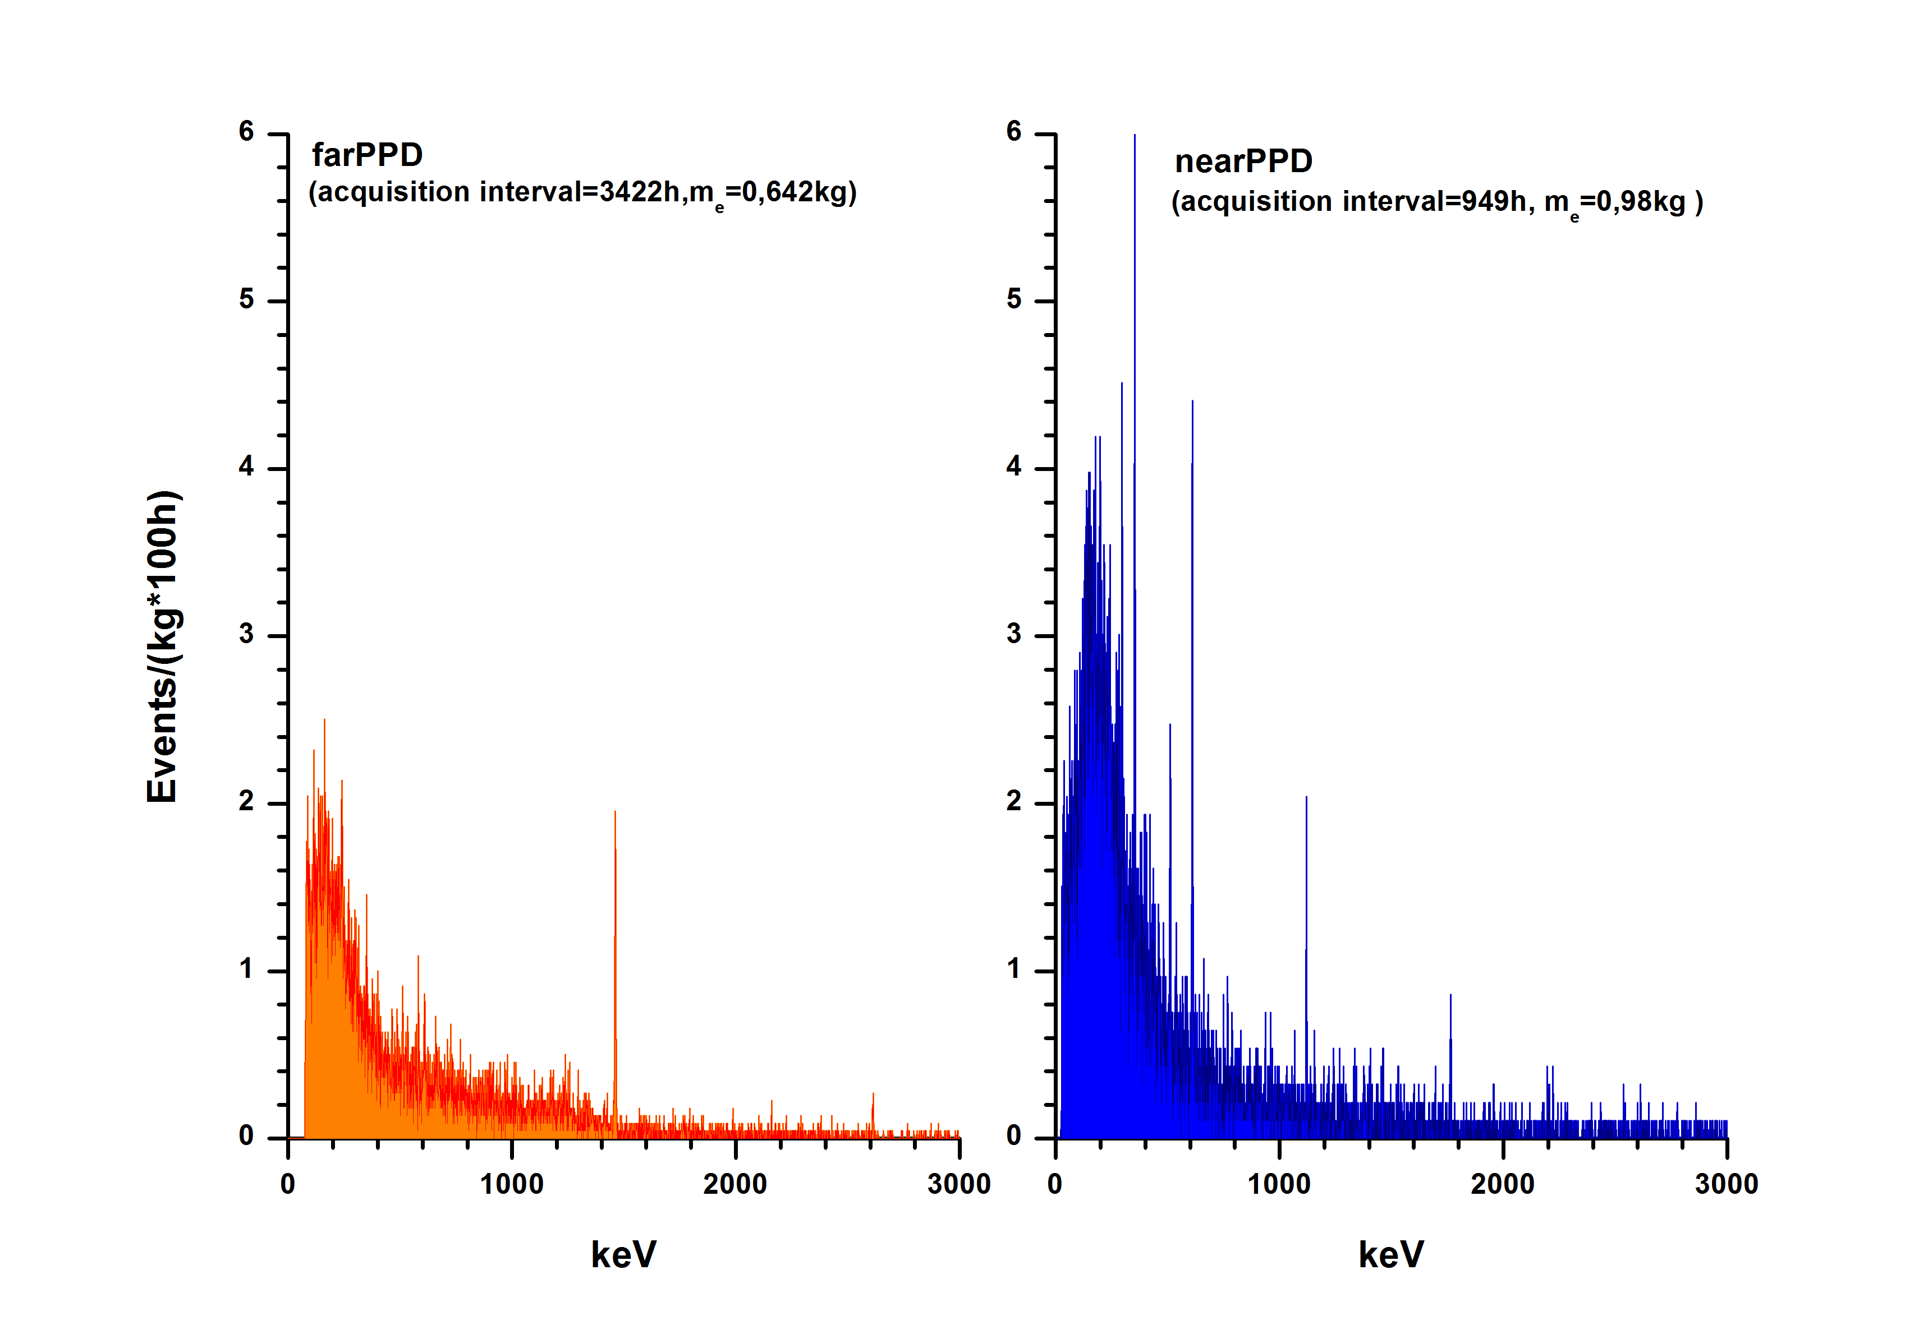
The comparison of background spectra of NIKA and SNEG

Slide 12
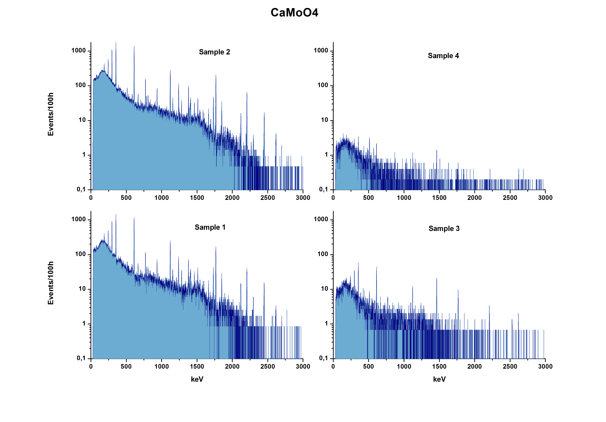

Slide 13
The list of the samples and their characteristics
Sample, material | Form | Mass, g | Measurement time, h
Charge A1 ~CaMoO₄ | Sintered material of cylindrical shape d=70 mm, h=30mm | 414 | 115
Charge A2 ~CaMoO₄ | Sintered material of cylindrical shape d=72mm, h=27mm | 420 | 209
Charge B ~CaMoO₄ | Sintered material of cylindrical shape d=80mm, h=29mm | 523 | 143
Monocrystal CaMoO₄ from B | Elliptical the cylinder with a convex top d₁=50mm, d₂=44mm, h≈40mm | 384,5 | 498
Calcium formate Ca(HCOO)₂ | Powder in two plastic bags ~130mm×90mm×13mm | 400 | 333
Molybdenum oxide ¹⁰⁰MoO₃ | Powder in plastic bag ~115mm×100mm×10mm | 223 | 740
⁴⁰CaCo₃ | White powder in a cylindrical plastic capsule d=52mm, h=27mm | 60,25 | 557
Monocrystal CaMoO₄ | Elliptical the cylinder with a convex top d₁=49mm, d₂=42mm, h≈71mm | 553,5 | 795
⁴⁰CaCo₃ | White powder in plastic bags (4 bags) ~100mm×100mm×15mm | 525,04 | 542
Monocrystal CaMoO₄ | Elliptical the cylinder with a convex top d₁=48mm, d₂=45mm, h≈95mm | 494,87 | 893
⁴⁰CaCo₃ | White powder in plastic bags (4 bags) ~60mm×60mm×15mm | 540 | 277
Notes:
The list of the samples and their characteristics
samples are given in the table as they become available to measure
samples in the table in order of receipt

Slide 14
Activity of radioactive isotopes in the samples (Bq / kg) (95% C.L.)
Sample, material | Isotopes
 | ⁴⁰K | ²²⁸Ac=(²³²Th) | ²⁰⁸Tl [(²³²Th)] | ²¹⁴Bi=(²³⁸U)
 | Activity of radioactive isotopes
Charge A1 ~CaMoO₄ | (2.7±0.5)⋅10⁻¹ | (5.3±1.9)⋅10⁻² | (1.3±0.3)⋅10⁻² [(3.6±0.8)⋅10⁻²] | 3.07±0.05
Charge A2 ~CaMoO₄ | (4.7±0.5)⋅10⁻¹ | (2.6±1.4)⋅10⁻² | (1.9±0.3)⋅10⁻² [(5.3±0.8)⋅10⁻²] | 3.51±0.04
Charge B ~CaMoO₄ | (3.6±0.4)⋅10⁻² | ≤7.1⋅10⁻³ | (2.8±1.5)⋅10⁻³ [(7.8±4.2)⋅10⁻³] | (7.8±1.1)⋅10⁻²
Monocrystal CaMoO₄ from B | (2.0±0.8)⋅10⁻² | ≤5.6⋅10⁻³ | ≤1.4⋅10⁻³ [≤3.9⋅10⁻³] | ≤2.2⋅10⁻³
Calcium formate Ca(HCOO)₂ | ≤7.0⋅10⁻³ | ≤3.0⋅10⁻³ | ≤8.9⋅10⁻⁴ [≤2.5⋅10⁻³] | ≤1.7⋅10⁻³
Molybdenum oxide ¹⁰⁰MoO₃ | (5.3±0,8)⋅10⁻² | ≤3.8⋅10⁻³ | ≤1.0⋅10⁻³ [≤2.8⋅10⁻³] | ≤2.3⋅10⁻³
⁴⁰CaCo₃ | (7.3±3.1)⋅10⁻² | (1.6±0.2)⋅10⁻¹ | (4.4±3.6)⋅10⁻³ [(1.2±1.0)⋅10⁻²] | (2.6±0.2)⋅10⁻¹
Monocrystal CaMoO₄ | ≤8.2⋅10⁻³ | ≤3.1⋅10⁻³ | ≤6.6⋅10⁻⁴ [≤1.8⋅10⁻³] | ≤3.2⋅10⁻³
⁴⁰CaCo₃ | ≤1.24⋅10⁻² | (5.9±0.5)⋅10⁻² | (1.1±0.1)⋅10⁻² [(3.03±0.27)⋅10⁻²] | (1.72±0.05)⋅10⁻¹
Monocrystal CaMoO₄ | (1.2±0.6)⋅10⁻² | ≤3.28⋅10⁻³ | ≤7,80⋅10⁻⁴ [≤2.15⋅10⁻³] | (1.6±0.2)⋅10⁻²
⁴⁰CaCo₃ | (1.4±0.5)⋅10⁻² | ≤3.2⋅10⁻³ | ≤9.0⋅10⁻⁴ [≤2.48⋅10⁻³] | (5.7±0.3)⋅10⁻²
Notes:
активность ²³²Th определяется в предположении равновесия в ряду из активности ²⁰⁸Tl делением на коэффициент ветвления.
²³²Th activity is determined by the assumption of equilibrium in a rad-ty series (row) from the ²⁰⁸Tl activity dividing by branching factor
²⁰⁸Tl/0,362

