Slide 1
Status of simulation at SNU
S.S. Myung

Slide 2
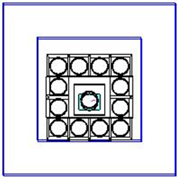
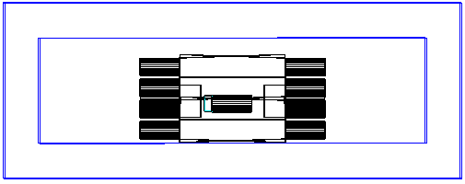
GEANT4 setup for pilot experment: by J.I. Lee
Lead
Lead
Lead

Slide 3
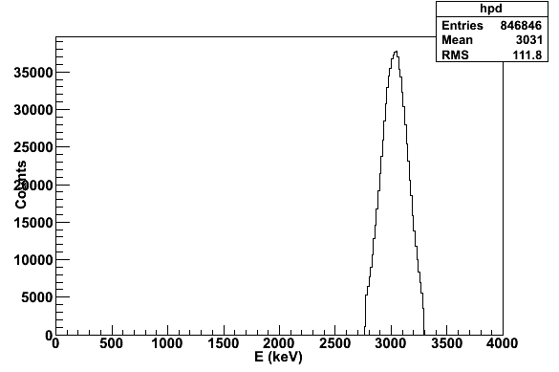
Correlation events of CaMoO4 & CsI(Tl)
Mo-100 0ν of CaMoO4
- sigma/E of S35 CaMoO4
2 sigma cut of 0νββ
10keV cut of CsI
84.7% efficiency
CsI crystal
10keV
CaMoO₄ crystal
Mo-100 0ν of CsI(Tl)
-CsI(Tl) < 10keV

Slide 4
0nbb
2nbb
Bi214
Tl208
Ca48
10 kg*5 year
Bi214: 1.7mBq/kg
Tl208: 0.26 mBq/kg
Reduction factor 30 applied
Enrichment :¹⁰⁰Mo = 96.1% ⁴⁸Ca < 0.001%
S35 CMO resolution/ background measurement used

Slide 5
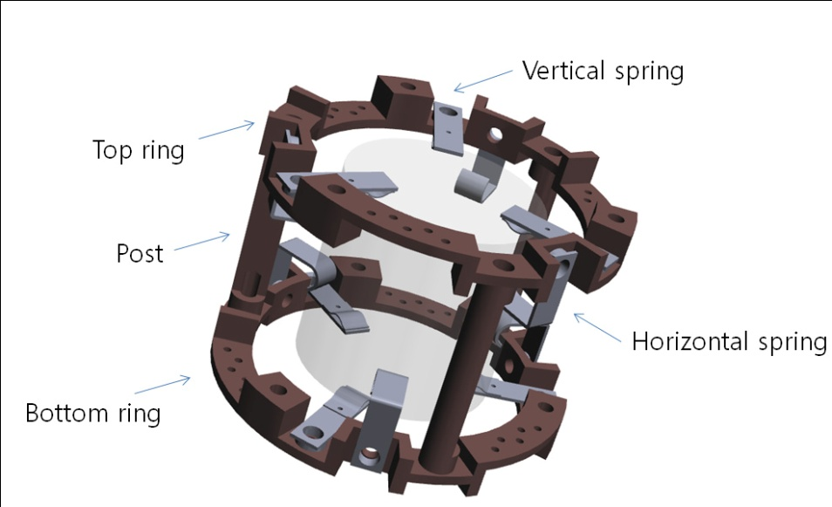
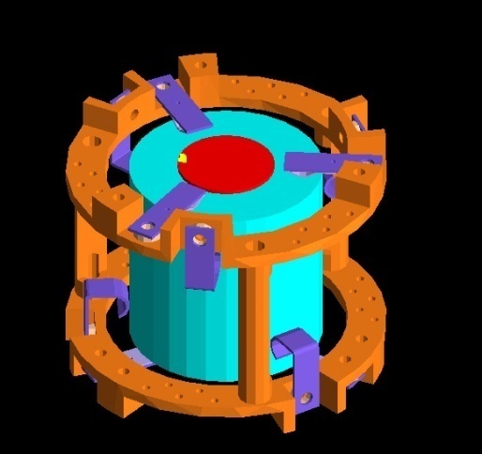
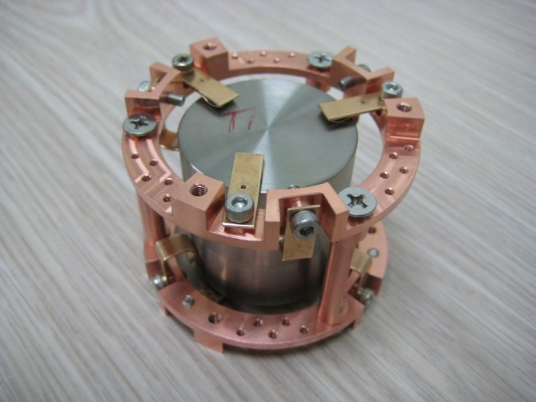
Simulation for Low Energy Setup
CaMoO4
φ4cm x 4cm, 11mK
Designed by Yury: 4cm x 4cm

Slide 6
Simulation for low
Simulation for Low Energy Setup
Copper 5cm top
1cm side
1cm bottom
101.1 kg
Lead 10cm top
1cm side
1cm bottom
139.7 kg

Slide 7
5 6
0 1 2
3 4
7 crystal * 3 layers:
Each crystal size: φ 4cm*4cm
Total mass: 226 g *21=4.75 kg

Slide 8
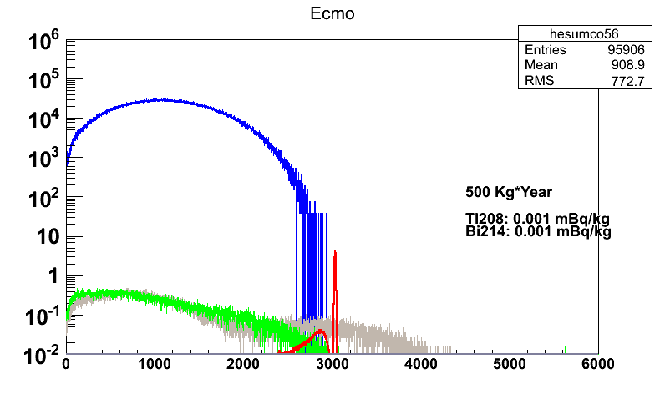
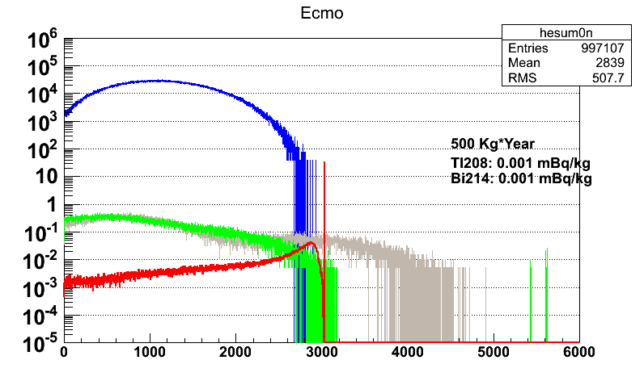
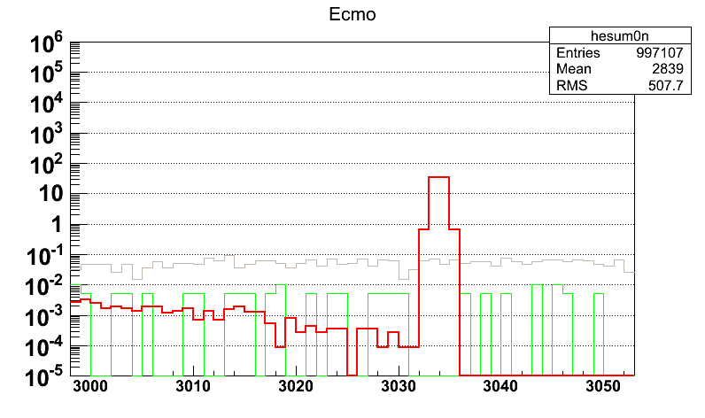
Number of event/100kg/5year/keV
0nbb
2nbb
Bi214
Tl208
HWHM=1 keV
T_half(0nbb): 1x10²⁵ year
(2nbb): 2.35x10¹⁹
Reduction factor 30 applied also:
CsI Shielding, PSD, time-correlation

Slide 9
Background level vs T_{1/2}
FWHM=14 keV
Bkg level(mBq/kg) nbkg* T_{1/2} (yr)
0.05 30.1 1.2 x 10²⁴
0.01 6 2.5 x 10²⁵
0.001 0.6 ** 3.7 x 10²⁶
FWHM=1 keV
0.05 3.4 9.2 x 10²⁵
0.01 0.7 ** 3.7 x 10²⁶
* # of background at FWHM window
** Used Nbkg=0 formula for T_{1/2}.

Slide 10
Anti-coincidence cut
(single + E_exit<10 keV)
Bi214: 57% survive
Tl208: 37%
Co56: 22%
BiPo212: 94%=> need to cut by PSD& Timing
0nbb: 89%
2nbb: 97%

Slide 11
Background from shield/cu
Assume background level of COURE
+ ⁵⁶Co with the same level of ⁶⁰Co

Slide 12
Background generated at Copper
Bi214
22M evts
Generated
Q(3272)
13817
14861
17462
18072
18168
18451
3005

Slide 13
Background due to cryogenics
Bi214
Co56
O(10⁻⁷)
Tl208
Co60
#of background /kg/yr/keV

Slide 14
Background due to Roman Lead
Bi214
Tl208
O(10⁻⁷
O(10⁻⁶
#of background /kg/yr/keV

Slide 15
plan
Simulate reduction factor
Update background vs T_{1/2}
Further simulation of background from shielding
Also other sources of background…

Slide 16
Thank you

Slide 20
Background generated at Copper
Bi214

