Slide 1
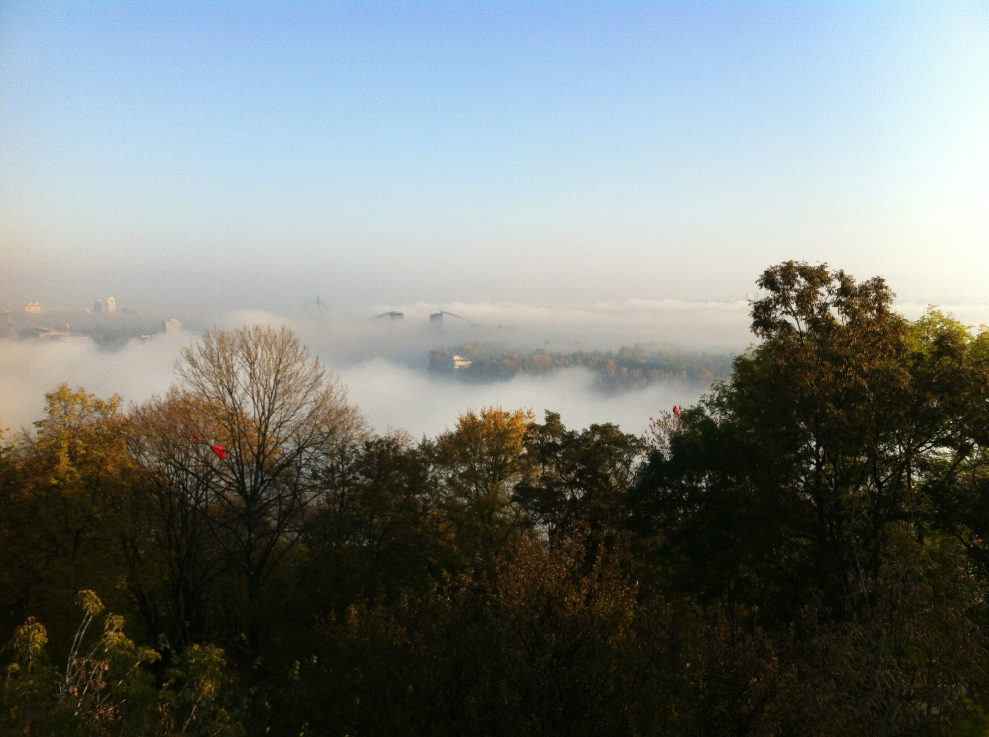
Goal of the workshop
Sun Kee Kim
Seoul National University
2nd AMoRE Workshop, Kiev, Oct. 27, 2011

Slide 2
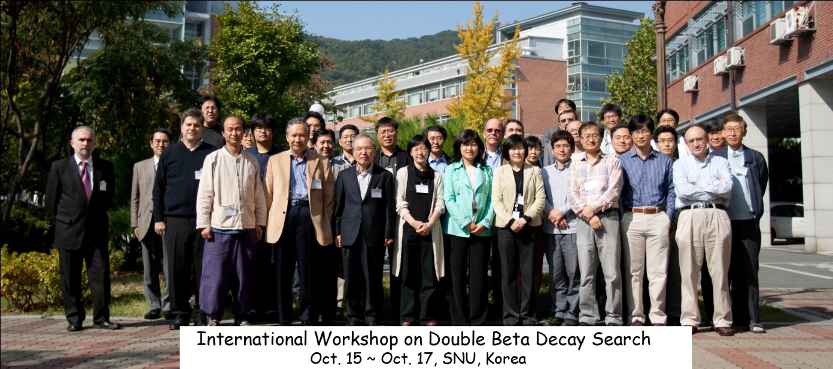
Amore Collaboration
Korea (39)
Seoul National University : H.Bhang, S.Choi, M.J.Kim, S.K.Kim, M.J.Lee, S.S.Myung, S.Olsen, Y. Sato, K.Tanida, S.C.Kim, J.Choi, H.S.Lee, S.J.Lee, J.H.Lee, J.K.Lee, X.Li, J.Li, H.Kang, H.K.Kang, Y.Oh, S.J.Kim, E.H.Kim, K.Tshoo, D.K.Kim(24)
Sejong University : Y.D.Kim, E.-J.Jeon, K. Ma, J.I.Lee, W.Kang, J.Hwa (5)
Kyungpook national University : H.J.Kim, J.So, Gul Rooh, Y.S.Hwang(4)
KRISS : Y.H.Kim, M.K.Lee, H.S.Park, J.H.Kim, J.M.Lee, K.B.Lee (6)
Russia (16)
ITEP(Institute for Theoretical and Experimental Physics) : V.Kornoukhov, P. Ploz, N.Khanbekov (3)
Baksan National Observatory : A.Ganggapshev, A.Gezhaev, V.Gurentsov, V.Kuzminov, V.Kazalov, O.Mineev, S.Panasenko, S.Ratkevich, A.Verensnikova, S.Yakimenko, N.Yershov, K.Efendiev, Y.Gabriljuk (13)
Ukraine(11)
INR(Institute for Nuclear Research) : F.Danevich, V.Tretyak, V.Kobychev, A.Nikolaiko, D.Poda, R.Boiko, R.Podviianiuk, S.Nagorny, O.Polischuk, V.Kudovbenko, D.Chernyak(11)
China(3)
Tsinghua University : J.Li, Y. Li, Q.Yue(3)
Germany(3)
University of Heidelberg : C.Enss, A. Fleischmann, L. Gastaldo (3)
5 countries
9 institutions
72 collaborators

Slide 3
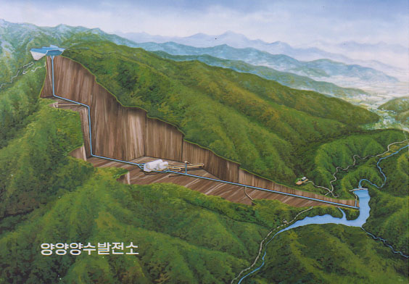
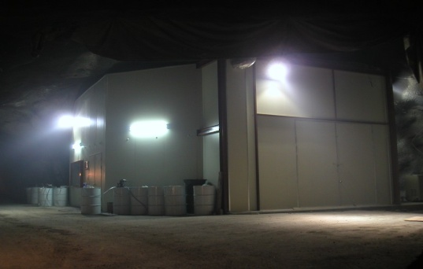
YangYang Underground Laboratory(Y2L)
(Upper Dam)
Y2L
Located in a tunnel of
Yangyang Pumped Storage Power Plant
Korea Middleland Power Co.
Minimum vertical depth : 700 m
Access to the lab by car (~2km)
In operation since 2003
Experiments:
KIMS: DM search exp. in operation
AMORE: DBD Search exp. in preparation
(additional laboratory space in design)
(Power Plant)
(Lower Dam)

Slide 4
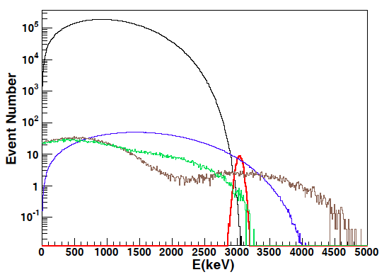
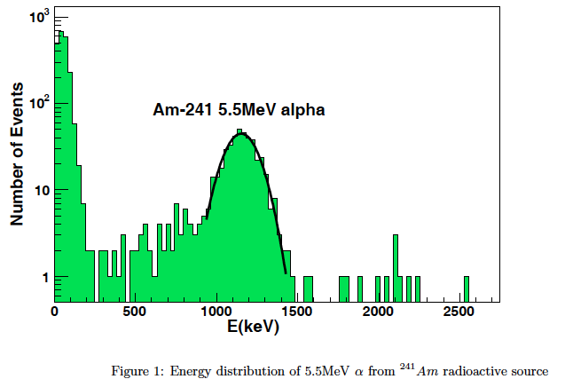
~500 p.e./MeV
20kg

Slide 5
CaMoO₄ crystal development

Slide 6
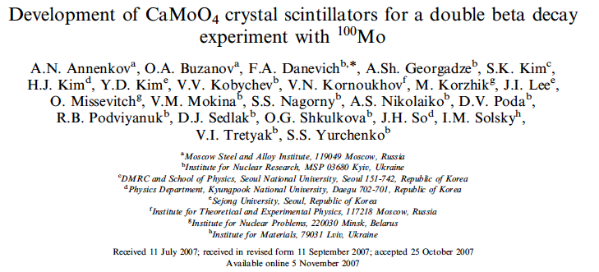
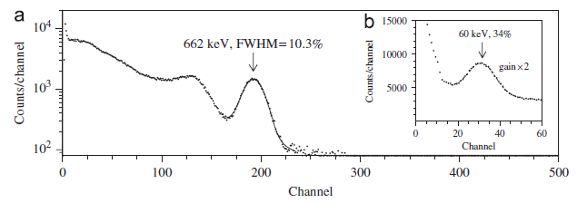
ISTC program
Ukraine-Korea program

Slide 7
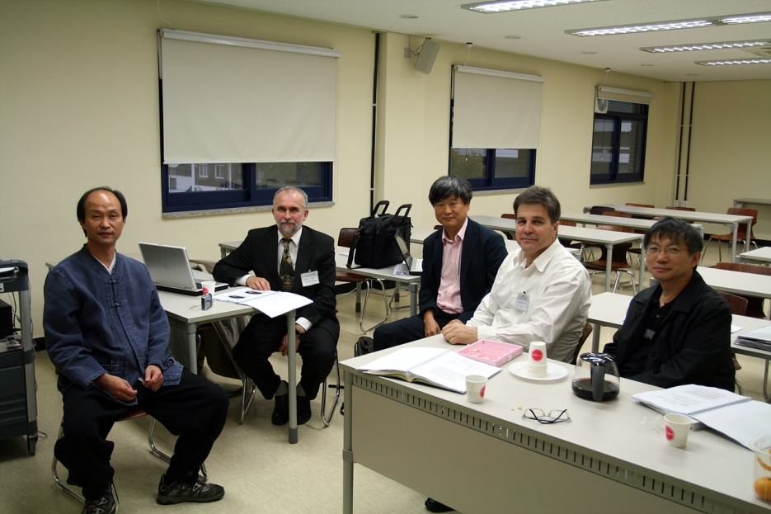
2009.10.15-10.17 1st workshop – Collaboration formed (needs of a body for decisions)
Steering committee : S.K.Kim, Y.D.Kim, H.J.Kim, Y.H.Kim, V. Kornoukhov, F. Danevich
2010.3.16 : Collaboration name AMoRE was decided
2010. 5. 7 : AMoRE software workshop
2010.10.7 : 2nd workshop
2011.10.27 : 3rd workshop (today)
Need a beautiful logo of AMoRE
INDICO Documents archive for AMORE
http://q2c.snu.ac.kr/indico/categoryDisplay.py?categId=16
Presentation files for 1st workshop
http://q2c.snu.ac.kr/indico/conferenceDisplay.py?confId=11
For 2nd workshop
http://q2c.snu.ac.kr/indico/conferenceDisplay.py?confId=70

Slide 8
AMoRE
Recent presentations (this year)
MEDEX 2011 (2011.7.13-16) (invited)
ASPERA Workshop on The next generation projects in Deep Underground Laboratories (2011.7.29-8.2) (invited)
LTD 2011(2011.8.1-5)
TAUP 2011(2011.9.5-9)
SCINT 2011(2011.9.12-16)
DBD 11(2011.14-17) Osaka (invited)
Recent publications
The Development of a Cryogenic Detector with CaMoO4 Crystals for Neutrinoless Double Beta Decay Search Astroparticle Physics, 34, 732 (2011)
Neutrino-Less Double Beta Decay Experiment Using Ca MoO Scintillation Crystals, IEEE Trans. Nucl. Sci. 57, 3 (2010)
Ancient Greek lead findings in Ukraine, Nucl. Inst. Meth.A 603, 328, (2009)
Development of CaMoO4 crystal scintillators for a double beta decay experiment with 100Mo, Nucl. Inst. Meth. A 584, 334 (2008)

Slide 9
0νββ
1/T^{0ν} _{1/2} = G^{0ν}(Q,Z) |M^{0ν}|² <m_{ββ}>²
Energy
¹⁰⁰Tc
¹⁰⁰Mo
Forbidden β transition
Q_{ββ}
Transition ββ
allowed
¹⁰⁰Ru
Z
Z
Z+1
Z+2

Slide 10
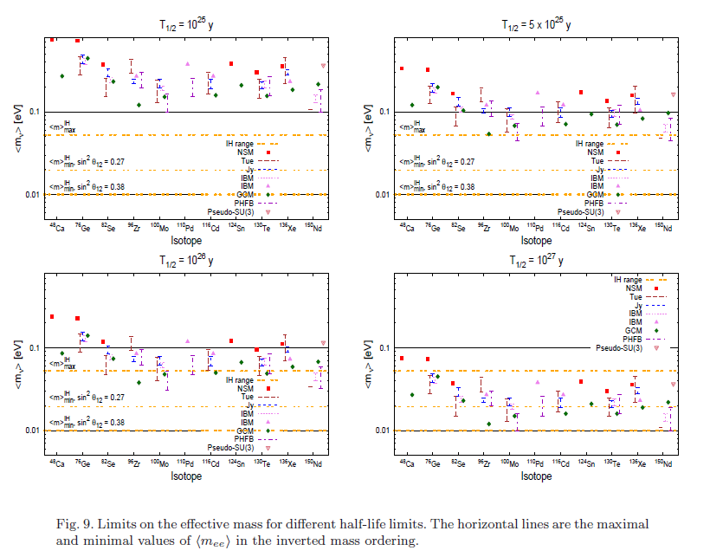
Werner Rodejohann, Int. J. M. Phys., 2011

Slide 11
CaMoO₄
DBD for Mo-100 (3034 keV), Ca-48(4272 keV)
high energy → less background
Mo-100 enrichment >90% not so difficult
for Mo-100 search, Ca-48 needs to be depleted
Scintillator
At room temp; 10-20% of CsI(Tl) at 20º
Decay time ; 16 μ sec
LY increases at lower temp. (almost the same as CsI(Tl))
Wavelength; 450-650ns-> RbCs PMT or APD
Pulse Shape Discrimination
Can be used as cryogenic detector
Debye temperature: 438 K ( Ge : 360 K, Si: 625 K)
Combining with Scintillation detection : NR, alpha/gamma separation
Good dark matter detector as well
Energy
¹⁰⁰Tc
¹⁰⁰Mo
Q_{ββ}
¹⁰⁰Ru
Z
Z
Z+1
Z+2

Slide 12
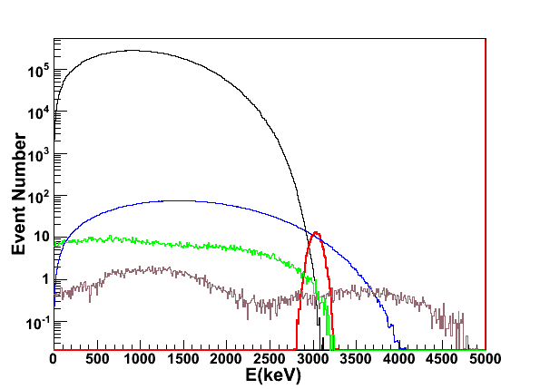
Enrichment & Depletion
Mo-100 enrichemeinet : 96.1%
Ca-48 depletion < 0.001% (Nantural abundance is 0.187%)
Depleted Ca : ~ 30 kg available (Ca48 < 0.001%)
➔ Good for 150 kg CaMooO4 crystals

Slide 13
⁴⁸Ca Enrichment/Depletion at KAERI (Korea Atomic Energy Research Institute)
ALSIS (Advanced Laser Stable Isotope Separation)
- Features : Isotope-Selective Optical Pumping (ISOP)
followed by Non-selective Resonant Photoionization (RPI)
- ISOP gives good isotope-selectivity and non-selective RPI high yield.
+
+
+
+
+
+
+
+
(-) Charge collector
+
+
+
+
+
+
+
+
+
+
+
+
+
+
+
+
+
+
+
+
+
+
Atomic vapor
RPI
target isotope
ISOP
other isotope
+
target isotope ion

Slide 14
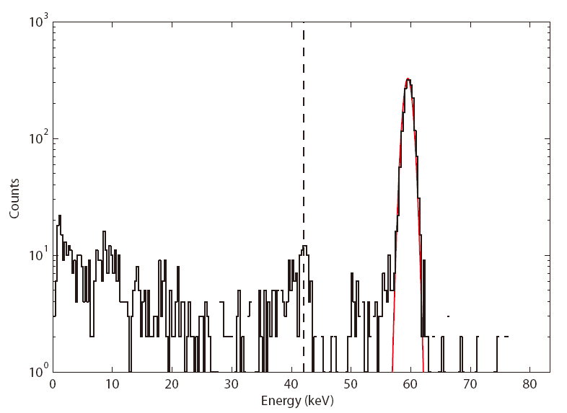
Performance of CMO+MMC
Astropart. Phys.34, 732, 2011
5.5 MeV alpha
FWHM = 11.2 keV
high energy resolution
suitable to search for Mo-100 0νββ
Emission line of Mo : 18keV
42 keV
60keV gamma
FWHM = 1.7 keV
low energy thresold
suitable to search for WIMP

Slide 15
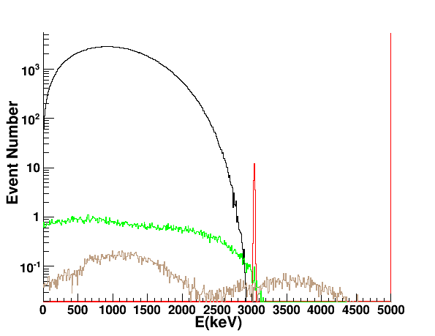
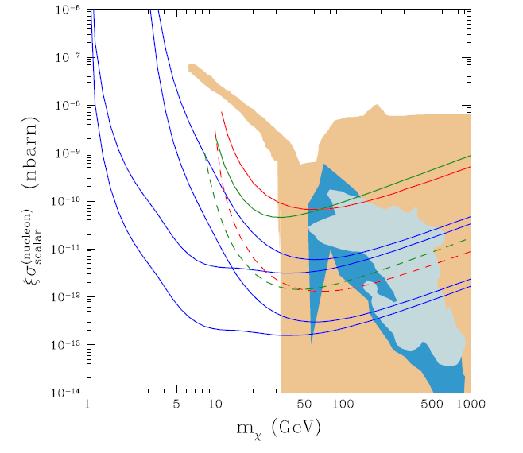
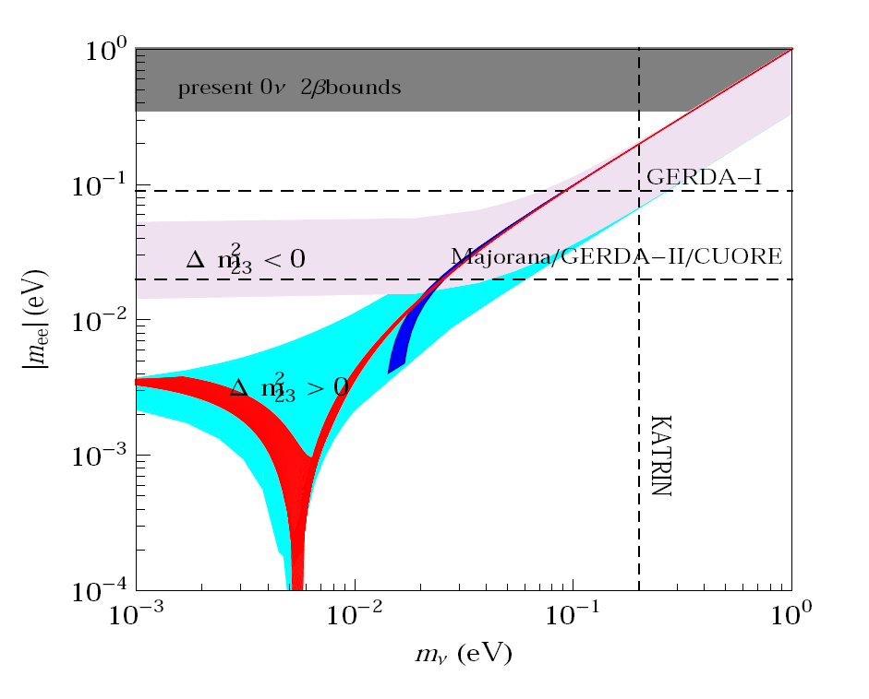
Cryogenic CaMoO4 Sensitivity
0.5% FWHM →15 keV FWHM for low temp.
5 years, 100 kg ⁴⁰Ca¹⁰⁰MoO₄ : T_{1/2} = 3.0x10²⁶ years → <m> = 20 – 70 meV
Dark matter search
→ High sensitivity
CaMoO4
E_{th}=10 keV (5 and 100 kg year)
Hirsch et al, PLB679:454-459,2009
Fully covers
inverted hierarchy
XENON100 6000 kgd
CaMoO4
E_{th}=1 keV
(5 and 100 kg year)
SuperCDMS 25kg

Slide 16
From V. Kornoukhov

Slide 17
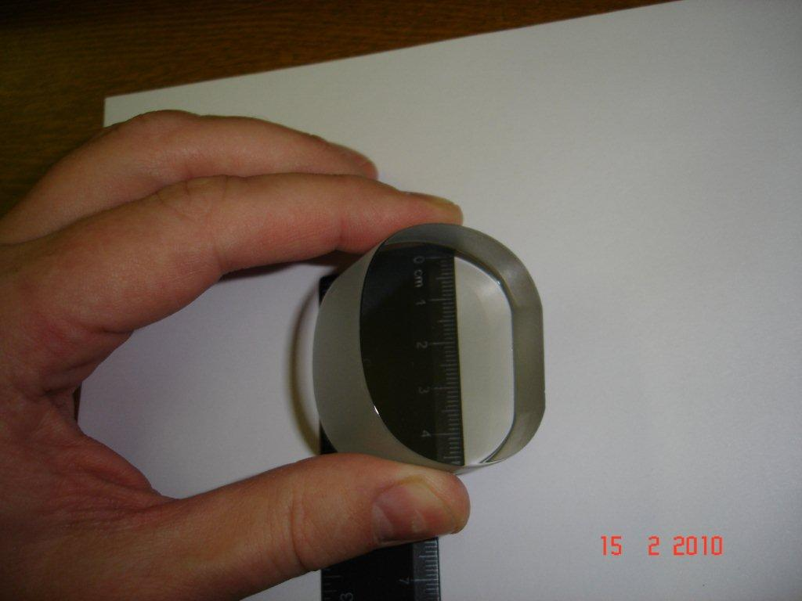
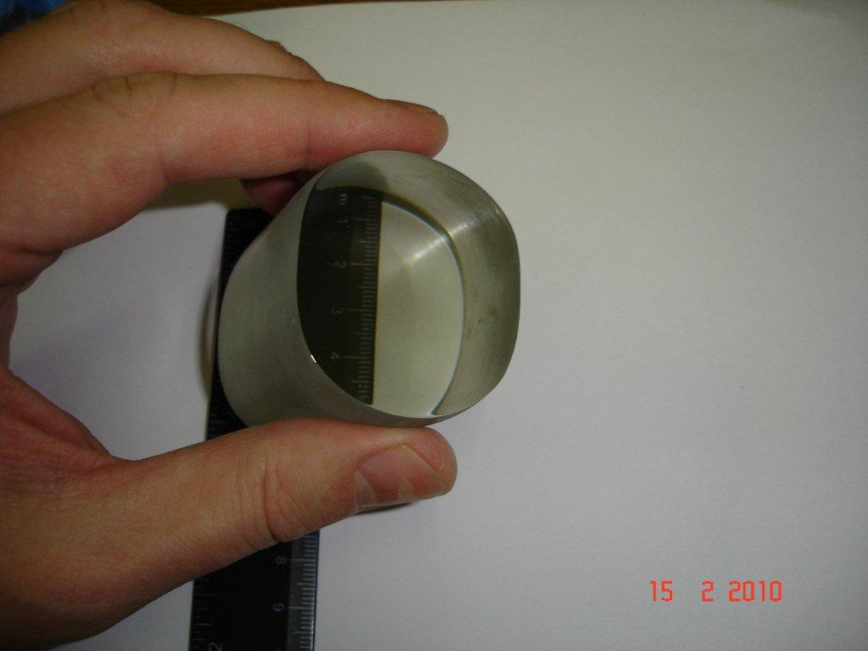
⁴⁰Ca¹⁰⁰MoO₄
1) SB28 40Ca100MoO4 crystal.
It was grown 09.09.2009.
H = 25,5 mm,
Dmax = 49,5 mm
Dmin = 40,5 mm
Mass = 195,94 gr.
Annealing procedure into oxygen atmosphere = 312 hours.
Colourless. There is weak blueness along small diameter of the ellipse.
The end face of the crystal was polished to optical grade quality.
Note. To accelerate annealing procedure, the cylinder side of the crystal was grinded with the sand paper 600/800 grade.
2) SB29 40Ca100MoO4 crystal.
It was grown 11.09.2009.
H = 48/51 mm,
Dmax = 50,0 mm
Dmin = 42,5 mm
Mass = 390,35 gr.
Annealing procedure into oxygen atmosphere = 240 hours.
Colourless. There is weak blueness along small diameter of the ellipse.
The end face of the crystal was polished to optical grade quality.
Note. No grinding of the cylinder side of the crystal was done.

Slide 18
⁴⁰Ca¹⁰⁰MoO₄
S35
SB28
CMO-3
D44 mm x L51 mm
~ 300g

Slide 19
Light output of SB35
SB28
Resolution : 30% (FWHM)
Mean : 2.88 x 10⁵
SB35
Resolution : 16% (FWHM)
Mean : 5.97 x 10⁵
CMO_3
Resolution : 16% (FWHM)
Mean : 6.79 x 10⁵

Slide 20
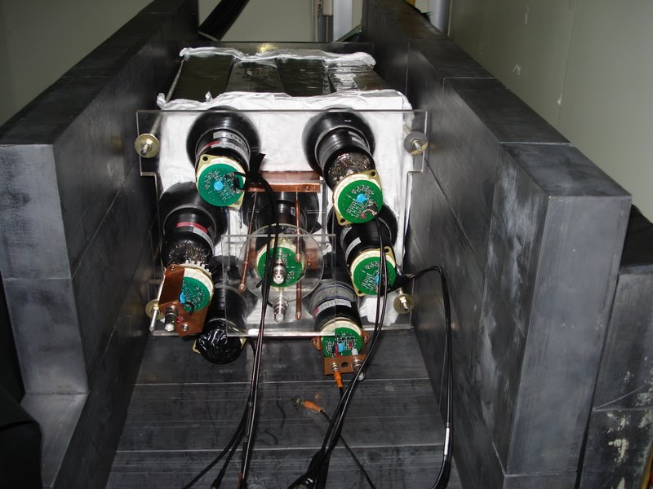
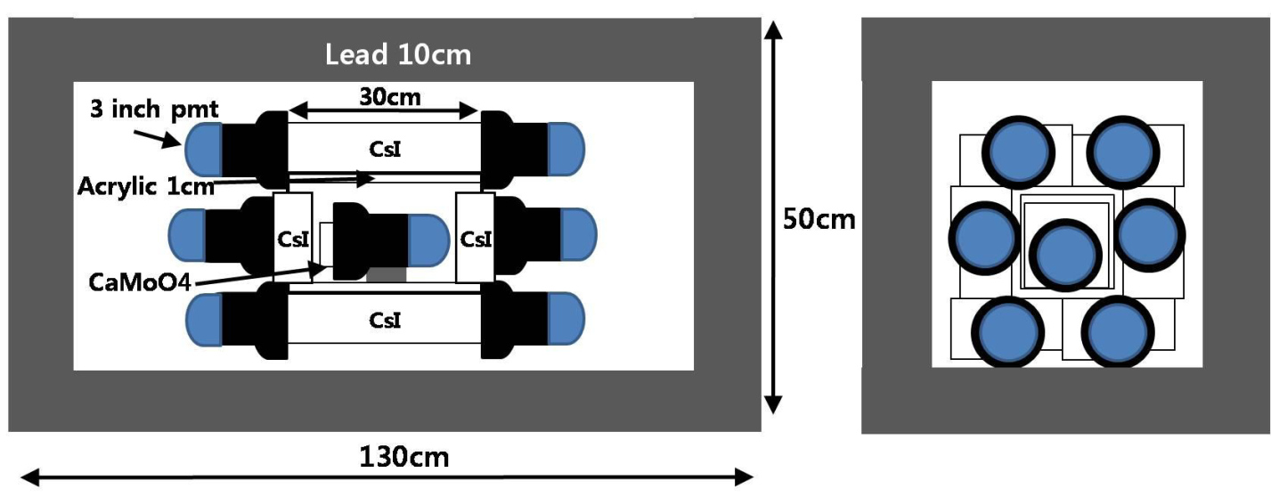
Experimental setup at Y2L
PMTs & CsI crystals are crossly connected.
Lead shielding(10 cm)
CsI detectors surround the CaMoO4 crystal
511keV signal is a opposite direction for momentum conservation.
(back to back cut)
CaMoO4 is surrounded by 14 CsI crystals & 14 PMTs.
Add more PMTs soon
CsI CaMoO4
6.5x5.5x30cm(12) - 2.2x2.2x6cm (2)
9x9x6cm(#13 & #14) - 255g

Slide 21
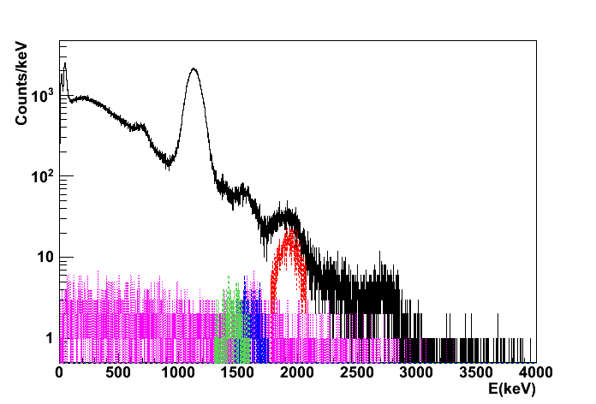
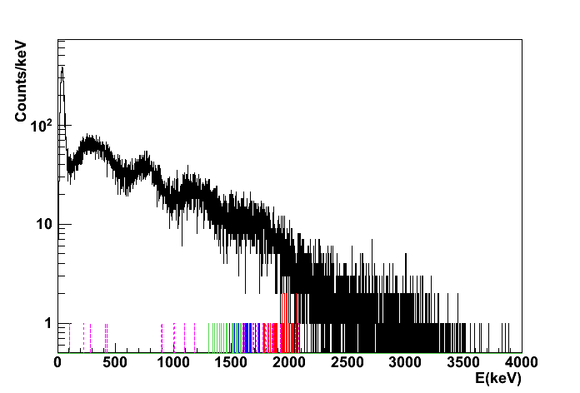
1st stage experiment (pilot experiment)
0.5-5kg CMO crystal
Scintillation only
→ J.H.So

Slide 22
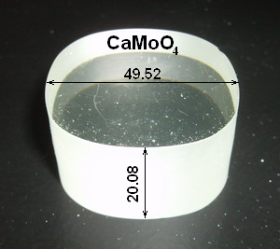
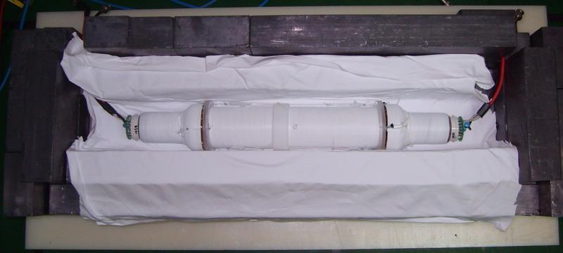
Detector installation - Ruslan
Mineral Oil
Teflon wrapping

Slide 23
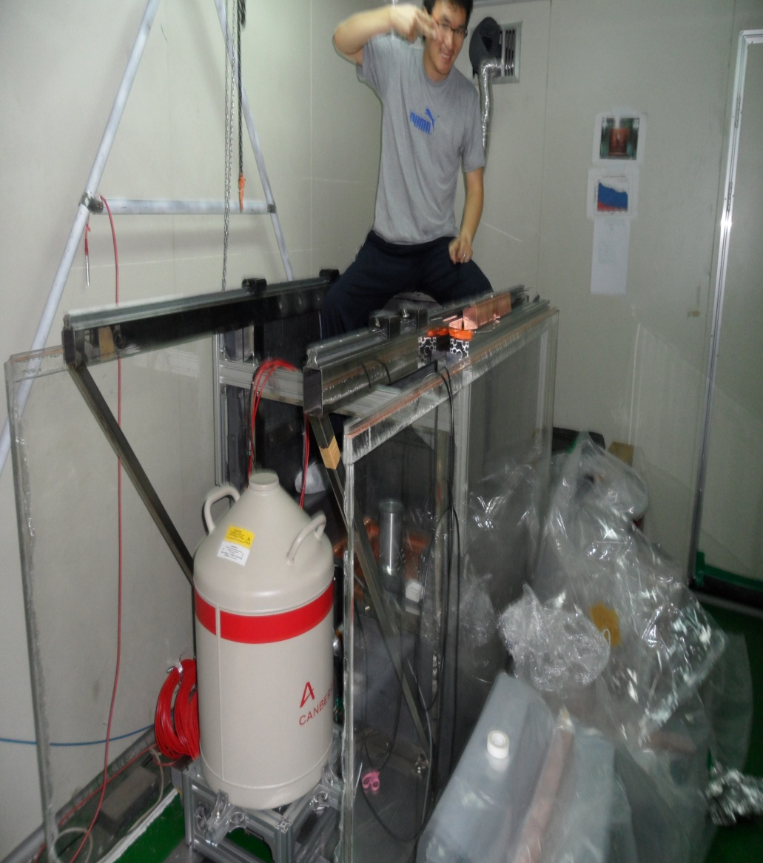
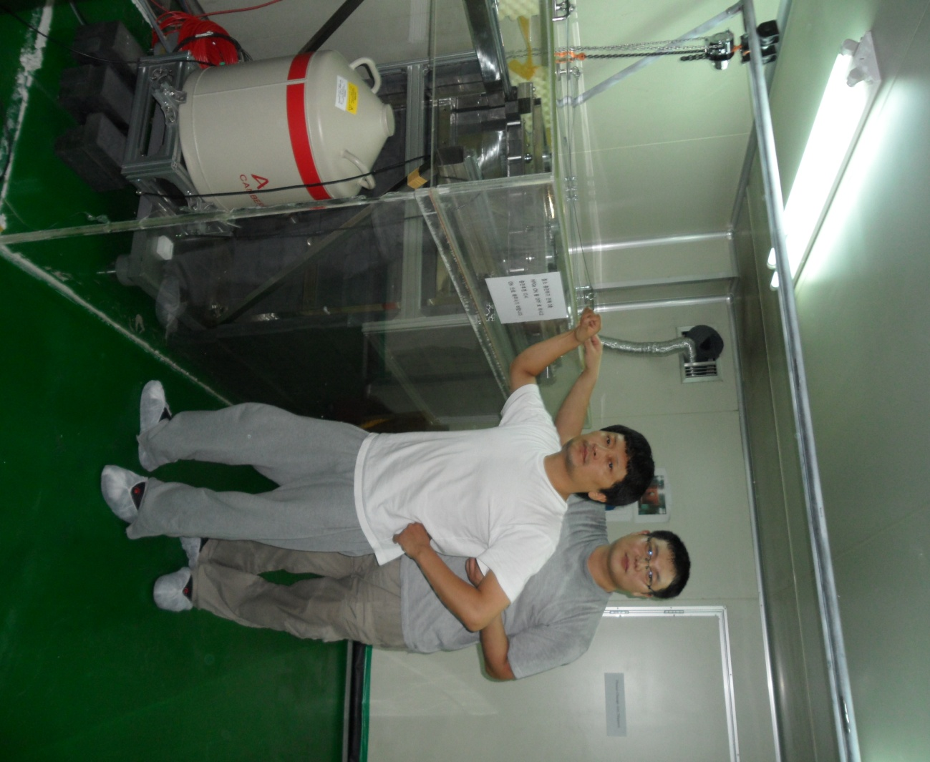
CANBERRA HPGe
Auto-filling system installed
Lower background level than the previous one
Mo-92 EC beta+ experiment will be done
Background control of AMoRE material selection
→ YDKim’s talk
Notes:
Three days ago, We was replace a ortec hpge with new canberra detector.
So, This is picture for new canberra detector
The left picture is before assembly and The right picture is after assembly

Slide 24
1st stage experiment (up to ~5 kg ?)
-- should be carried out within the currently available budget.
Intermediate step could be
5kg Cryogenic detector
(maybe possible w/o additional funding)
100 kg Cryogenic detector ← We should aim for it
will need new budget
funding opportunity exists!
→ Design of the experiment should be done

Slide 25
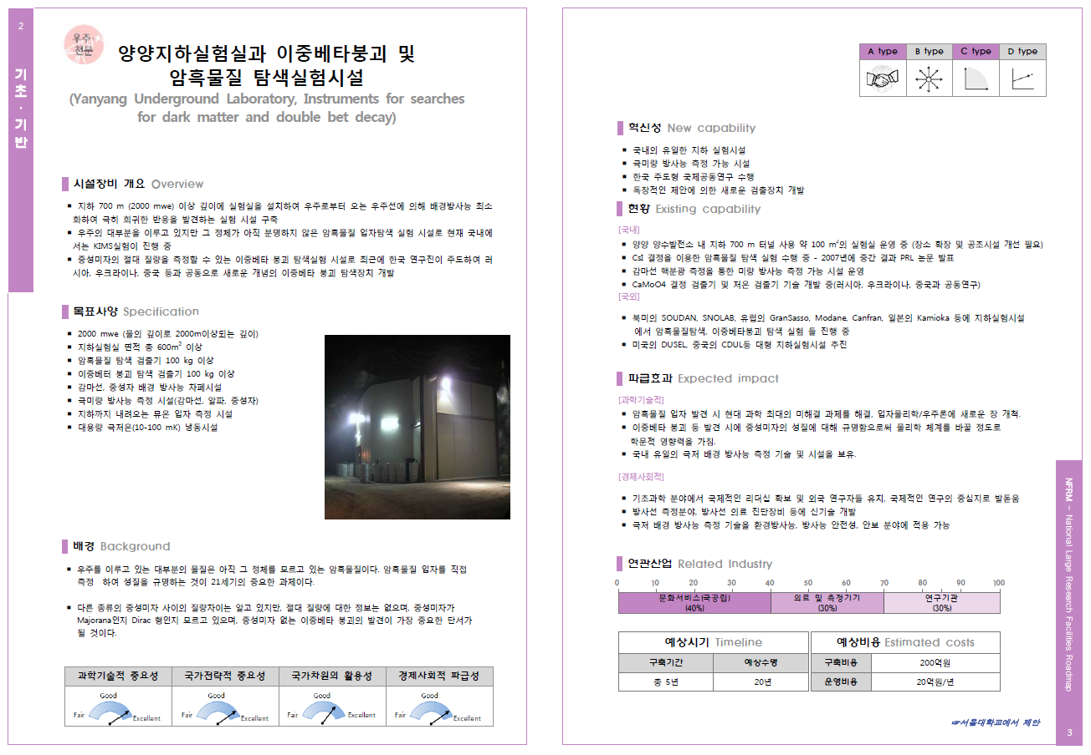
National Facility Road Map (NFRM)
Included in a list of 71 out of 282 proposals

Slide 26
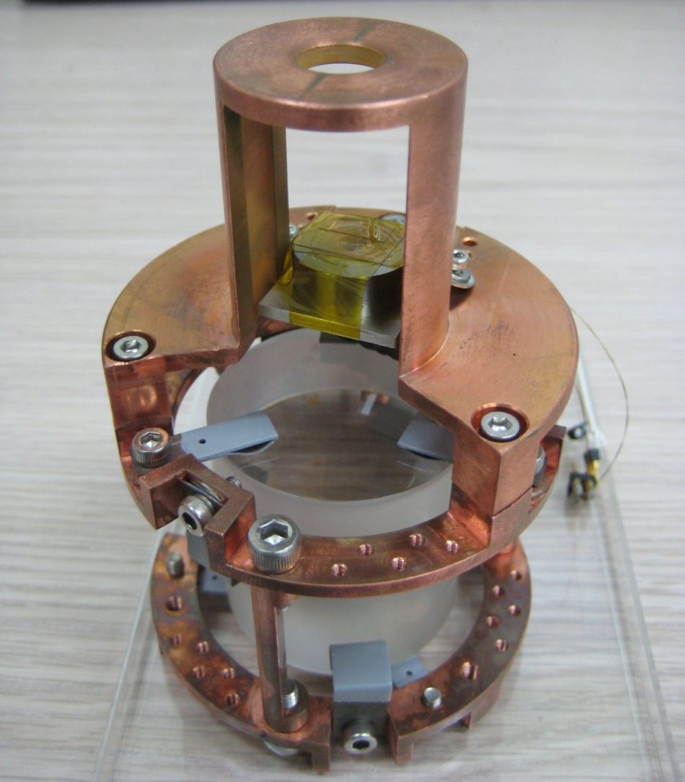
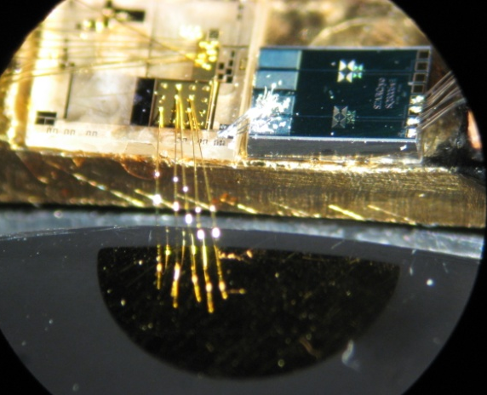
Toward 100 kg Cryogenic detector
²⁴¹Am source
meander MMC
thermalization pad
(gold film)
teflon-coated
copper springs
4cm (D) x 4cm (L) ~ 211g
Issues :
Energy resolution improvement
module size
photon detector
readout channels → multiplexing ?
cryostat, shielding

Slide 27
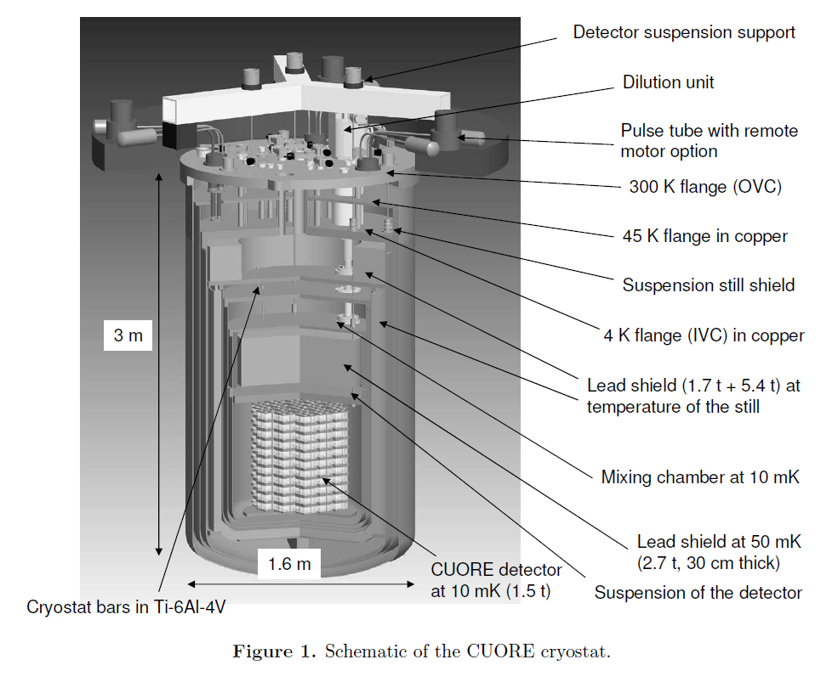
Cryostat
CUORE
90 cm d x 100 cm h
TeO2 +
Ge NTD sensor
10 mK
2700 wires
shield 30 cm Pb
cryogen-free
cooling power
1.5mW at 120 mK
6 μW at 10 mK

Slide 28
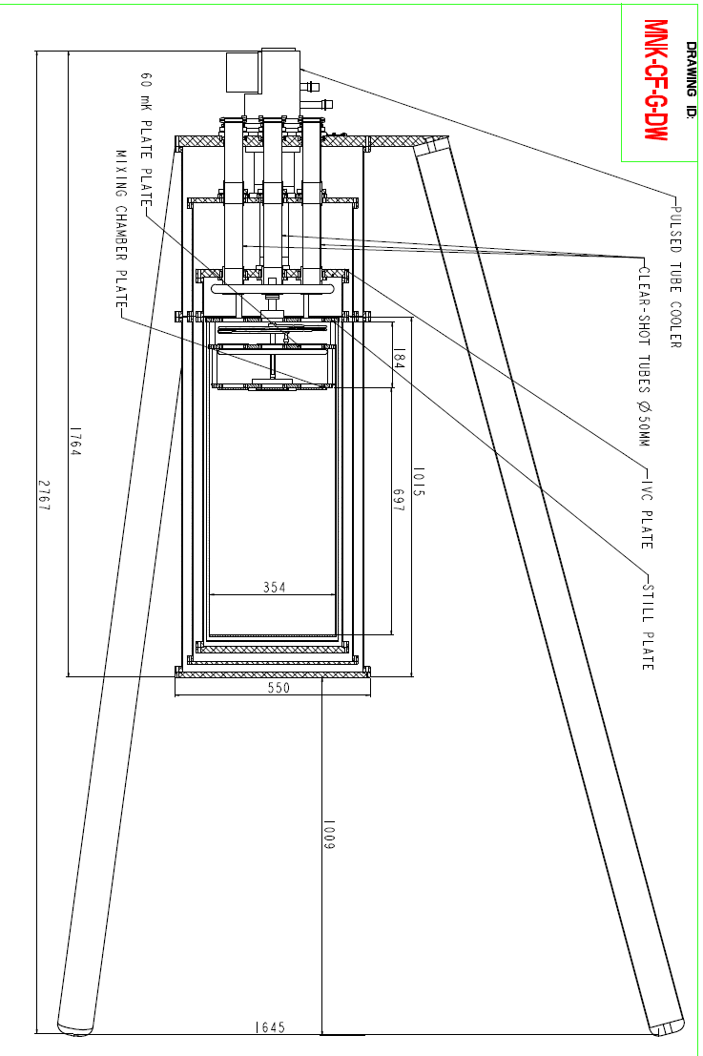
Cryostat
First guess :
100 kg CaMoO4
density : 4.2g/cm3
30cm d x 33cm h ~ 100 kg
Cooling power : 650 ㎼ at 120mK

Slide 29
Report by Li Jin, Aug. 2011

Slide 30
Report by Li Jin, Aug. 2011
Inner lead shield

Slide 31
Report by Li Jin, Aug. 2011

Slide 32
Goal of the workshop
Review of the current status
Identify the issues for the crystal growing/ purification of materials
Identify the issues for the 1st stage experiment
Decide whether we have 2nd stage : cryogenic detector w/ about 5kg mass CMO
Identify the issues for the 100 kg detector design
List of tasks
…
Discussions on
Job sharing
Collaboration issue ?
Steering committee → Institutional board ?
…

Slide 33
