Slide 1
Discussion & Summary
Sun Kee Kim
Seoul National University
2nd AMoRE Workshop, Kiev, Oct. 27-28, 2011

Slide 2
Goal of the workshop
Review of the current status
Identify the issues for the crystal growing/ purification of materials
Identify the issues for the 1st stage experiment
Decide whether we have 2nd stage : cryogenic detector w/ about 5kg mass CMO
Identify the issues for the 100 kg detector design
List of tasks
…
Discussions on
Job sharing
Collaboration issue ?
Steering committee → Institutional board ?
…

Slide 3
Issues on Crystal growing
Specification on crystals
Background index
Transparency
Light yield
Size & shape
Quick feedback mechanism needed ?
Specification for ISTC project exists
Good time to update the specification
→
Some known but not understood issues
Recrystallization reduces background, but degrade the light yield?
Background reduction factor ?
Can we use natural materials for this study?
How to improve the current enriched crystals?
Enriched crystals at Y2L ~ 850 g
The rest at FOMOS → we need to decide what to do
Special issue is on recovery of enriched material from the waste
Loss of material/effort/cost/etc on the waste recovery should be understood
1) How many recrystallization processes can be done (seems to be even one is questionable because evaporation of Mo and broken stoichiometry);
2) One should check ZrO2 ceramics (as possible very radioactive)
3) Is it possible to replace (seems to possible, but need an R&D to choose crystal growth conditions because different thermo properties of ZrO2 and e.g. alumina);
4) What is segregation coefficient for Th (which the most dangerous for AMoRE)? I expect 0.3 from our study of CaWO4 [NIMA 631 (2011) 44];
5) Protocol to obtain a certain level of purity in powder is strongly requested; 6) recovery of 48Ca and 100Mo obviously is needed. We could propose our experience (Dr. Roman Boiko) to develop such a technique. Questions by Fedor Danevich➔ look the F.Danevich’s talk

Slide 4
ISTC3293 (2006.3-2007.5)
Expected results:
- Requests on optimum geometry, light output and transparency of СаМоО₄ crystals, and also tolerable content of dangerous radionuclides in crystals to get a sensitivity of the experiment of 10²⁵ years.
- Technology of big volume СаМоО₄ crystal growing of high quality (with diameter up to 45 mm and length of up 240 mm). Light output of the crystals under room temperature≥ 2500 photons/MeV; scintillation kinetics up to 0.1 ms in the range of temperature of 77-293K.
- Radiopurity of the crystals grown of raw material of high purity (using specially developed technology of purification) should be satisfied of request of the double beta decay experiment at YangYang laboratory in Korea, namely ≤ 20 μBq/kg of ²¹⁴Bi and ²⁰⁸Tl (²³⁸U and ²³²Th series).

Slide 5
Issues on Cryogenic 100 kg detector
R&D issues
Improvement of energy resolution for large crystal
Photon detector development
Thermal modeling
Position information ?
Pulse shape information ?
Experiment design
Crystal geometry:
size and shape
Photon detection scheme
Packing
cables
Sielding and Cryostat
Space
→
Need an organized effort

Slide 6
How about…
Workgroups
Role : identify issues and make a list of works
Material purification and Crystal
1st stage experiment
Cryogenic detector
Simulation

Slide 7
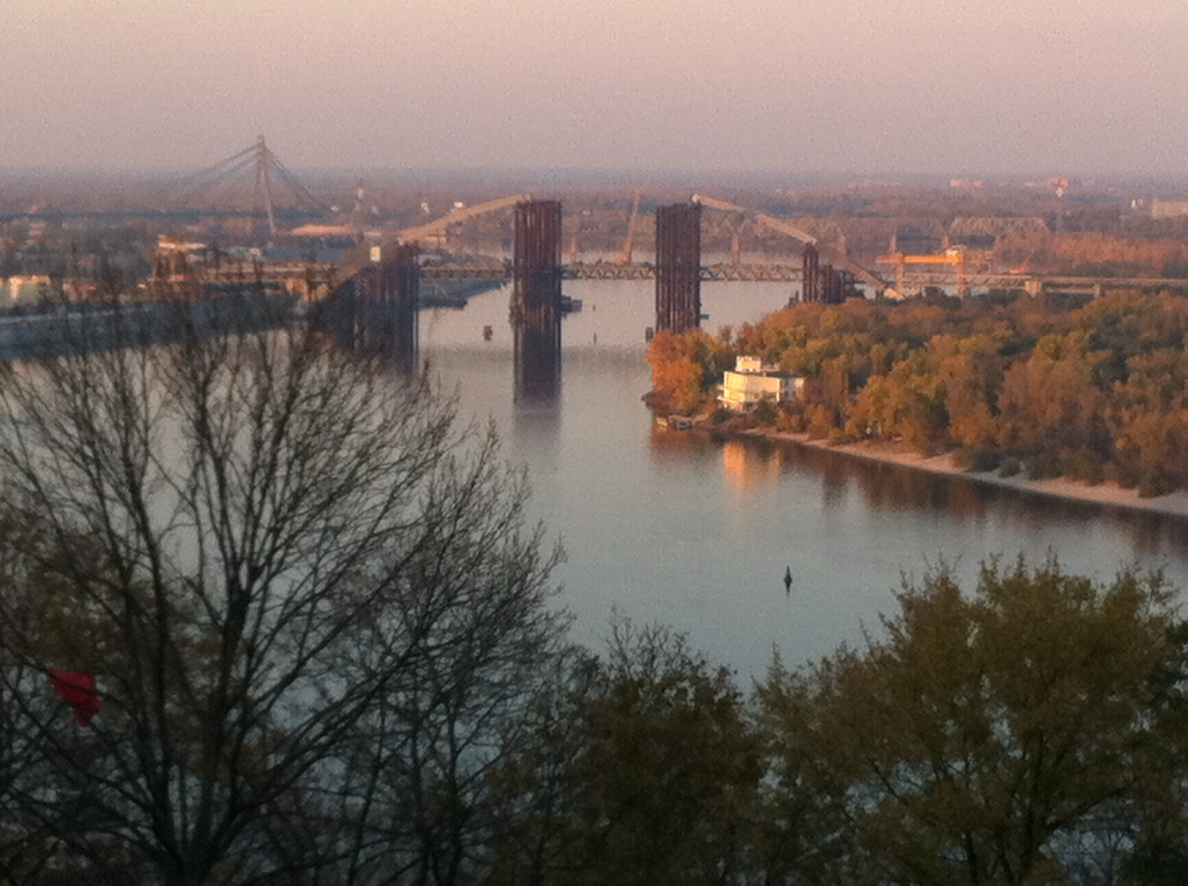
Next AMoRE Collaboration meeting ?

