Slide 1
Cryogenic detector development with CaMoO₄ crystal
3rd AMoRE Workshop
Sang-jun Lee*
*Seoul National University, Korea Research Institute of Standards and Science

Slide 2
Outline
Measurement with 2g crystal
Measurement with 200g crystal
  before/after lead shielding
  with/without external source
Prospects

Slide 3
Decay half-life
3
ε : efficiency, α : enrichment, M : mass,
t : time of measurement,
B : background,
FWHM : energy resolution

Slide 4
Choice of detector
4
ε : efficiency, α : enrichment, M : mass,
t : time of measurement,
B : background,
FWHM : energy resolution

Slide 5
Basic idea: Calorimetric detection
X-ray, e⁻,
WIMP, etc.
Thermometer
Choice of thermometers
  MMC (metallic magnetic calorimeter )
  TES (Transition Edge Sensor)
  Thermistors (doped Ge, Si)
  STJ, KID etc.
Absorber
Thermal link
Heat sink < 100 mK

Slide 6
Why cryogenic detectors?
High resolution
Low threshold
240g sapphire (CRESST)
  580 eV at 10 mK, 99% efficiency
Counting 1.5μm (0.8 eV) photons (NIST)
Source ≡ Detector ≡ Absorber
→ High efficiency

Slide 7
Choice of detector
7
ε : efficiency, α : enrichment, M : mass,
t : time of measurement,
B : background,
FWHM : energy resolution

Slide 8
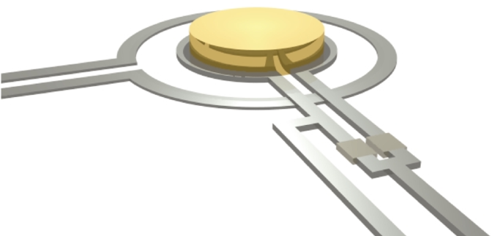
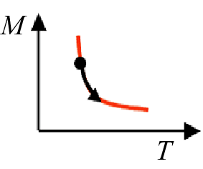
Metallic Magnetic Calorimeter (MMC)
Field coil
Magnetic material (Au:Er) in dc SQUID
junctions
Absorber
SQUID Loop
Au:Er
Si

Slide 9
CaMoO₄ crystal was originally developed for room temperature measurement with PMTs
Can be a good cryogenic absorber?

Slide 10
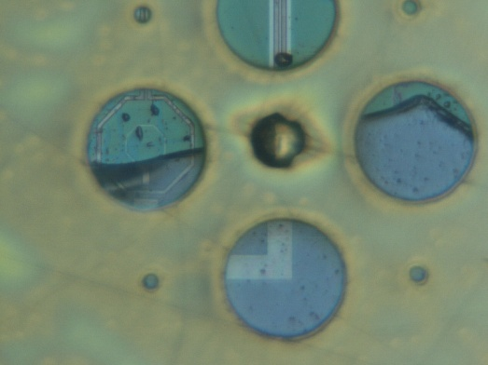
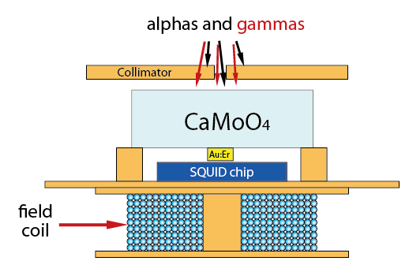
Proof-of-principle experiment with a small crystal and a hand-built sensor
²⁴¹Am
~ 500 μm thick brass
45 μm diameter
30 μm height
crystal size
~ 1 cm × 1 cm × 0.6 cm
Cu post
Astroparticle Physics 34-9: 732-737 (2011)
10

Slide 11
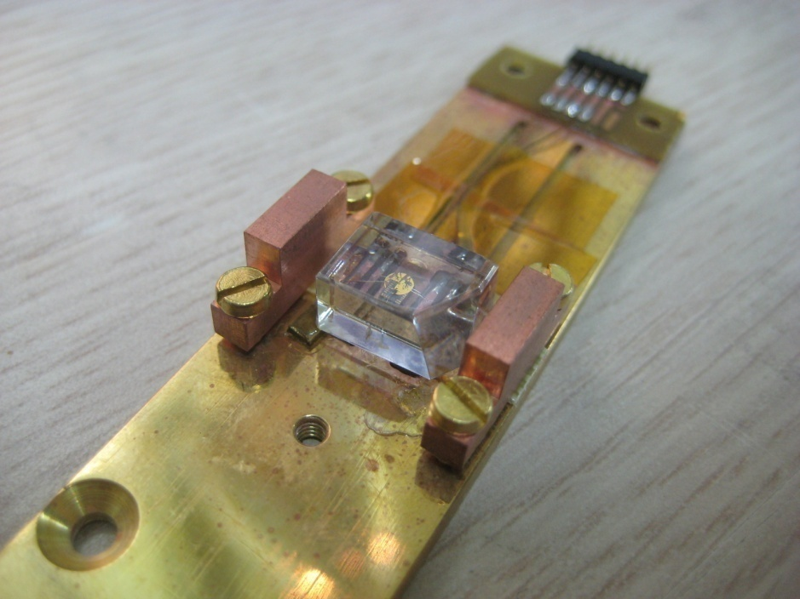
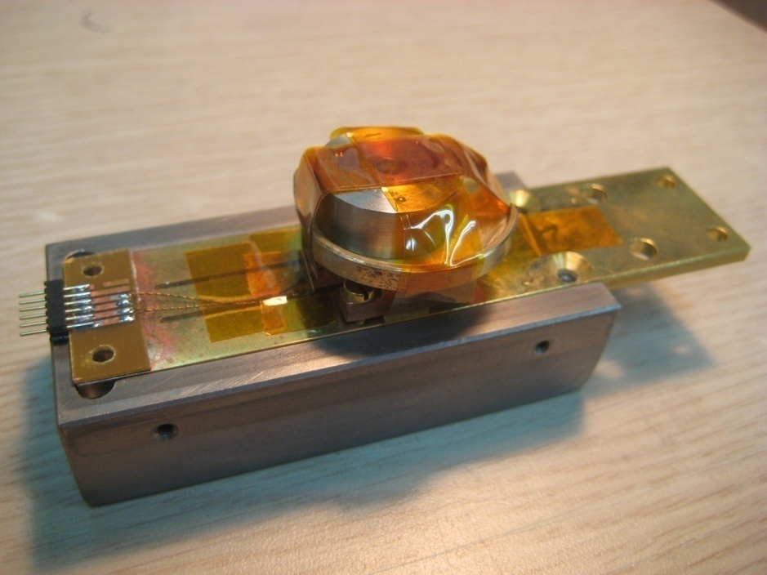
²⁴¹Am alpha-source
superconducting Nb shield
11

Slide 12
Full spectrum
12

Slide 13
Full spectrum
alpha
13

Slide 14
Alpha energy spectrum
FWHM = 11.2 keV
60 keV gamma added
14

Slide 15
Full spectrum
60 keV gamma
15

Slide 16
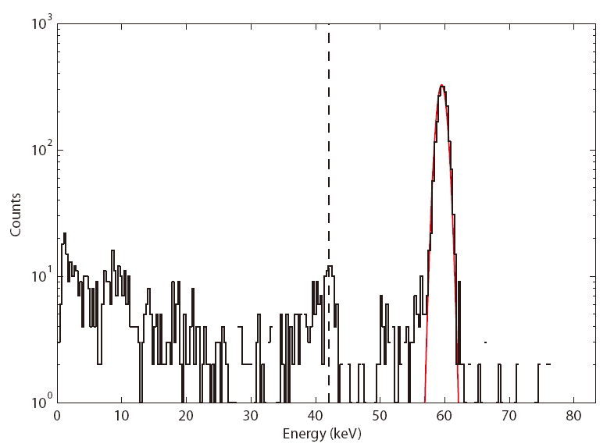
Gamma energy spectrum
Emission line of Mo : 18 keV
42 keV
FWHM = 1.7 keV
16

Slide 17

Temperature dependence

Slide 18
High energy-resolution and low energy-threshold were achieved.
  Lowering energy-threshold is important for this detector to be used for dark matter search at the same time.
Next step
  light detector or large crystal?

Slide 19
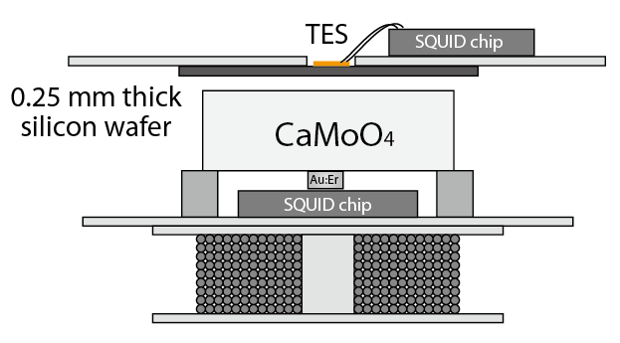
Dual channel detection
- temperature and light
Incident particles
1 cm × 1 cm

Slide 20
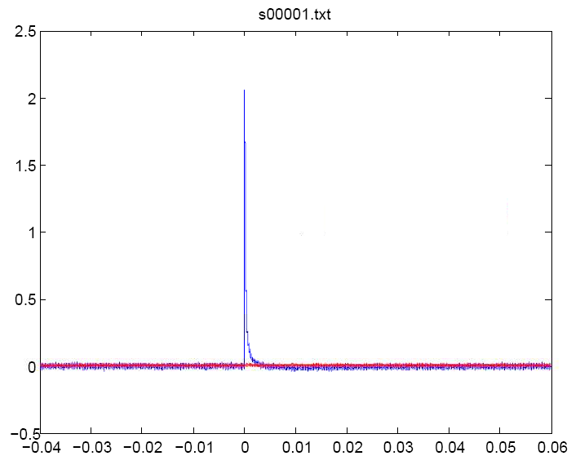
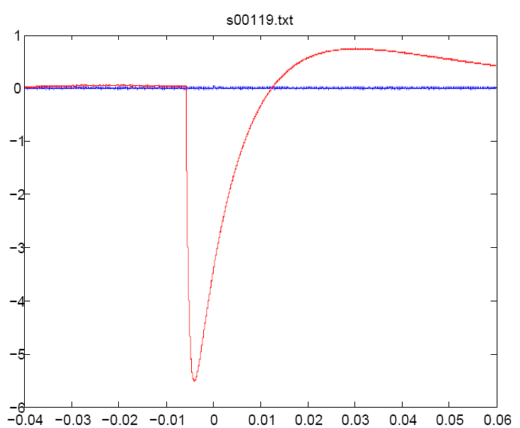
Light signal
Phonon signal
However, most of the big pulses from each detector seem to be independent.

Slide 21
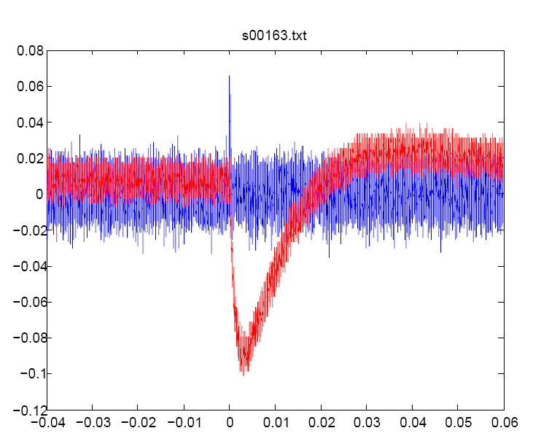
Anyway, we do have a few events happening simultaneously.
TES
MMC

Slide 22
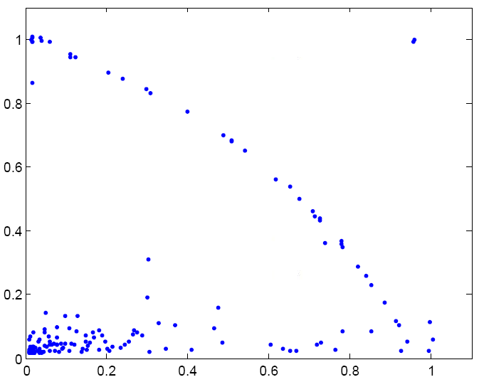
Selected coincident events
TES
MMC

Slide 23
Selected coincident events
TES
MMC

Slide 24
Possible explanation
- collimation failure
Incident alpha

Slide 25
Rough estimation of energy deposited in the light detector when a 5,500 keV alpha was absorbed in the crystal.
5,500 × 1/10 × 1/5 × 1/5 × 1/2 = 11 keV
light quenching solid reflectivity
yield factor angle

Slide 26
Light sensor not as good as the temperature sensor.
Too high transition temperature
( ~ 120 mK)
Too fast decay

Slide 27
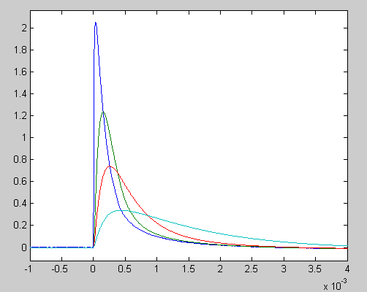
Lifetime dependence
TES signal
0.1 ms
0.3 ms
1 ms

Slide 28
Development of proto-type detector for a future massive experiment
Use large crystal for a massive detector
  Natural CMO : ∅4 cm × 4 cm (216 g)
  100 times bigger than before
Challenges
  Sensitivity (signal size as large as possible)
  Heat flow design
  Holder (simultaneously steady and flexible)

Slide 29
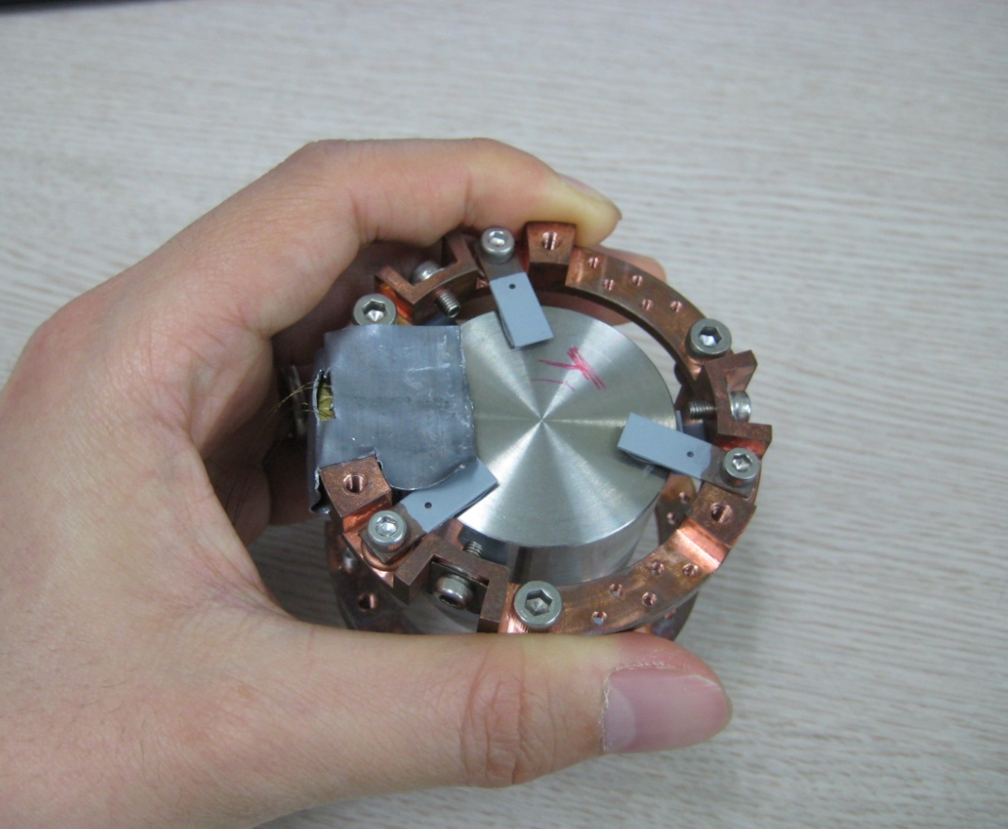
New holder to house the large crystal
Benchmarking of CRESST holder
Natural choice for cylindrical crystal
∅4 cm
teflon-coated spring
Copper

Slide 30
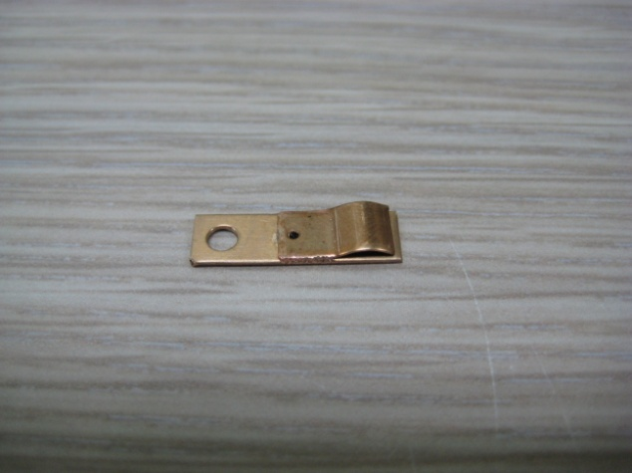
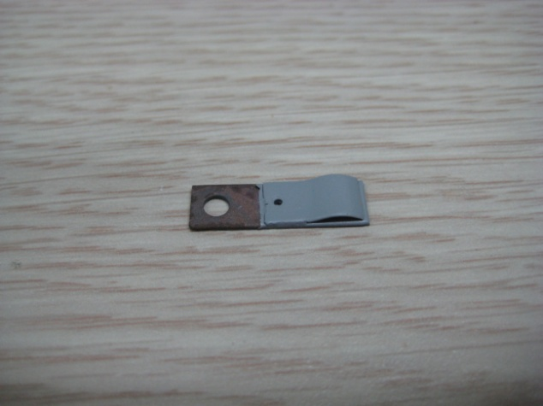
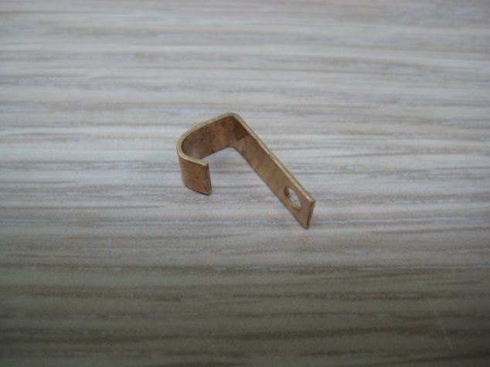
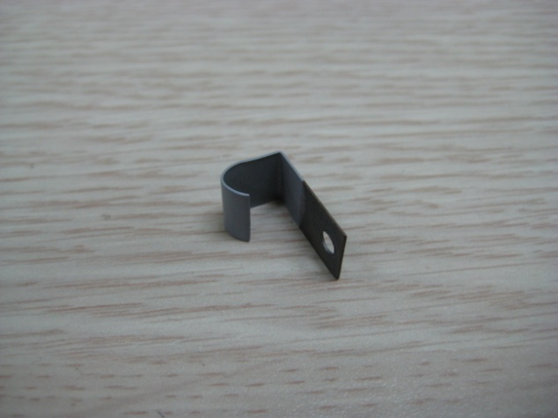
Custom-made springs
Desired flexibility
Teflon-coated

Slide 31
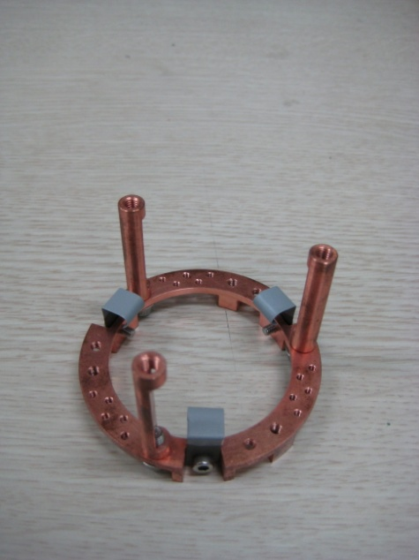
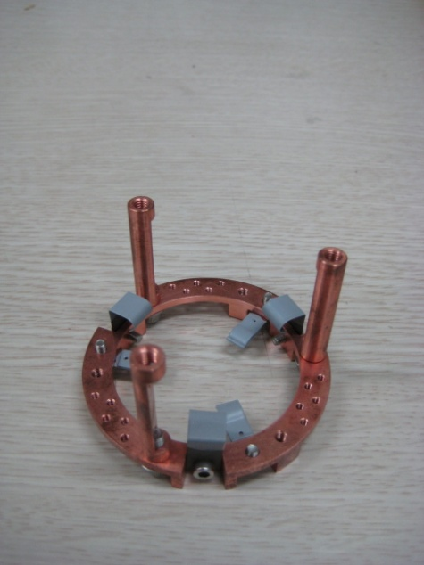
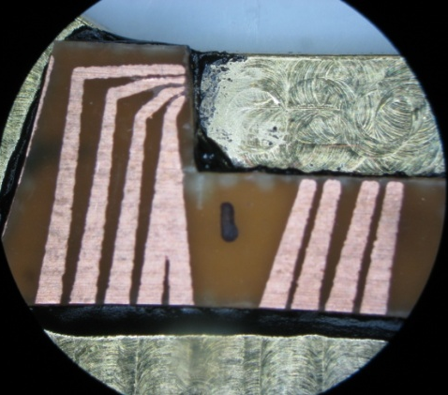
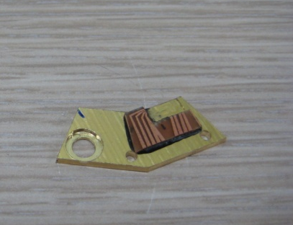
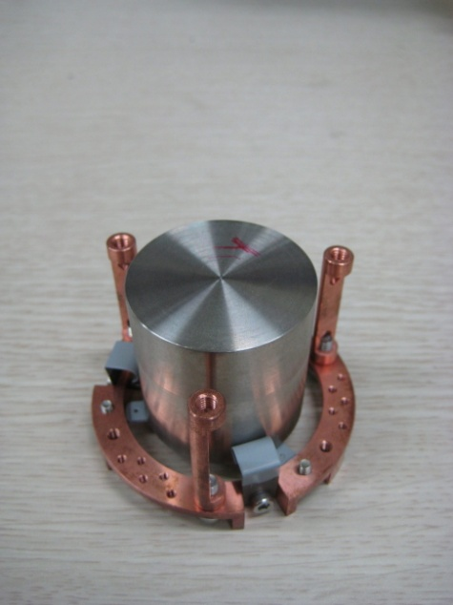
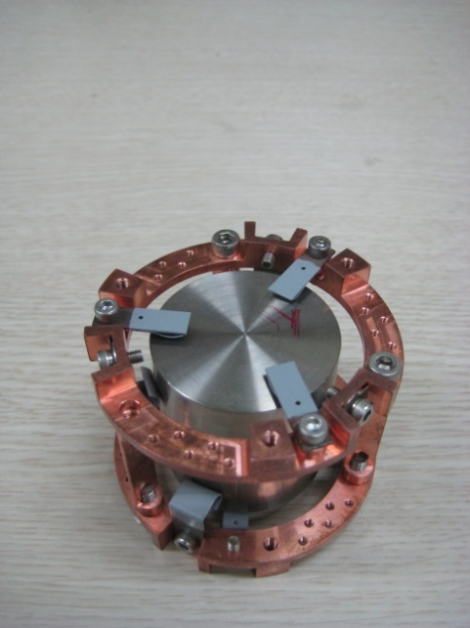
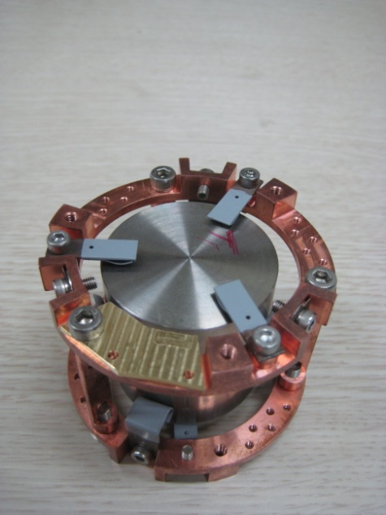
Assembly
SQUID
and
Meander

Slide 32
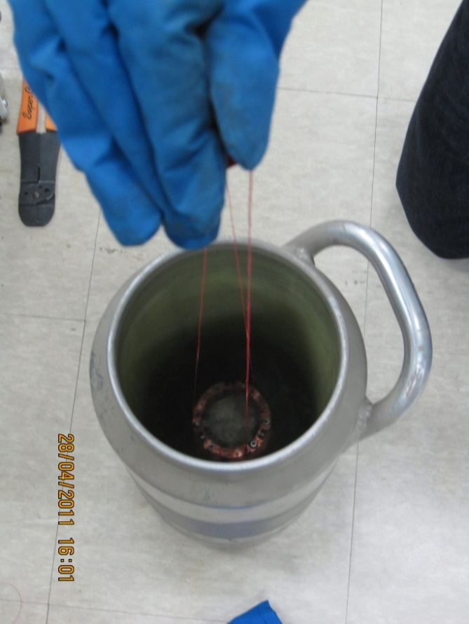
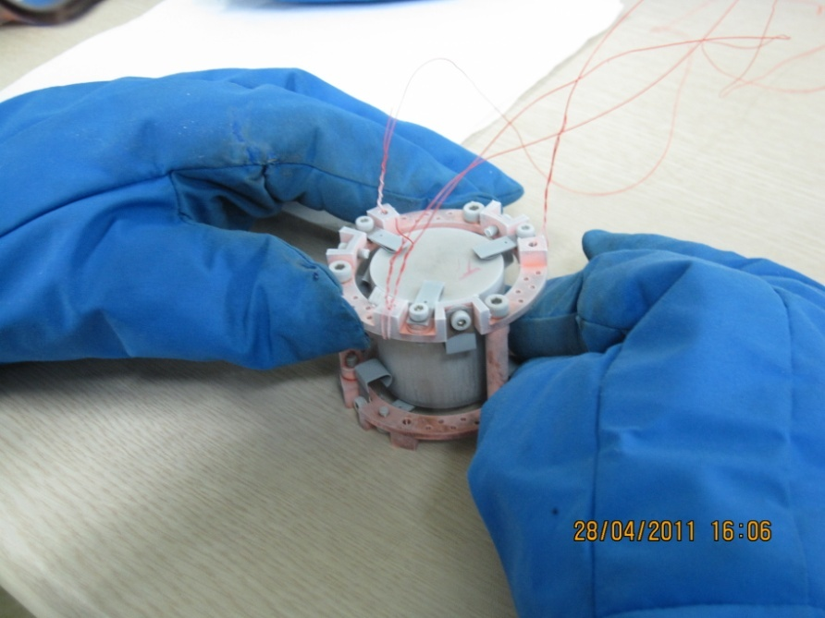
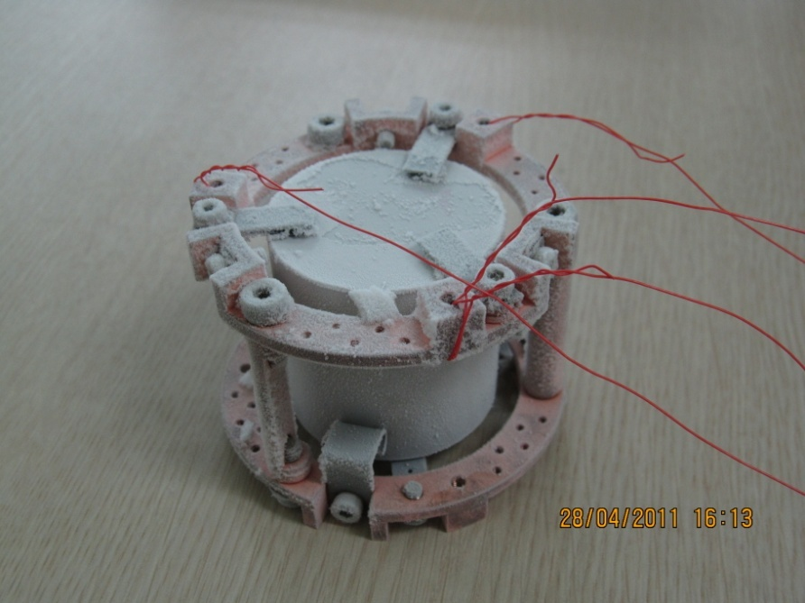
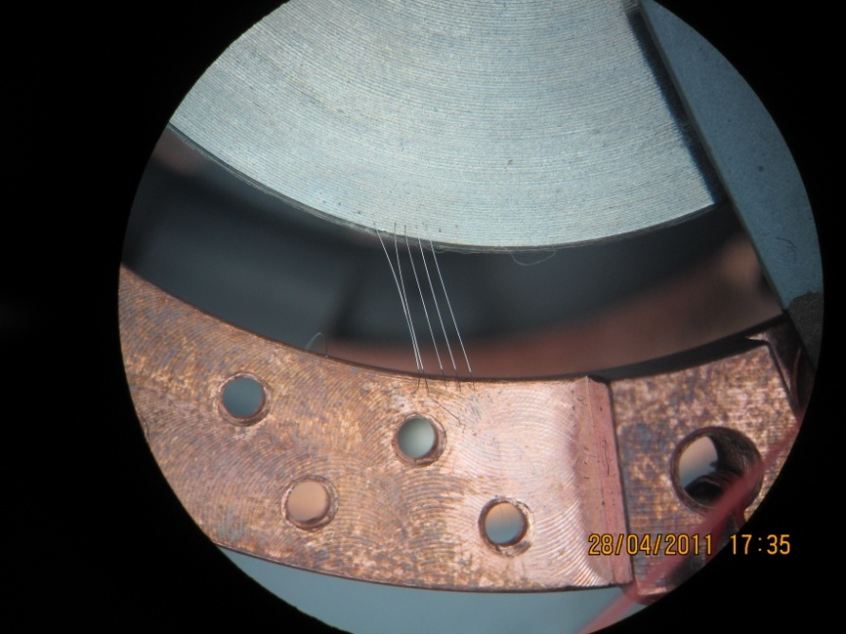
Yury’s holder in LN₂

Slide 33
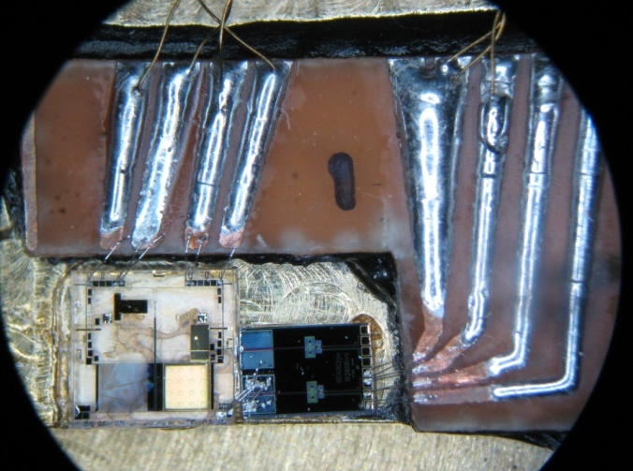
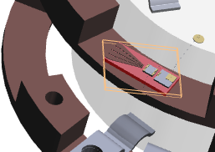
Temperature sensor holder
Fully micro-fabricated meander-type MMC from Heidelberg and SQUID
  on a separate holder for 4K test
Meander chip
(3 mm × 3 mm)
sensor material
SQUID

Slide 34
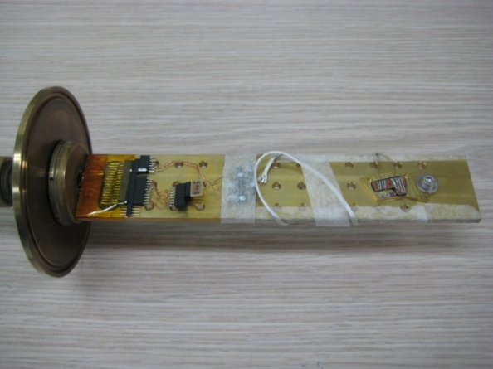
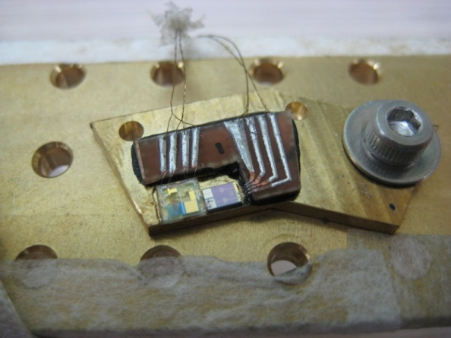
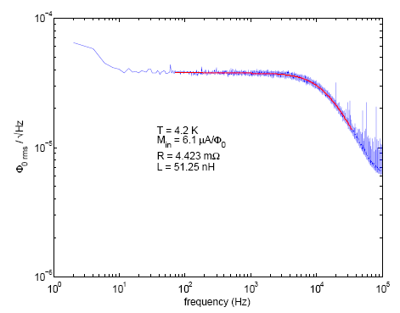
Essential check-up before going into cryostat
Meander and SQUID test at liquid helium dewar (4 K)
From the noise measurement, they seems okay.

Slide 35
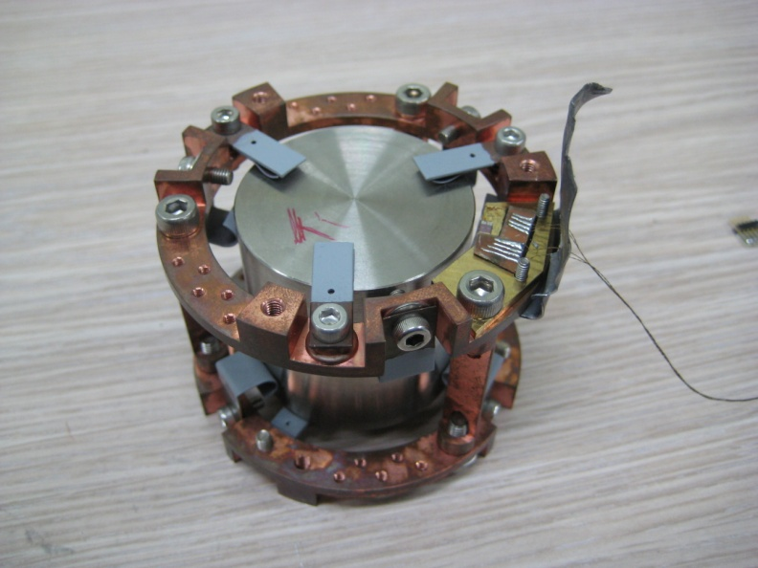
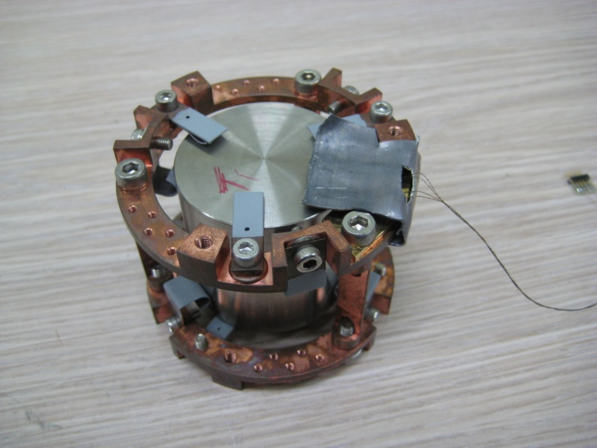
Magnetic shielding
home-made with 0.5mm thick (superconducting) lead sheet
  how efficient?

Slide 36
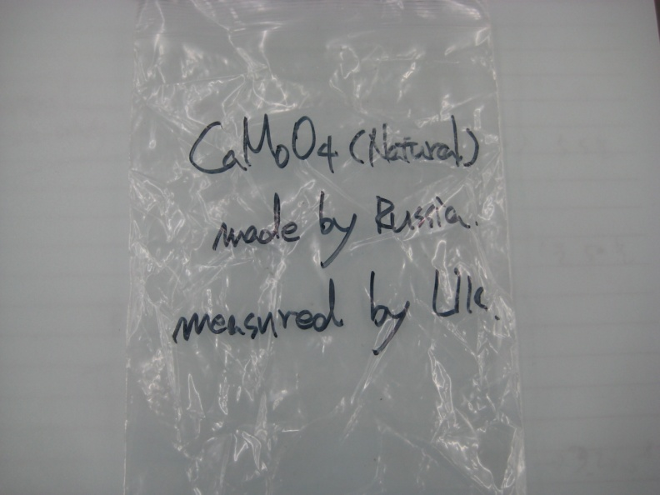
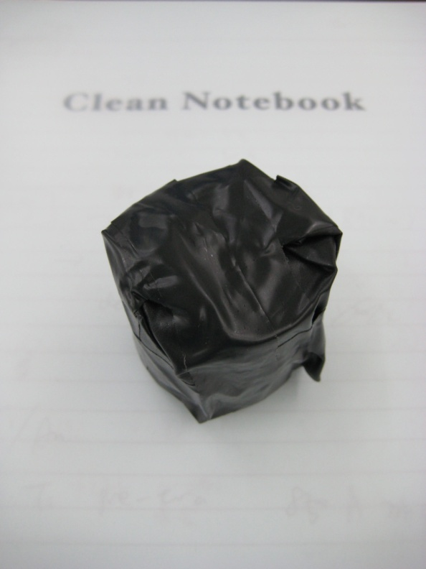
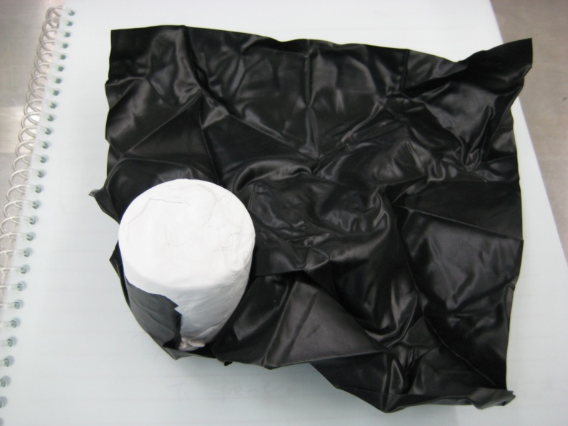
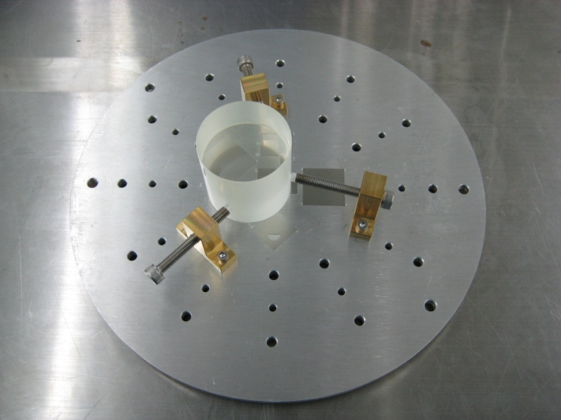
CaMoO₄ crystal

Slide 37
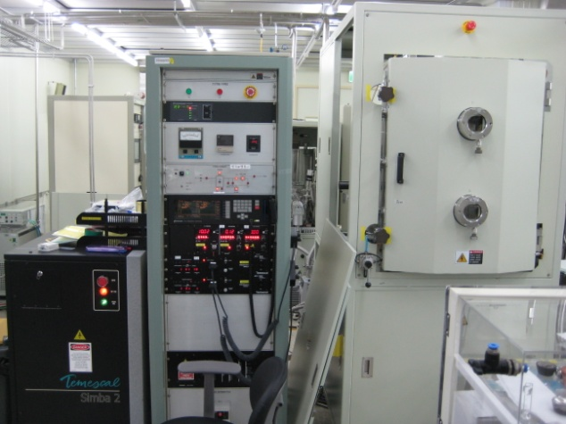
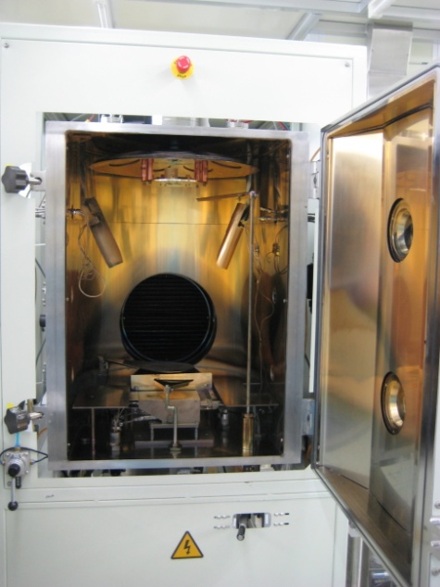
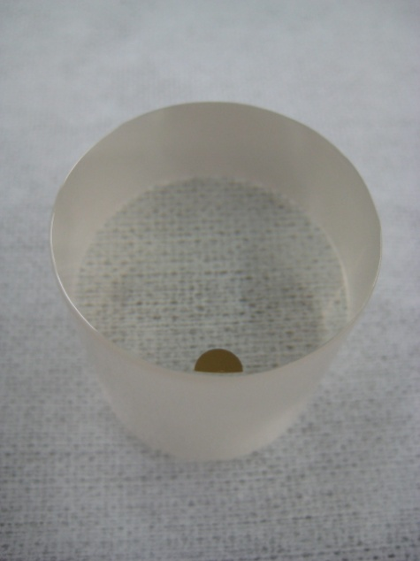
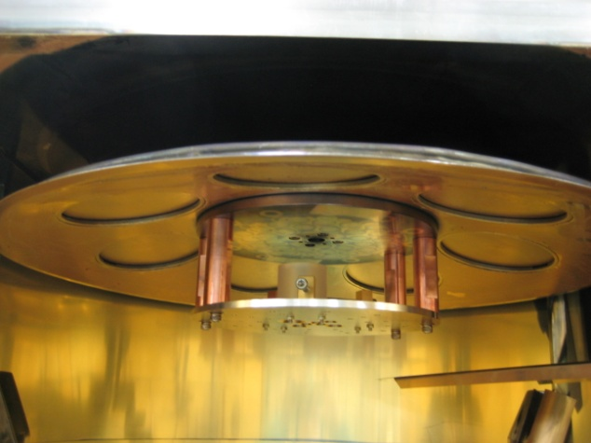
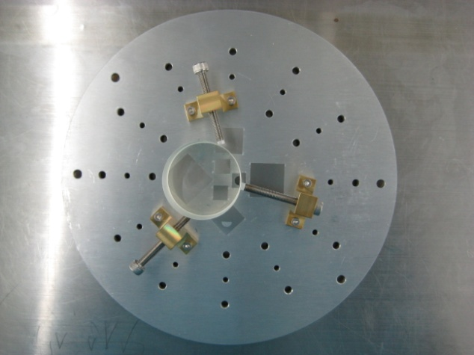
E-beam evaporation
Cleaning
  IPA → DI water → air gun blowing
Thermal contact
35/1960 Å

Slide 38
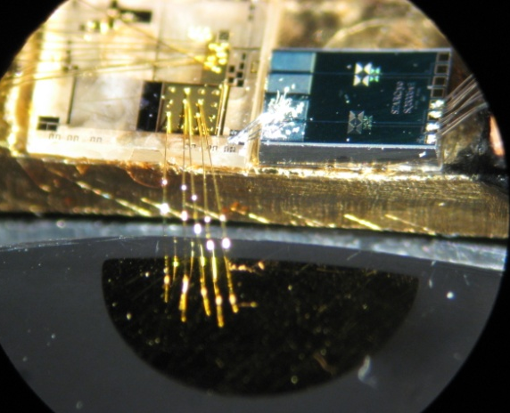
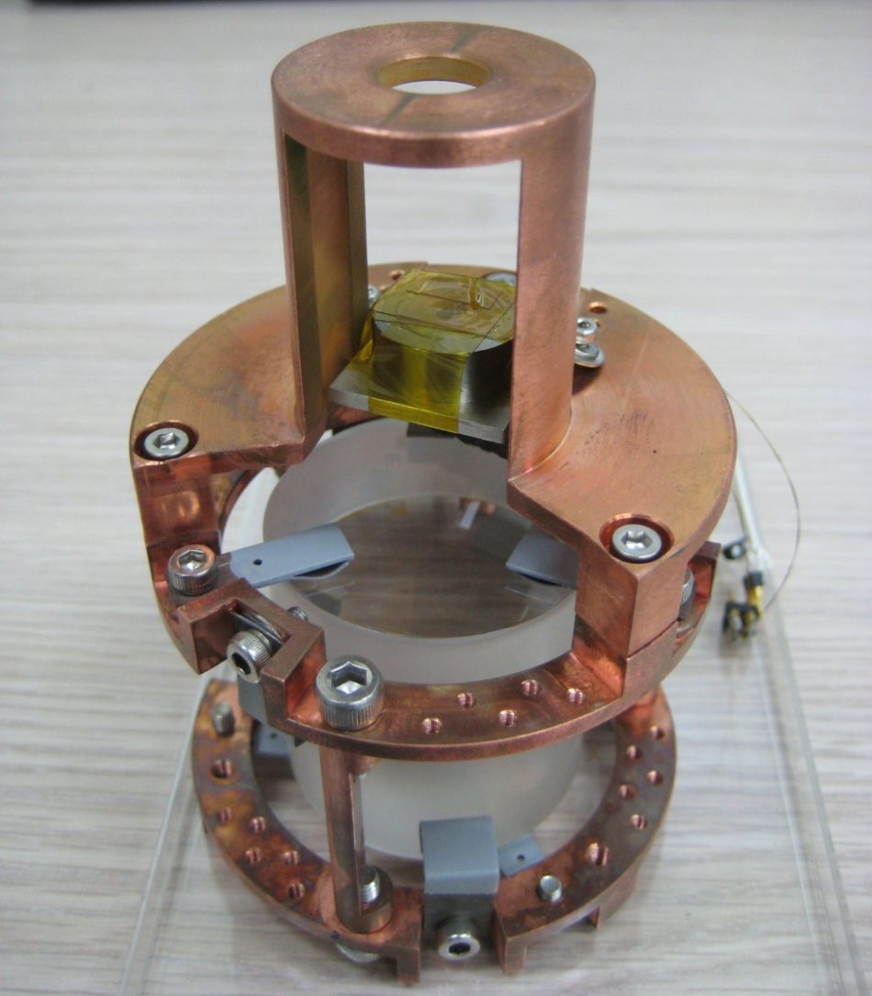
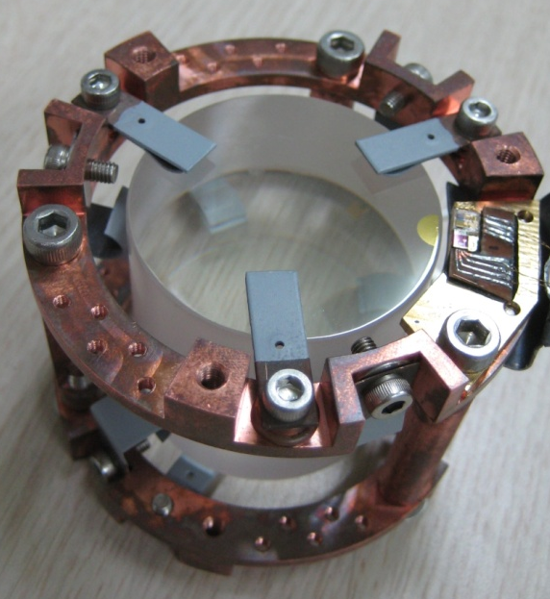
Final assembly
meander MMC
from
Heidelberg
²⁴¹Am source
thermalization pad
(gold film)
teflon-coated
copper springs

Slide 39
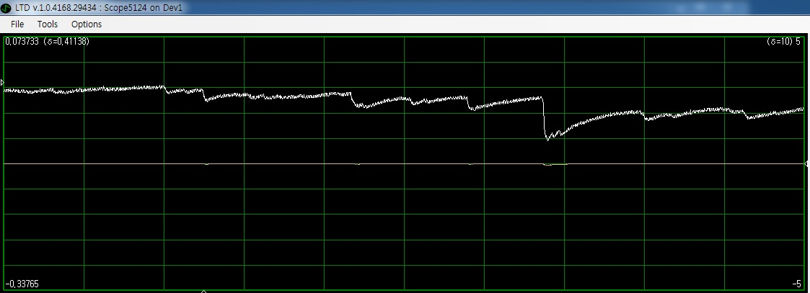
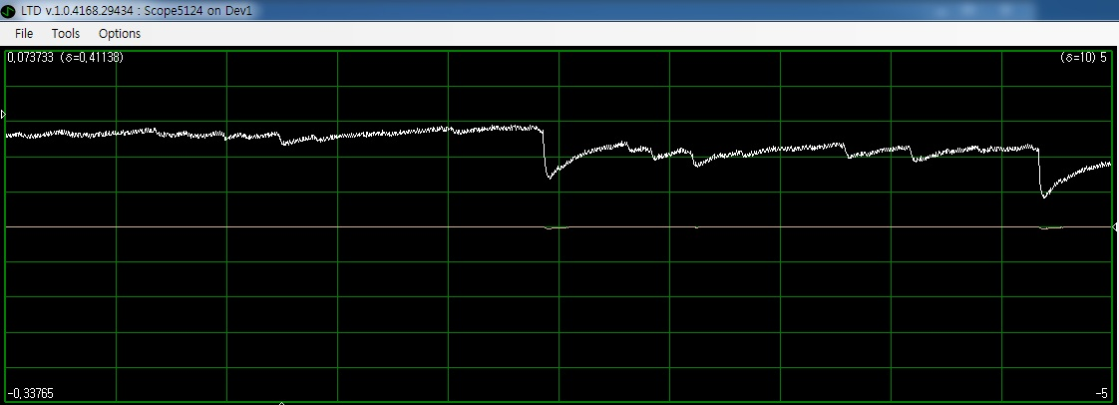
Pile-ups at 40 mK
40 mV/div
50 ms/div
pulses not
from the source
alpha pulse

Slide 40

Spectrum
linear scale log scale
?
corresponds to
yellow circle
corresponds to
red circle

Slide 41
Shield the detector!
The background is probably due to the 1460 keV gamma-rays from ⁴⁰K inside concrete wall.
Install 5cm-thick lead blocks around the cryostat (4 tons in total)

Slide 42


20 × 10 × 5 cm³ lead blocks

Slide 43




GEANT4 MC simulation
lead shielding
lead
MeV
MeV

Slide 44

Experiment after shielding
The same setup except for the external source (²⁴¹Am → ²¹⁰Po : 5304 keV alpha)
Less small signals, but still some left
at 7.6 mK
50 ms/div

Slide 45

Energy spectrum at 7.3 mK
alpha events
muon events
background events

Slide 46

1) ²¹⁰Po Alpha spectrum
unidentified yet
²¹⁰Po contribution
FWHM : 1.1%

Slide 47

Compare with ²⁴¹Am alpha spectrum
unidentified yet
²⁴¹Am contribution

Slide 48

2) Background spectrum
2615 keV
from ²⁰⁸Tl
1460 keV
from ⁴⁰K
Q of ¹⁰⁰Mo

Slide 49
3) muon spectrum
alpha events
muon events
background events

Slide 50




GEANT4 simulation with 100,000 muons
0.1 GeV
1 GeV
MeV
MeV
10 GeV
100 GeV
MeV
MeV

Slide 51

4) Baseline resolution
FWHM : 0.44%

Slide 52



5) Heater pulse spectrum
heater
Baseline resolution
FWHM : 0.54%
crystal
FWHM : 0.55%
thermalization pad
on the back side

Slide 53



Another experiment without external source
To help identify the peak at alpha region
Efforts to reduce microphonic noise was made for better energy resolution
FWHM : 0.29%

Slide 54


Results without external source
A peak still exists near the previous alpha peaks.
Event rate ~ 0.13 cps
Rather broad and asymmetric
Unidentified yet
Preliminary

Slide 55
Further experiment
Detector set-up was finished before my departure and is now cooled down waiting for me.
This time, radioactive source ²¹⁰Po is irradiating the crystal from the bottom side.
This measurement might reveal why we obtained a rather broad spectrum for alpha background from position dependency problem.

Slide 56
Indirect simulation
Using GEANT4
Non-thermal phonons’ propagation will be regarded as scintillation light produced inside crystal wrapped with reflector.

Slide 57

Small pulse as a template
FWHM : 7.2% → 3.0%
(44 keV @ 1460 keV)

Slide 58


Heat flow analysis (Geonbo)

Slide 59

Solution

Slide 60


Pulse fitting

Slide 61



Optimization

Slide 62
New design under consideration
Increase signal size
  Larger gold film area
  Cover one/both whole surface of crystal?
  Use quasi-particle trap such as aluminum film?
Decrease signal’s decay time
  Higher thermal conductivity between crystal and holder

Slide 63
Summary
Good energy resolution and low energy threshold achieved with small crystal
signal-to-noise ratio corresponding to better than 0.29% FWHM w.r.t the alpha energy achieved with large crystal
Room for improvement

Slide 64
Further steps
Analysis of signal shape (e.g. rise-time) of different particles (e.g. gamma vs alpha)
Alpha spectroscopy of the crystal at room temperature using surface barrier detector
  → clue for the origin of contamination : surface or internal?
Superconducting lead shielding
Light detector

Slide 65


Rise-time analysis

Slide 66

Future prospects

Slide 67
Thank you!
Question or Comments?

Slide 68
Back-up slides
68

Slide 69

Same data analyzed by optimal filtering

