Slide 1
⁴⁰Ca¹⁰⁰MoO₄ crystals with enriched materials for AMoRe Collaboration
V.N. Kornoukhov
for behalf of ITEP group (Moscow)
O.A.Buzanov
JSC Fomos-Materials (Moscow)
3rd AMoRE Workshop
Kiev, Ukraine
October 27-28, 2011

Slide 2
Main goal of AMoRE Collaboration
Investigation of neutrinoless double beta decay of Mo-100 isotope
Motivation:
Q_{ββ} = 3034 keV: the biggest of the DBD isotopes can be produced at tenths – hundred kg scale (by centrifuges, in Russia);

Slide 3
⁴⁰Ca¹⁰⁰MoO₄ cryogenic scintillation detector as a tool for Mo-100 DBD search
“Detector = Source”: ε ~ 90% efficiency;
High content of working isotope (Mo) in compound: 50% (stoichiometry ratio);
Good energy resolution and high light yield for scintillation mode;
High energy resolution (3÷6 keV) for phonon mode (comparable with the resolution for HPGe detectors): no 2νββ of Μο−100 background;
Scalability of the experiment (increasing of mass by break-in “crystal by crystal”);
Chochralsky technology of the production → High purity&zone refinement

Slide 4
AMoRE: cryogenic scintillation detector based on CaMoO₄ single crystal
CaMoO₄ sheelite-type self-activated scintillator
Т_{melt} = 1445 ^{о}С (Pt or Ir crucible)
Technology: Chochralsky method
Light yield (under RT):
up to 9300 photon/MeV
Kinetics of scintillation light (main component):
under RT = 16 µsec
at 6 К = 345 µsec
Transparency – 0.01 cm⁻¹ at 520 nm

Slide 5
Synthesis of CaMoO₄ raw material at NeoChem (Moscow)
There are two techniques to synthesize CaMoO₄ raw material (charge):
solid-phase synthesis of the oxides (CaO and MoO₃) mixed into stoichiometric ratio
Co-precipitation reaction

Slide 6
Synthesis of CаMoO₄ raw material at NeoChem (Moscow)
Co-precipitation reaction:
(NH4)₆Mo₇O₂₄ + 7*Ca(NO₃)₂ + 8*NH₄OH →
7*CaMoO₄ + 14*NH₄NO₃ +4*H₂O
guaranteed stochiomery
additional purification in the process
- NH₄OH and NO₃ are easy can removed by
washing and heat treatment
Now new Ca-compound (calcium formiate):
(NH₄)₆Mo₇O₂₄ + 7 Ca(HCOO)₂+ 8 NH₄OH →
→ 7 CaMoO₄ + 14 NH₄ (HCOO) + 4 H₂O

Slide 7
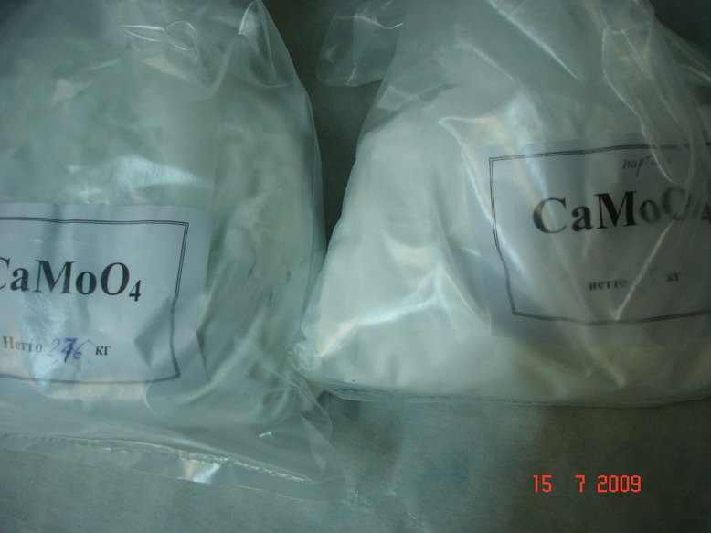
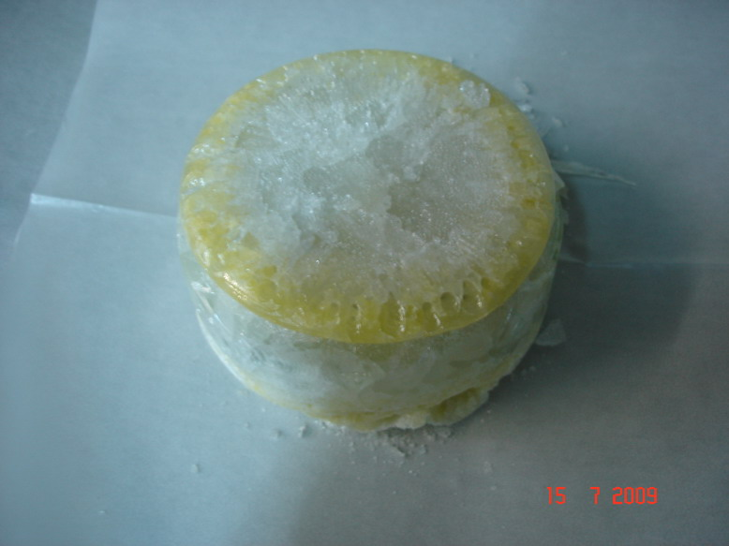
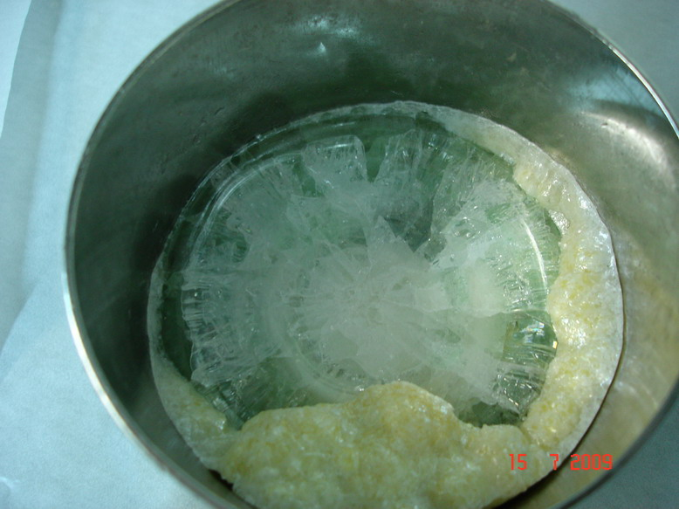
⁴⁰Cа¹⁰⁰MoO₄ raw material
JSC NeoChem
After melt at FOMOS-Material

Slide 8
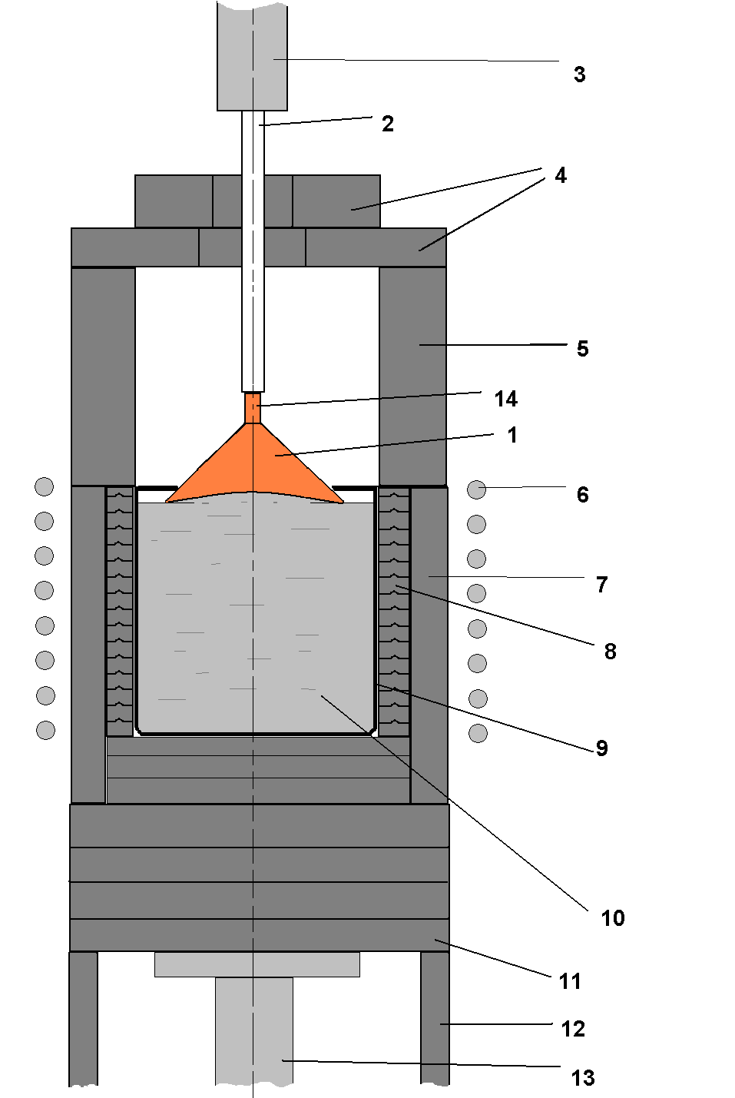
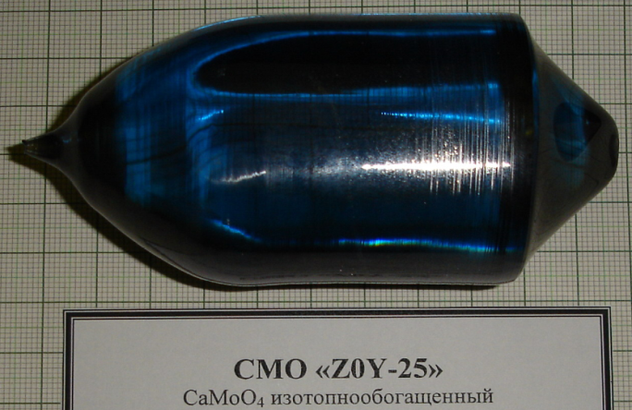
Sketch: Chochralsky method
1 – growing crystal;
2 – seedholder; 3,13 – water-cooling shaft; 4,11 – ceramic plates;
5,7,12 – ceramic tubes; 6 – induction coil;
8 – heat insulation ceramic;
9 – crucible;
10 – melt;
14 - seed
Just grown ⁴⁰Ca¹⁰⁰MoO₄ crystal
before annealing
m = 0,55 kg, D49 x 42 mm,
L_{cylinder} = 53 mm

Slide 9
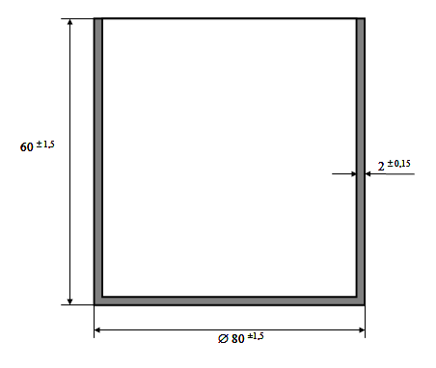
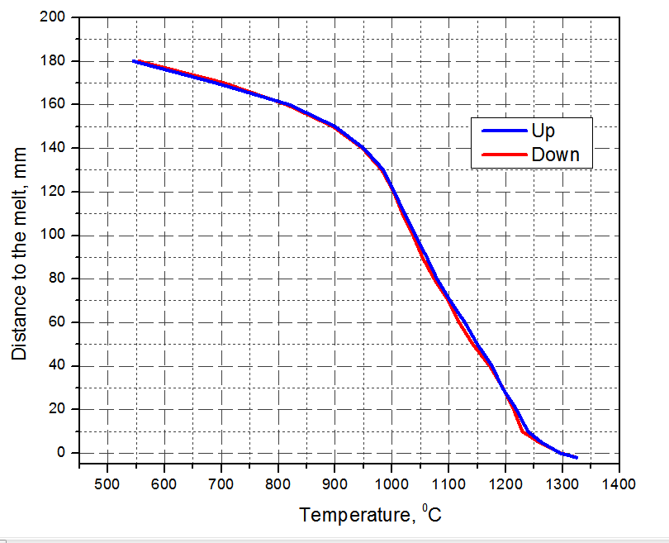
Crucible for CMO crystal growing and axial temperature distribution above the melt
Pt
Pt+ZrO₂

Slide 10
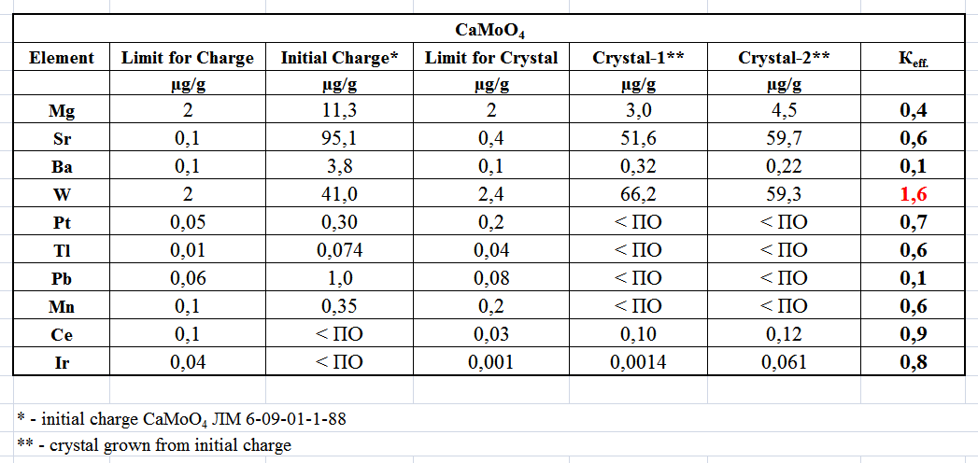
Effective Distribution Coefficients

Slide 11
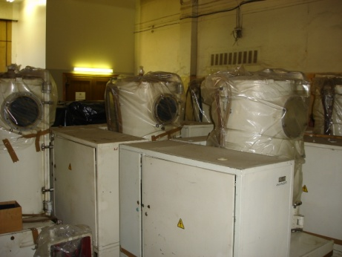
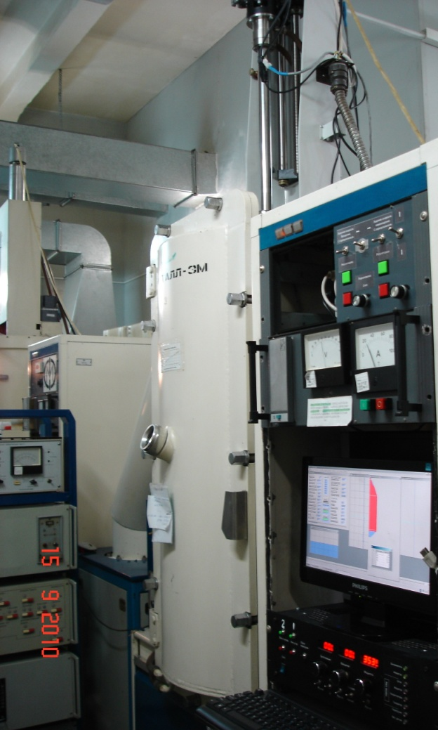
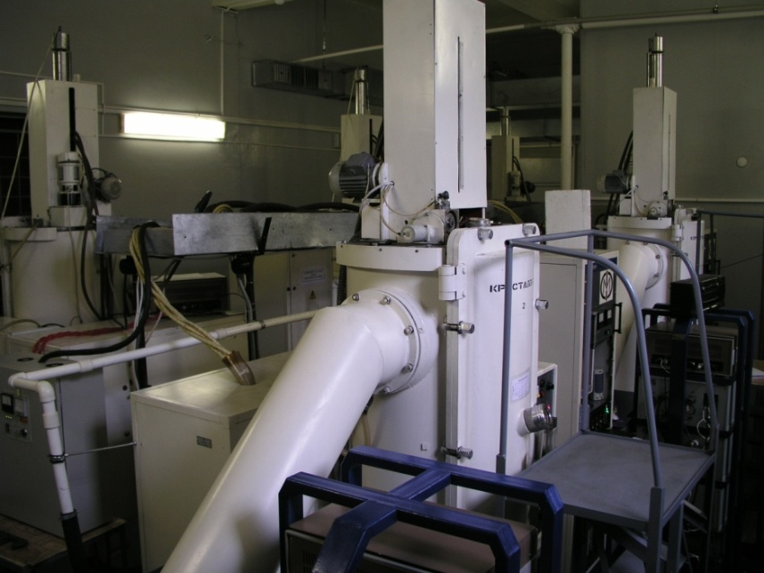
Crystal Growing Facility
Type –“Kristall-3m”
RF heating – 8 kHz
Power - 60 kW
Max. temperature - 2100⁰C
Crucible diameter – up to 200 mm
Max. crystal weight – up to 16 kg
Vacuum – up to 10⁻⁵ Pa
Oxygen analyzer
Stations in stock
Established crystal growth stations

Slide 12
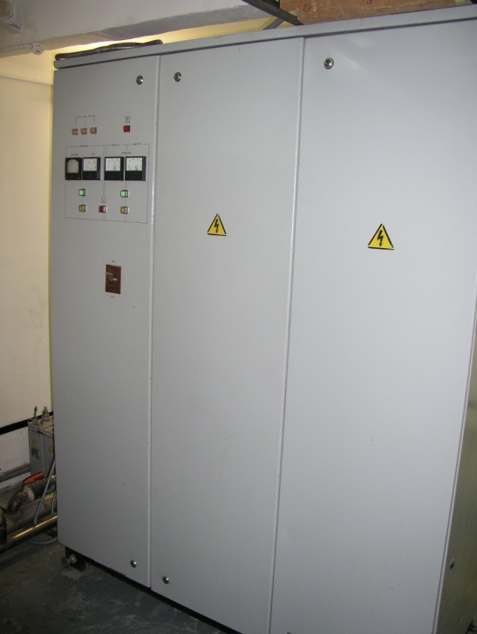
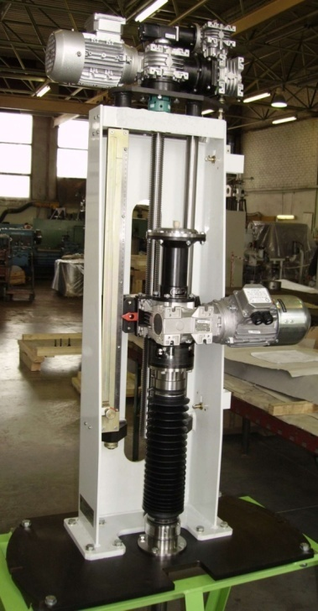
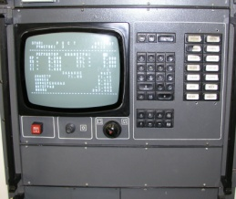
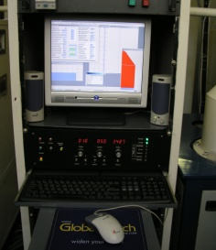
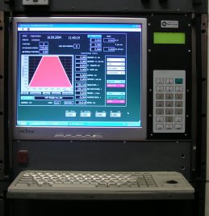
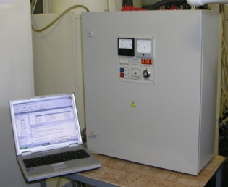
Upgrade of the Crystal Growth StationS
Rafos
12-bit DAC
M1-processor
Control unit
Vega (C++) LabWiev
16-bit ADC & 16-bit ADC & DAC
DAC Pentium-4 486-processor
Upper rod rotation
and moving system
Power - 60 kW Base – IGBT
Accuracy - ± 0.05%

Slide 13
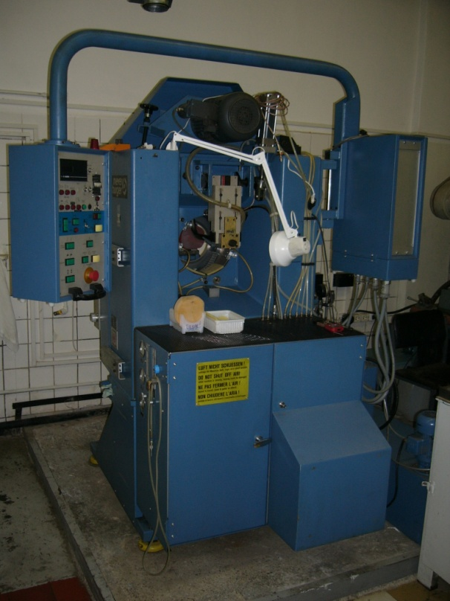
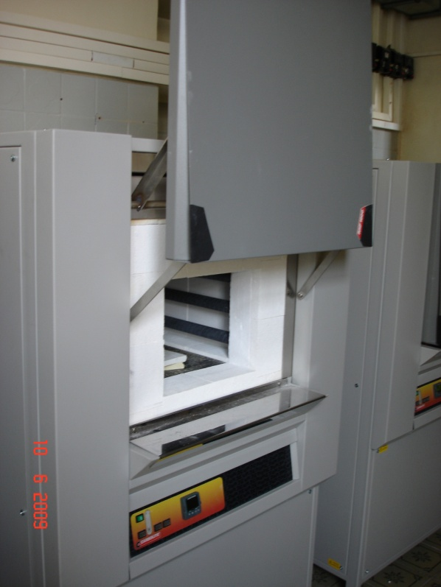
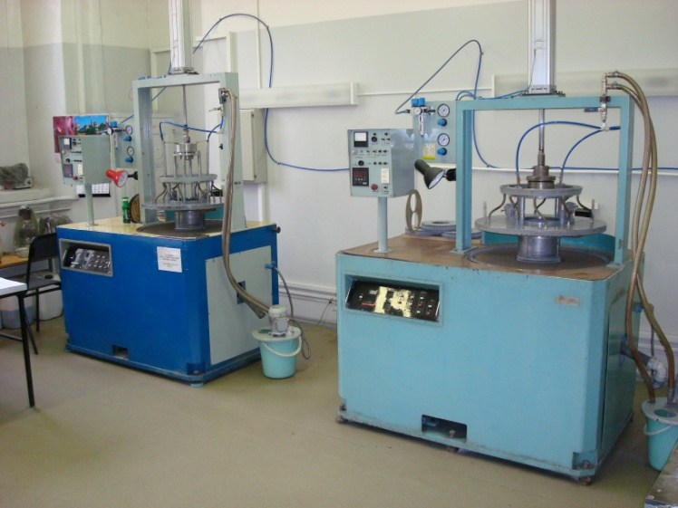
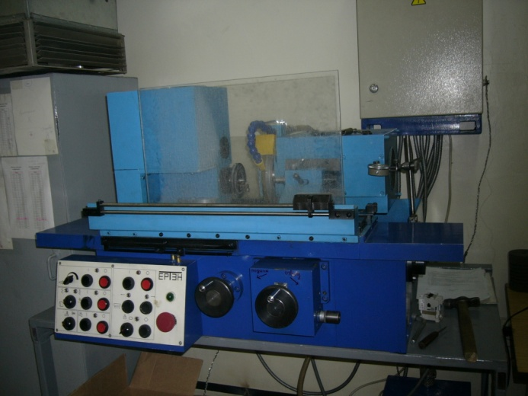
JSC FOMOS Materials (Moscow):
Equipment for heat and mechanical treatment

Slide 14
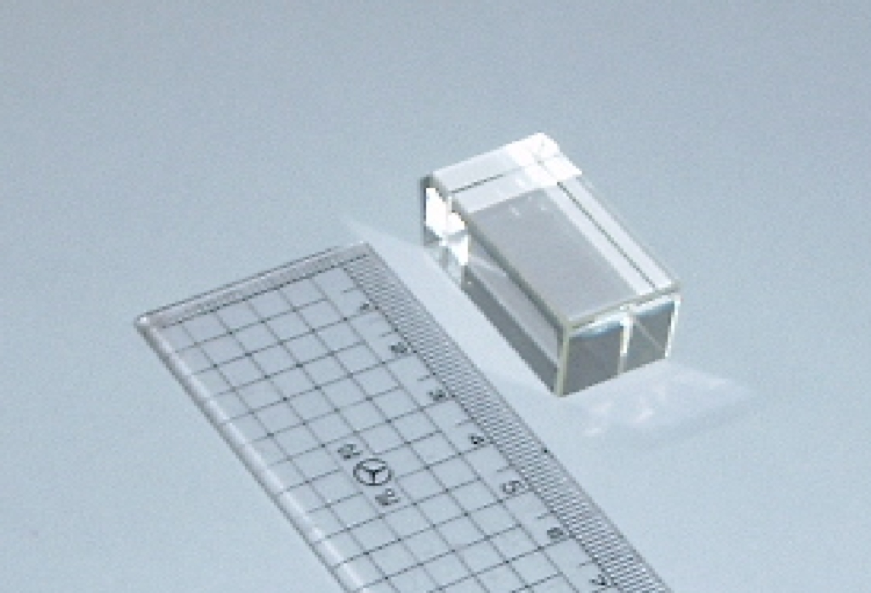
Beginning of R&D: 2004
Dimensions of CaMoO₄ crystals up to 15 cm³;
LY ~ 400 photons/MeV;
Low transparency (absorption band at 395 nm was obseved).
High content Bi-214(U-238) = 286 mBq/kg
Th-232(Tl-208) ≤ 25 mBq/kg

Slide 15
The results: 2007
The scintillation CaMoO₄ crystal of cylindrical geometry with dimensions of D40x40 mm

Slide 16
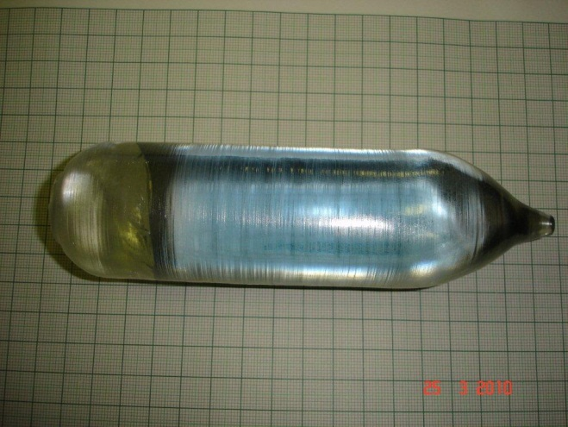
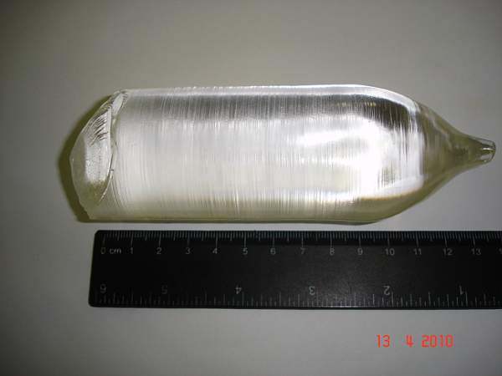
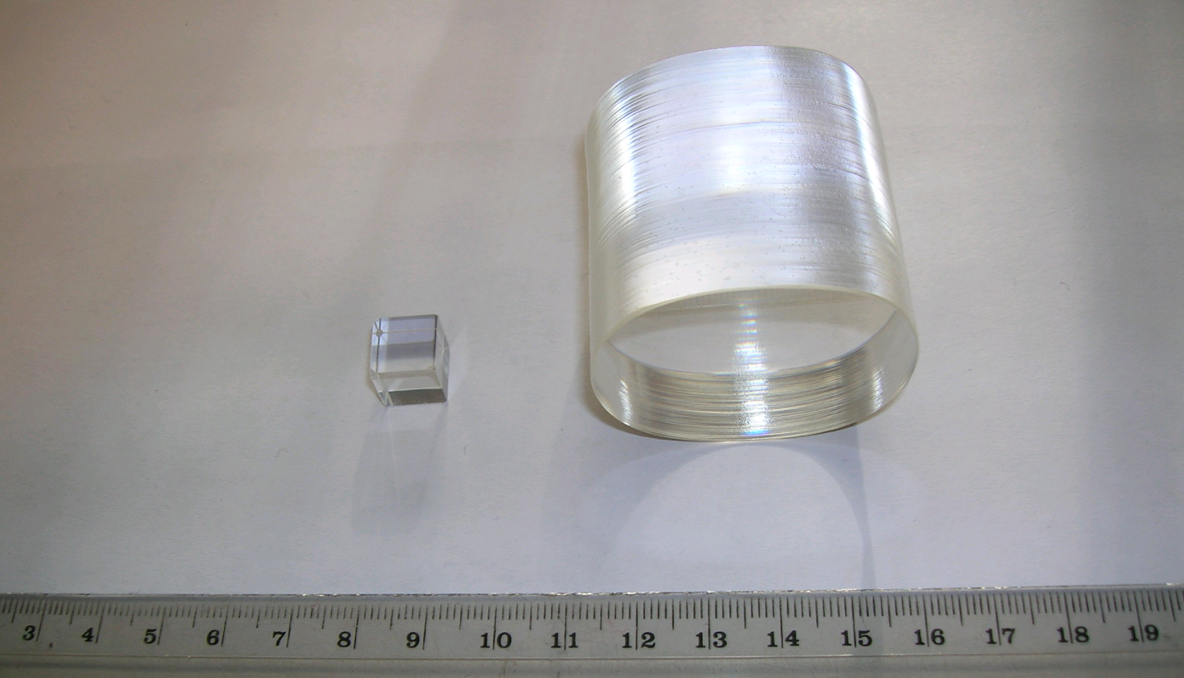
Scintillator element ⁴⁰Са¹⁰⁰МоО₄_S35
D(42 x 40) x 42 mm, m = 260 Gr
M = 815 gr
Annealing →

Slide 17
CMO crystal growth process at
JSC Fomos-Materials Co.
Process stages:
Initial powder ICP analysis
Initial pellets preparation – pellets manufacturing 550g in mass each
Initial charge for crystal growing preparation including МоО₃ adds - 2 pellets + up to 3 mass % of МоО3
Growth of the initial crystallized charge – crystals up to 550 g each
Initial crystallized charge for end-crystal growing preparation
Crystallizer assembling and end crystal growing
Aftergrowth heat treatment of the end crystal – heat treatment in oxidizing atmosphere
Mechanical treatment of the end crystal (cutting, lapping and polishing) – manufacturing of the CMO element according to the specification

Slide 18
Example of one of schemes of the crystal growth process. One-by-one.
End crystal growing
Pellets
Crystallized initial charge manufacturing
Crystal mass 550 g
Melt mass 1100 g
Melt mass 1100 g
Crystal mass 550 g
Pellet mass 550 g
Melt mass 1100 g
End crystal
mass 550 g
Total initial charge – 1650 g
End crystal mass – 550 g
Waste for recuperation – 1060 g
Losses – 40 g (possible lower)
Waste 530 g
Waste 530 g

Slide 19
Time demand for one-by-one scheme
One pellet manufacturing duration - 24 hours
Crystallized initial charge manufacturing duration – 96 hours
End crystal growth process duration – 96 hours
Total time demand for one circle – 3х24+2х96+96=360 hours or 15 days
One year – 327 days
Percentage of crystal growth setup time working – 80%
Working time in one year– 262 days
Working circles in a year for one crystal growth setup– 18
End crystals yield from one crystal growth setup in a year – 10 kg

Slide 20
Mass balance for one-by-one scheme
Total initial CaMoO₄ powder: 130 kg (up to3,9 kg MoO₃ )
From 1650 g we can produce 550 g of end crystal
From 130 kg of initial charge we can produce 43 kg of end crystals
Total circles - 78
Waste for processing (Ca and Mo extracting and purification)– 82,7 kg
Initial charge after waste processing (if losses 15%) – 70,3 kg
From 70,3 kg of initial charge we can produce 20 kg of end crystals
Total circles – 42
Waste for processing - 23,1 кг
Total amount of end crystals – 105,8 kg or 120 pcs
For 120 pcs of end crystals producing on one crystal growth setup - 10,5 year OR 11,4 pcs PER YEAR

Slide 21
Heat treatment
Heat treatment duration at 1250 ºC ≥100 hours
Temperature up and down duration – 14 and 14 hours
Heat treatment process duration including cooling to room temperature – 14+100+14+12 = 6 days
Total crystals mass per one process – up to 3 kg
Heat treatment circles per year - 262/6=43
Maximum crystals mass per year 43х3=130 kg

Slide 22
CONCLUSION regarding of schemes of the crystals growth
One-by-one two stage scheme is the most productive and functional
We need more than one Pt crucible
We need to use more than one crystal growth setup

Slide 23
Temperature dependence of scintillation properties of ⁴⁰Ca¹⁰⁰MoO₄ sample
Dr. V.B. Mikhailik Department of Physics, University of Oxford Oxford OX1 3RH, UK
Parameter | T=295 K | T=8 K
Light output (relative to reference CaMoO₄*) , % | 105±39 | 106±32
Decay constant, μs | 16.5±0.3 | 345±25
*- CaMoO₄ sample produced by Carat in 2006

Slide 24
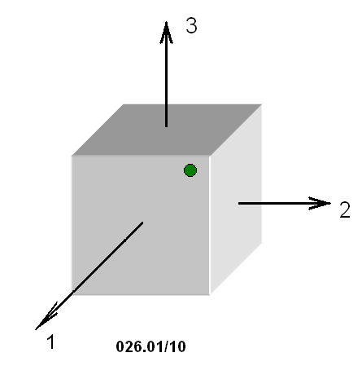
S35: Attenuation length
Measurements of two testing samples with Spectrophotometer Cary-5000 UV-VIS-NIR
L = 90 cm at 530 nm
λ(530 nm) = 0,011 cm⁻¹
Y-axis: attenuation index, cm-1
X-axis: wavelength, nm

Slide 25
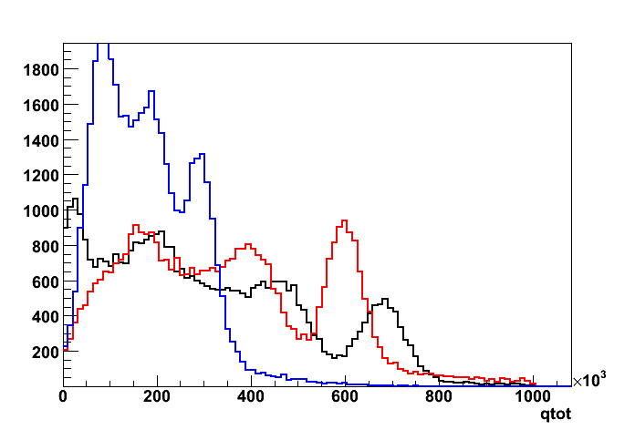
Light output and Energy resolution of S35. Measurements at YangYang laboratory by 4π gamma veto system.
(J.H.So talk to SCINT2011)
SB28
Resolution : 30% (FWHM)
Mean : 2.88 x 10⁵
S35
Resolution : 16% (FWHM)
Mean : 5.97 x 10⁵
CMO_3
Resolution : 16% (FWHM)
Mean : 6.79 x 10⁵

Slide 26
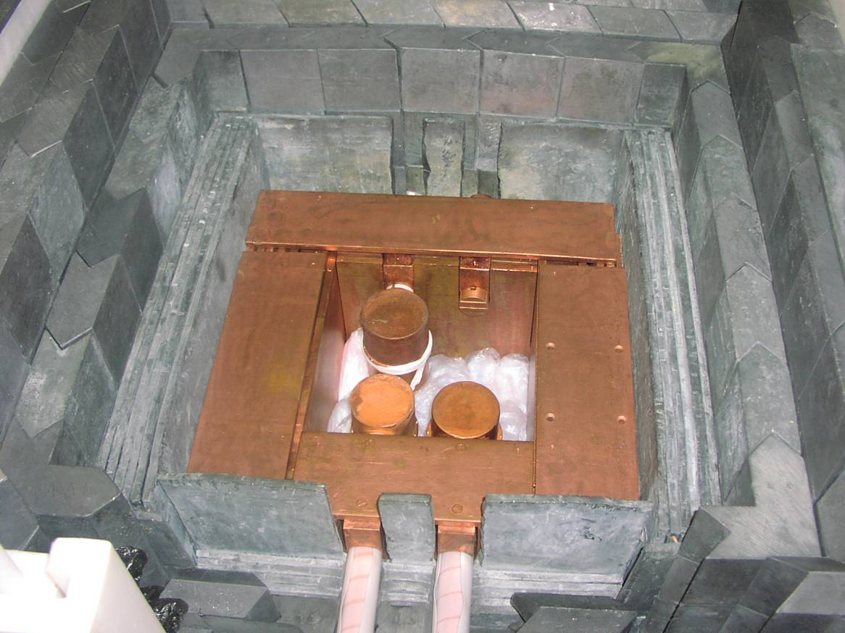
HPGe measurements at Baksan Neutrino Observatory INR RAS
HPGe detectors (3 x ~1 kg) at low background underground lab (H = 660 m.w.e.)
V_{int} = 30 x 30 x 30 cm³
Registration of
γ–rays from samples

Slide 27
HPGe measurements at Baksan Neutrino Observatory: the results
          Ac228 ≤ 3,1 mBq/kg
          Tl208 ≤ 0.83 mBq/kg
          Bi214 (Ra226) ≤ 6,4 mBq/kg
Double crystallization procedure: Purification ≥ 35 times!

Slide 28
Samples sent to ELEKTROKHIMPRIBOR to check possible isotopic “dilution” effect during initial preparation and crystal growing
#1 Raw material ⁴⁰Ca¹⁰⁰MoO₄ from JSC NEOCHIM
#2 single crystal S 27
#3 single crystal SB 28
Result:
No isotopic dilution of Ca-48 (and Ca-46) was observed (≤ 0,001%)!

Slide 29
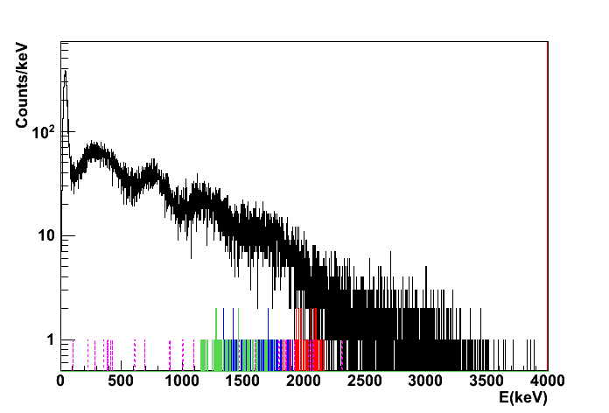
Background spectra of SB28
(J.H.So talk to SCINT2011)
β−α decay in ²³⁸U
²¹⁴Bi (Q-value : 3.27-MeV) → ²¹⁴Po (Q-value : 7.83-MeV)→ ²¹⁰Pb
α−α decay in ²³²Th
²²⁰Rn (Q-value : 6.41-MeV) → ²¹⁶Po (Q-value : 6.91-MeV)→ ²¹²Pb
²¹⁶Po : 1.61-MeV, 57 events ≈ 0.07mBq/kg
²¹⁴Po : 1.93-MeV, 63 events ≈ 0.08mBq/kg
²²⁰Rn : 1.45-MeV
²¹⁴Bi (Q-value : 3.27-MeV)

Slide 30
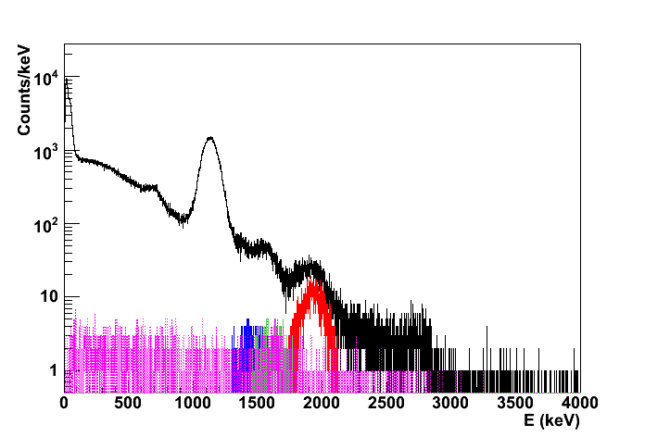
Background spectra of S35
(J.H.So talk to SCINT2011)
β−α decay in ²³⁸U
²¹⁴Bi (Q-value : 3.27-MeV) → ²¹⁴Po (Q-value : 7.83-MeV)→ ²¹⁰Pb
α−α decay in ²³²Th
²²⁰Rn (Q-value : 6.41-MeV) → ²¹⁶Po (Q-value : 6.91-MeV)→ ²¹²Pb
²¹⁰Po : 1.13-MeV
²¹⁶Po : 1.62-MeV, 363 events, 0.26mBq/kg
²¹⁴Po : 1.93-MeV, 2445 events, 1.74mBq/kg
²²⁰Rn : 1.44-MeV

Slide 31
Mo-100 isotope production:
The ECP (Electrochemical plant)
Zelenogorsk, Krasnoyarsky kray, Siberia
We bought ¹⁰⁰MoO₃ oxide (2,5 kg of Mo-100)
Enrichment:
Mo-100 = 96,1%
Impurities (the results from ICP MS measurements):
U ≤ 0.00007 ppm (< 0,07 ppb)
Th ≤ 0.0001 ppm (< 0,1 ppb)
²²⁶Ra ≤ 2,3 mBq/kg, ²²⁸Ac ≤ 3,8 mBq/kg
Regular productivity of Mo-100 is up to ~ 30 kg per year

Slide 32
Ca-40 isotope production in Russia
Electrochimprobor Lesnoy, Sverdlovk region
We bought ⁴⁰CaCO₃ compound (mass of Ca-40: 1,25 kg)
Enrichment:
Ca-40 = 99,964+/-0,005%
Ca-48 < 0,001% (K depletion is 187 times/ > 35 times)
Impurities (ICP MS measurements)
U <= 0.0002 ppm (< 0,2 ppb)
Th <= 0.0008 ppm (< 0,8 ppb)
Sr = 25 ppm
Ba = 26 ppm
Productivity: 4 – 5 kg/year

Slide 33
⁴⁰CaCO₃: new chemistry at EKP
Conclusion
Purity of last sample produced by EKP in 2011 is - taking into account purification during double crystallization procedure - practically OK for AMoRe’s application !

Slide 34
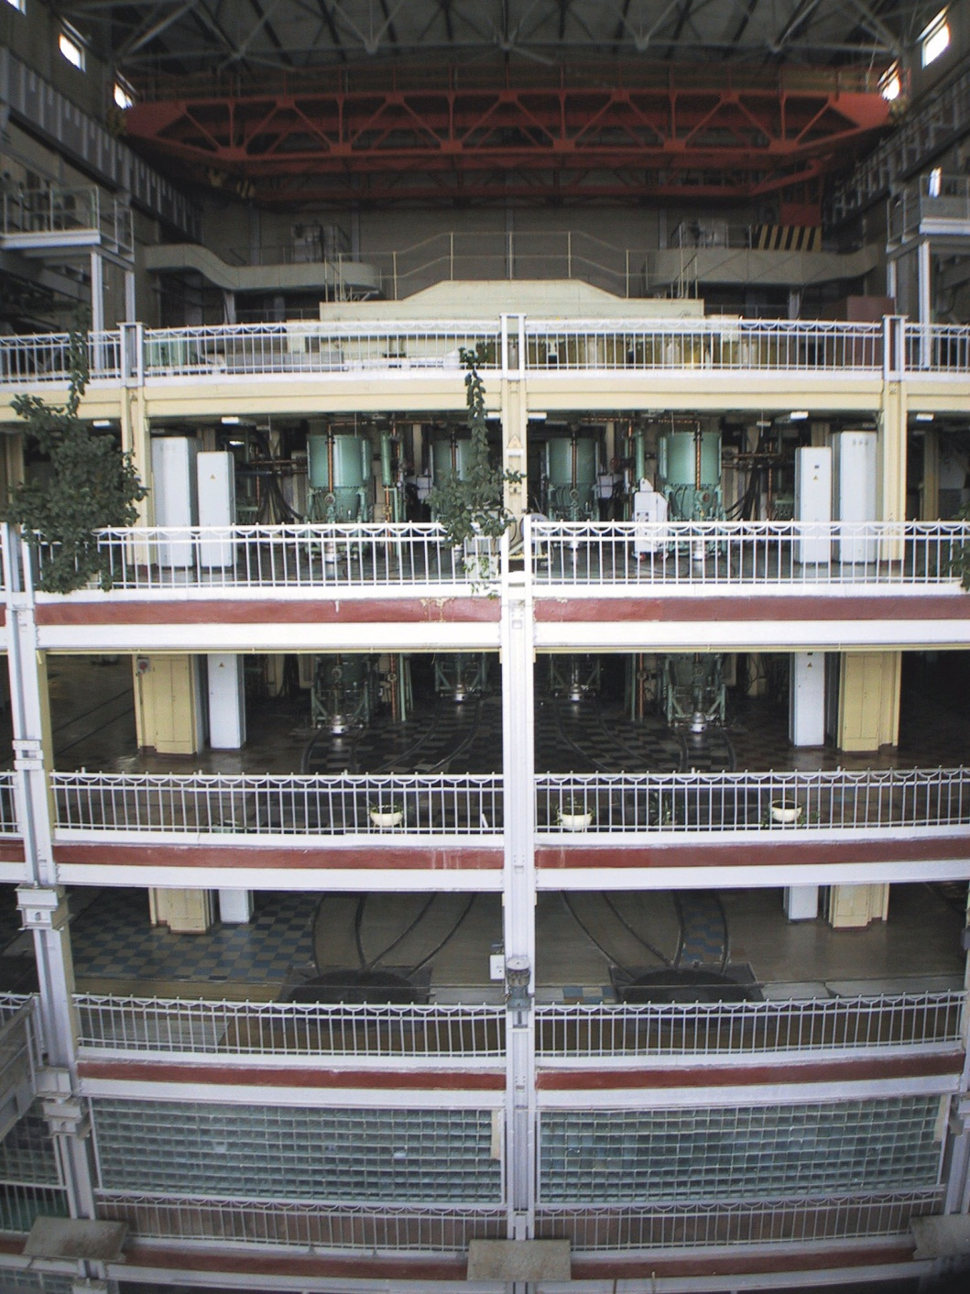
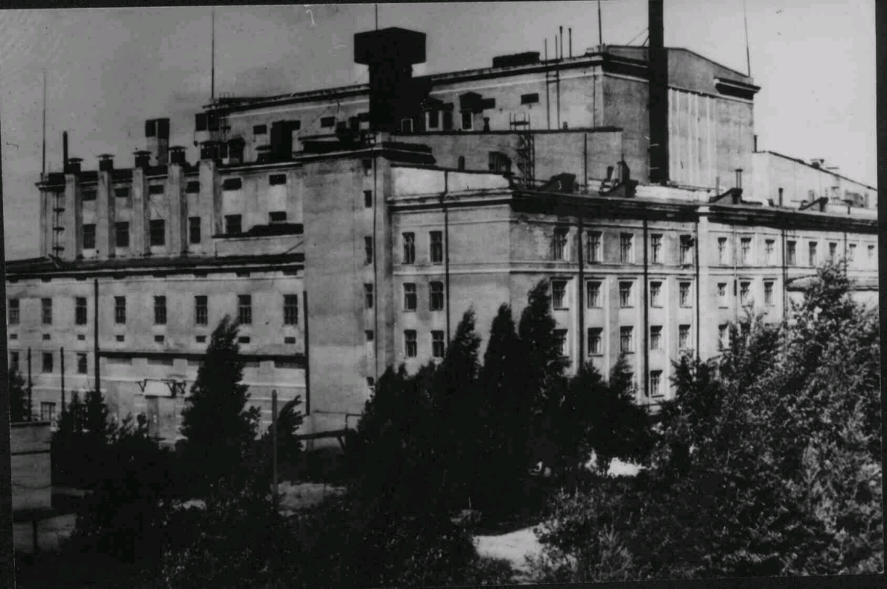
The industrial separator SU20
Lesnoy, Sverdlovky region, Russia
30 kg of Ca-40 (40CaCO3)
is available now
Ca-48 < 0,001%
Good for 150 kg of ⁴⁰Ca¹⁰⁰MoO₄
Productivity: 4 – 5 kg/year

Slide 35
Main results from ITEP/FOMOS
¹⁰⁰MoO₃ purity (²²⁶Ra < 2,3 mBq/kg, ²²⁸Ac < 3,8 mBq/kg, ²³⁸U < 0,07 ppb, ²³²Th < 0,1 ppb) produced by the ECP is good
⁴⁰CaCO₃ purity (²²⁶Ra = 53 mBq/kg, ²²⁸Ac ≤ 0,65 mBq/kg, ²³⁸U < 0,07 ppb, ²³²Th < 0,1 ppb) produced by the ECP is – taking into account double crystallization Czochralski procedure - quite good (since 2011)
Purity of SB28 single crystal (²²⁶Ra/214Bi ≈ 0.08mBq/kg, ²²⁸Ac/216Po ≈ 0.07mBq/kg) is practically OK for AMoRE experiment
Purification coefficient impurity of double crystallization Czochralski procedure was defined at level of
K (Ra-226 ) >= 35
No possible isotopic dilution of Ca-48 (and Ca-46) after crystal growing was observed (≤ 0,001%)!

Slide 36
PROBLEMS should be resolved
Recoverable loss (WASTE MATERIAL (remains from crucible after crystals growing)) is 44%
Recovery of Ca-40 and Mo-100 isotopes from WASTE MATERIAL (remains from crucible after crystals growing)
Purification of Ca-40 and Mo-100 extracted from waste material.
TOTAL unrecoverable loss during laboratory process of crystal growing is 6,5%.

Slide 37
www.newpiezo.com
THANK YOU FOR YOUR ATTENTION
buzanov@newpiezo.com

