Slide 1
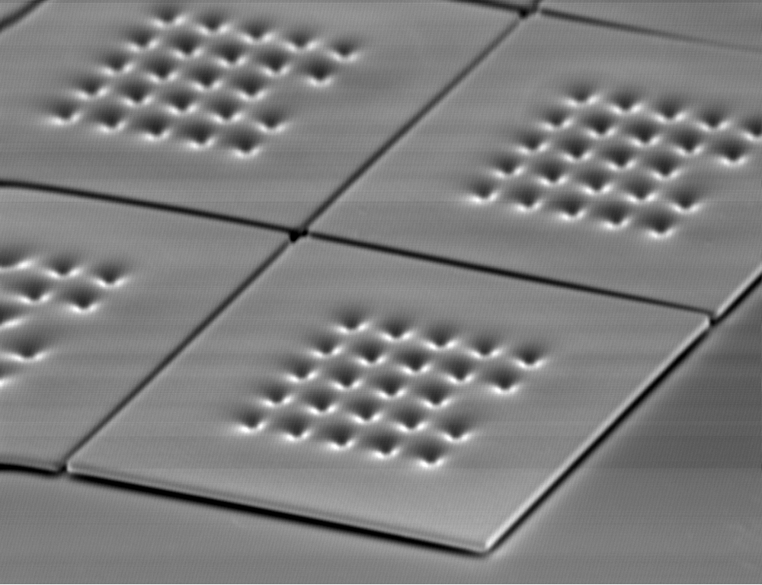
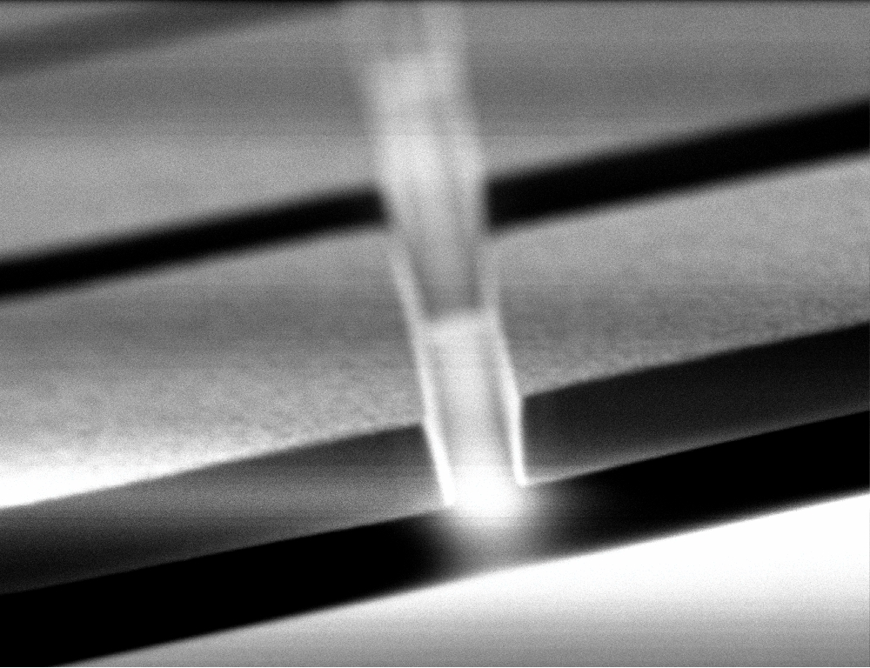
Metallic magnetic calorimeters for
high resolution
x-ray and particle detection
A.Fleischmann,
L.Gastaldo, D.Hengstler, S.Heuser, A.Kampkötter, C.Pies,
J.P.Porst, S.Kempf, S.Schäfer, P.Ranitzsch, C.Enss
Kirchhoff Institute for Physics
Heidelberg University

Slide 2
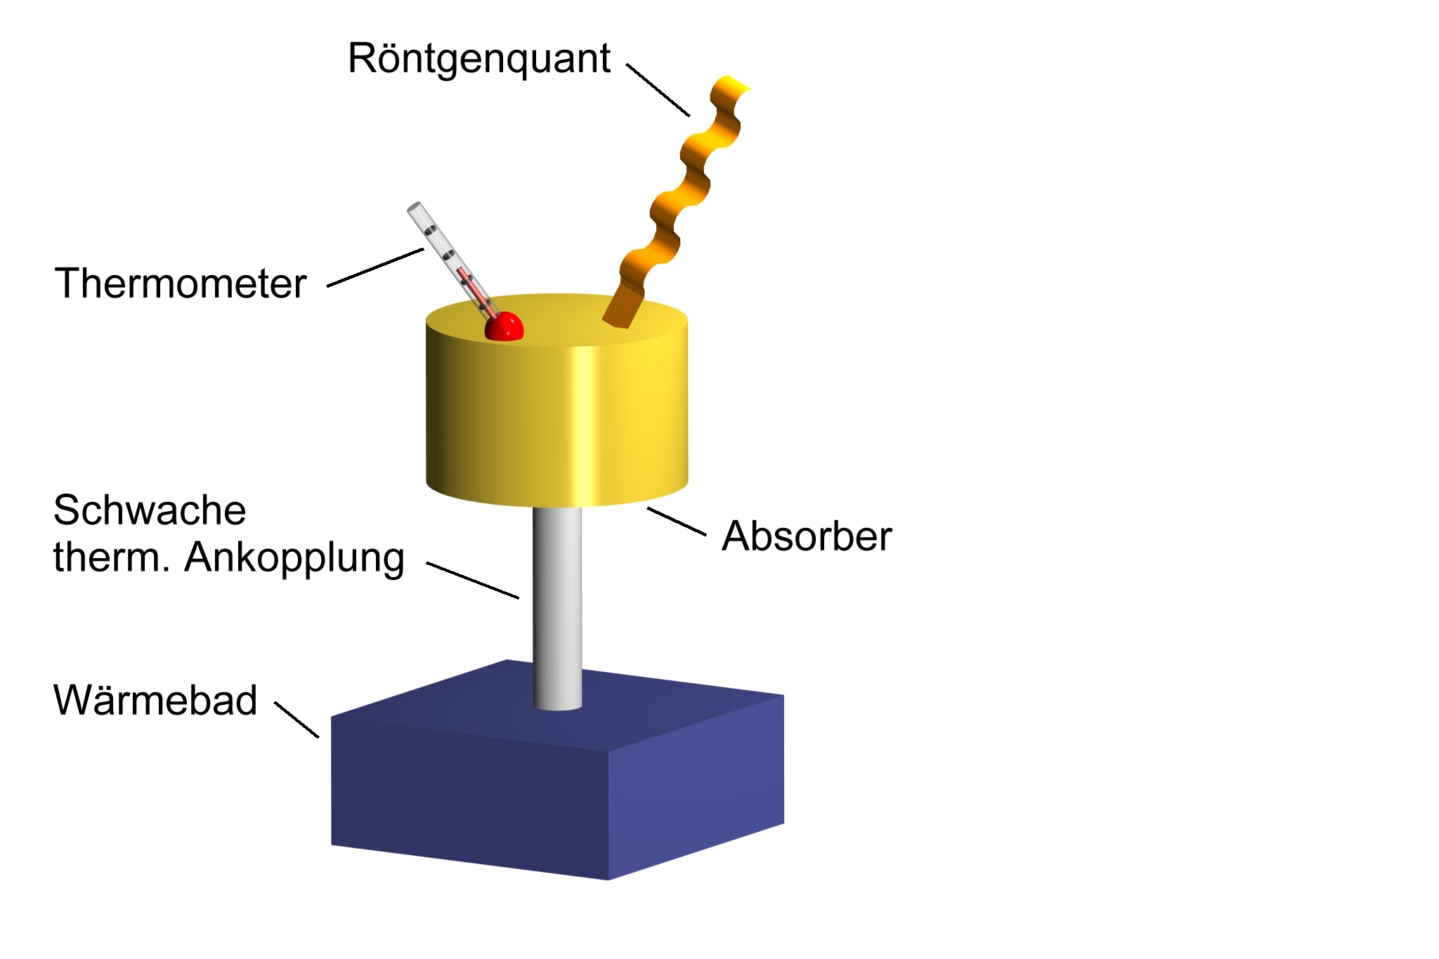
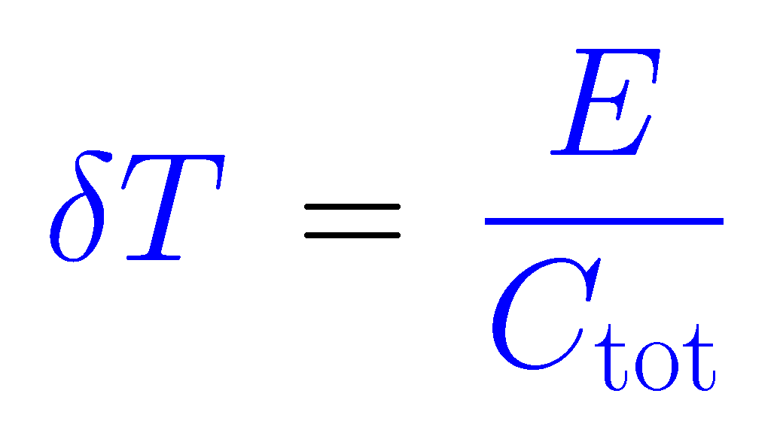
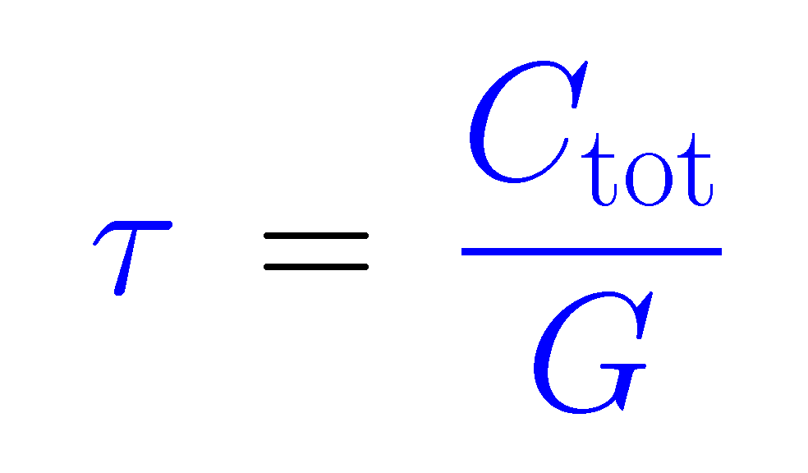
detection principle of micro-calorimeters
X-ray photon
Temperature change
Thermometer
Relaxation to bath temperature
Weak thermal link G
Absorber C
Thermal bath
(T < 100mK)
Operation at low temperature (T < 0.1 K):
small specific heat
large temperature change
small thermal noise

Slide 3
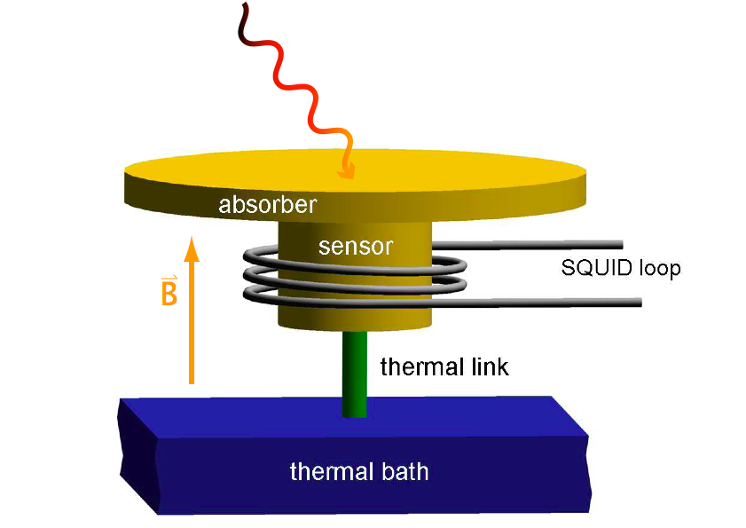
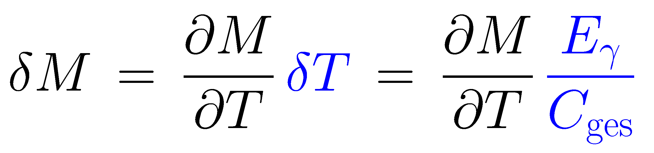
Metallic Magnetic Calorimeters
paramagnetic sensor: Au:Er
M
T
signal size:
main differences to calorimeters with resistive thermometers
no power dissipation in the sensor
no galvanic contact to the sensor

Slide 4
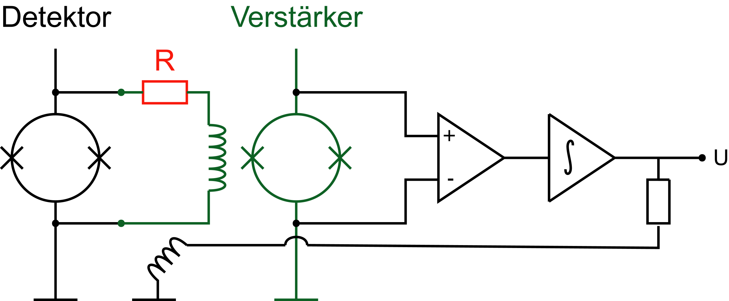
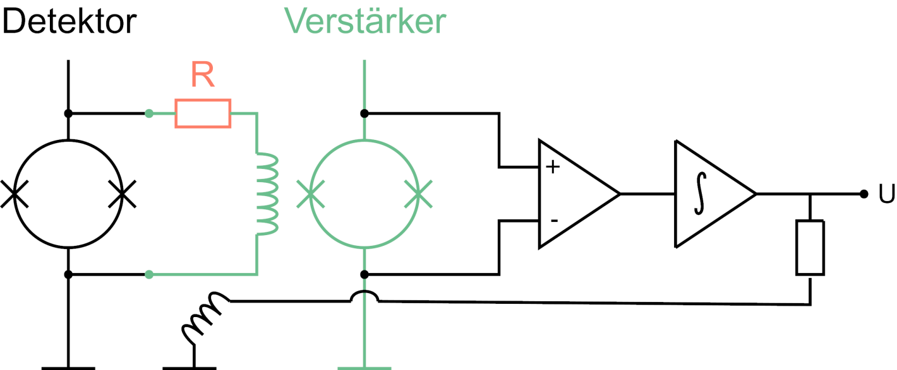
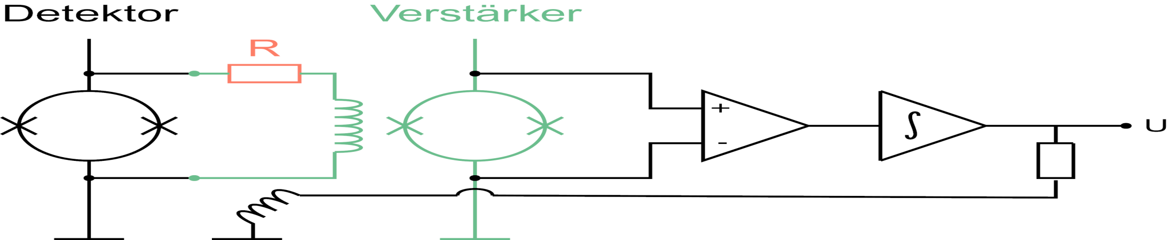
readout of magnetic calorimeters
T = 50 mK
T = 0.5 ... 4 K
room temperature
Detector
Amplifier
paramagnetic
sensor
SQUID
magnetometer
two-stage SQUID setup with flux locked loop to linearize the first stage SQUID
allows for:
low noise
large bandwidth / slewrate
small power dissipation on detector SQUID chip (voltage bias)

Slide 5
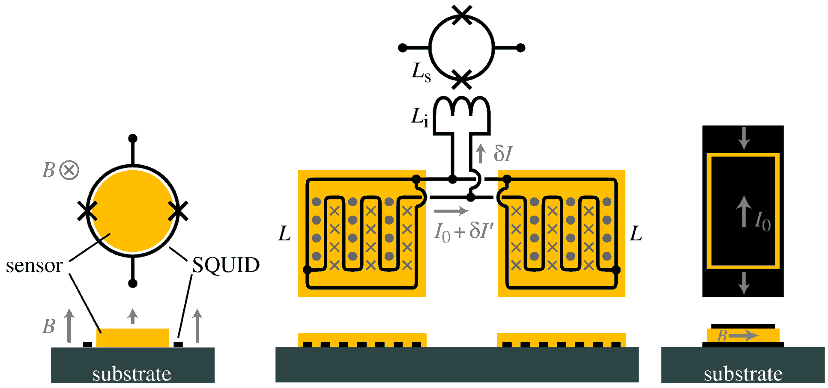
sensor and pickup coil geometries
present working horse:
planar T-sensor
sc. meander shaped pickup loop
B-field generated by persistent current
transformer coupled to SQUID
early devices:
cylindrical T-sensor
circular SQUID loop
external magnetic field
just started:
sandwiched planar sensor
best filling factor

Slide 6
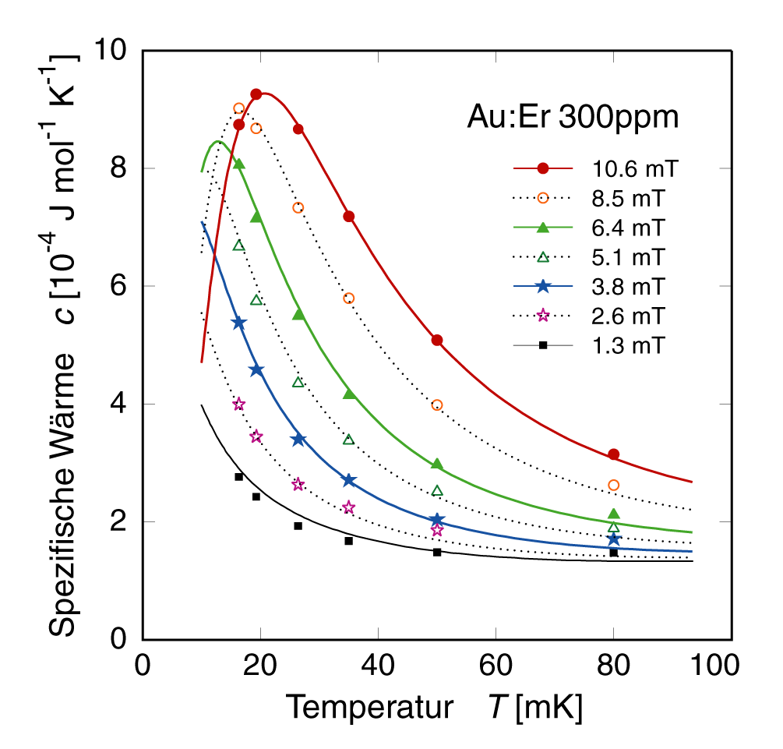
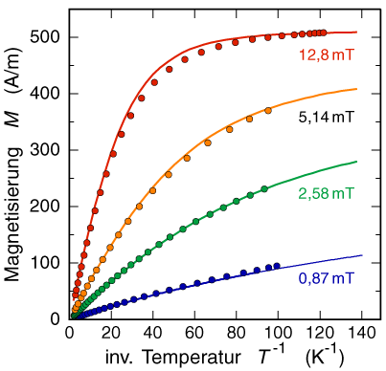
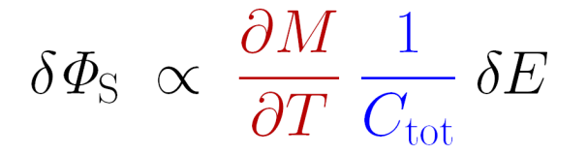
signal size
thermodynamic properties of interacting spins (RKKY)
can be calculated with confidence
by mean field approximations
Au:Er 300 ppm
Au:Er 300 ppm
Au:Er 300 ppm
Specific heat C [10⁻⁴ J mol⁻¹K⁻¹]
Magnetization M [A/m]
Inverse Temperature T⁻¹ [K ⁻¹]
Temperature T [mK]
Signal size of a detector can be calculated with confidence

Slide 7
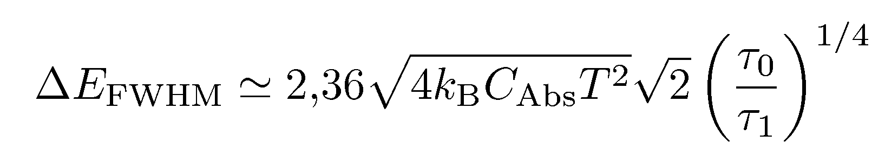
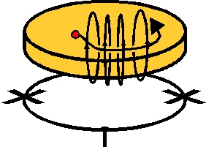
noise contributions
fluctuations of energy between sub-systems
(optimum for C_{abs} = C_{spins})
flux noise of SQUID-magnetometer
S_{Φ} = 2 ε L, required:
magnetic Johnson noise
- thermal currents in the metallic components
- marginal in all present detectors
excess 1/f noise S_{Φ} ~ N_{Er}
S_{Φ} ~ 1/f, S_{m}|_{1Hz} ≈ 0.023 μ_{Er}²/Hz
temperature independent (20mK – 4K)
C_{abs}
C_{spins}
sensor
SQUID

Slide 8
expected energy resolution for some configurations
considering:
meander geometry
signal rise time: τ₀ < 1 μs
thermodynamic fluctuations of energy
1/f noise of Er ions
flux noise of SQUID
    white: S_{Φ} = 0.5 μΦ₀/√Hz
    1/f: S_{Φ} = 5 μΦ₀/√Hz @ 1Hz
realistic flux coupling to a 1.6 nH current sensor SQUID (PTB)
Absorber [μm³] | C_{abs} [pJ/K] @ 50mK | τ₁ [ms] | ΔE_{FWHM} [eV] @ 50 mK | ΔE_{FWHM} [eV] @ 30 mK
250 × 250 × 5 (Au) | 1 | 1 | 2.2 | 1.2
250 × 250 × 5 (Au/Bi) | 0.3 | 1 | 1.1 | 0.6
 | 0.3 | 0.3 | 1.5 | 0.8
1000 × 1000 × 200 (Au) | 500 | 1 | 50 | 25

Slide 9

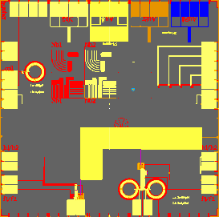
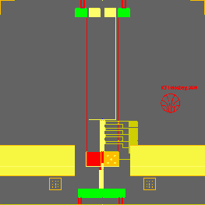
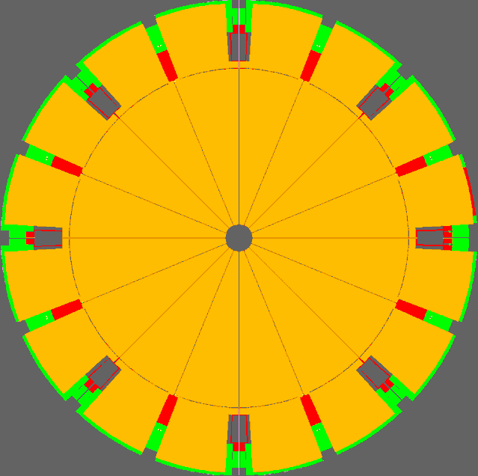

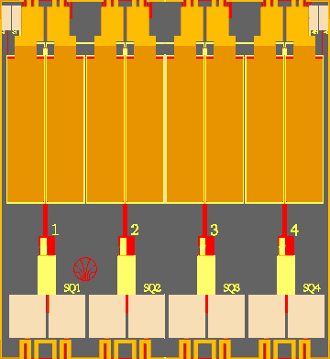
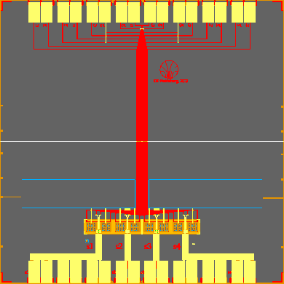
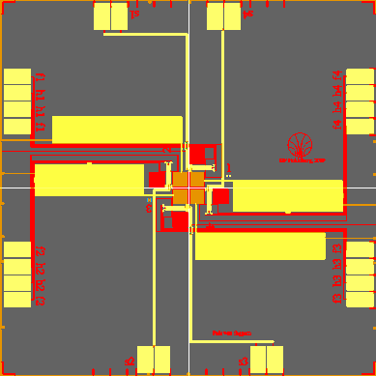
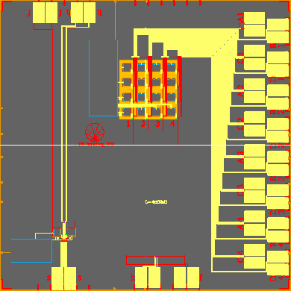
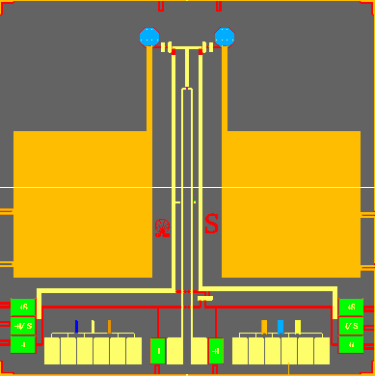
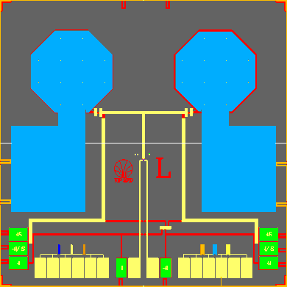
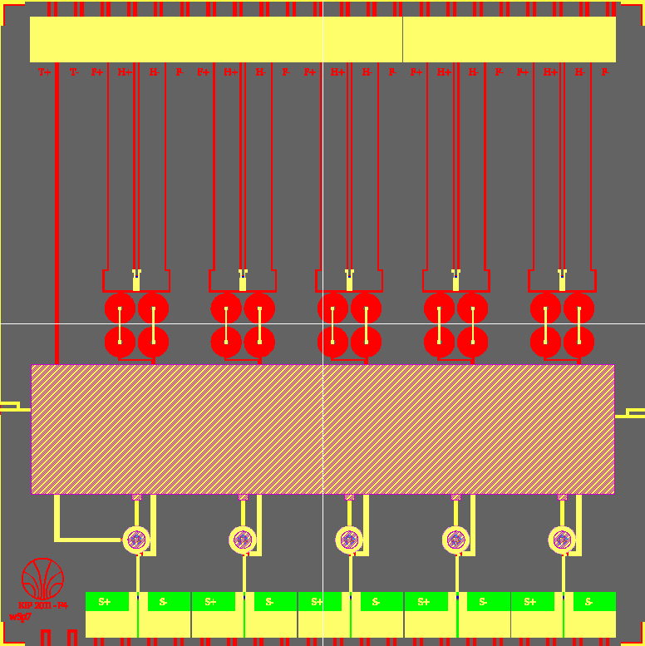
Detectors for a veriety of applications

Slide 10
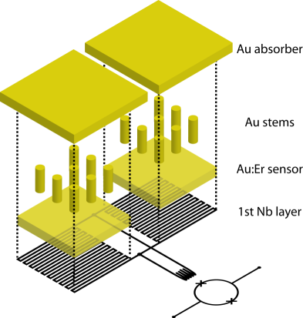
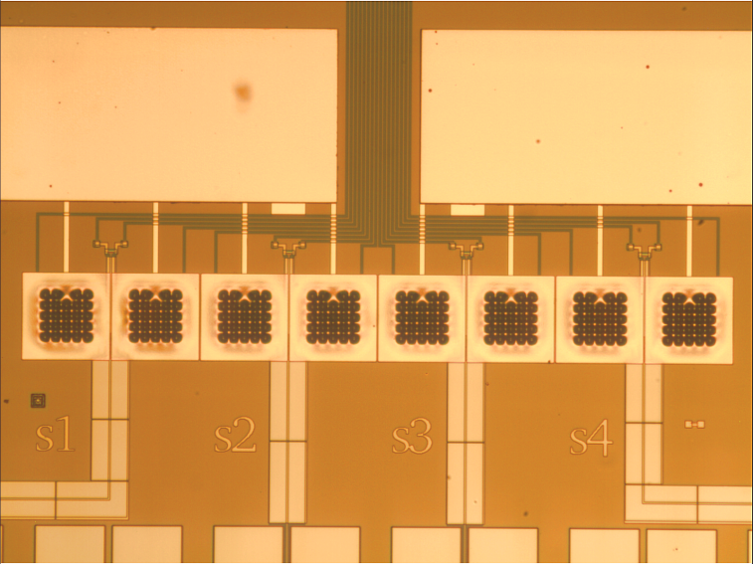
maXs-20: detector arrays for x-rays up to 20 keV
first array prototype:
1x8 x-ray absorbers
250 μm × 250 μm × 5 μm gold
98% quantum efficiency at 6 keV
ΔE_{FWHM} < 3 eV

Slide 11
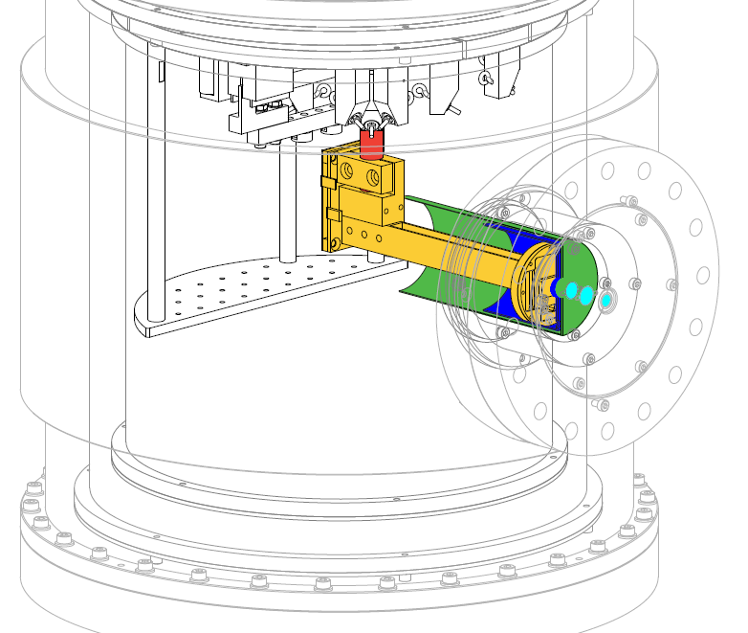
maXs-20: detector arrays for x-rays up to 20 keV
present system for HD-EBIT
pulse-tube cooled ADR
Base 27 mK
Time below 30mK: 24h

Slide 12
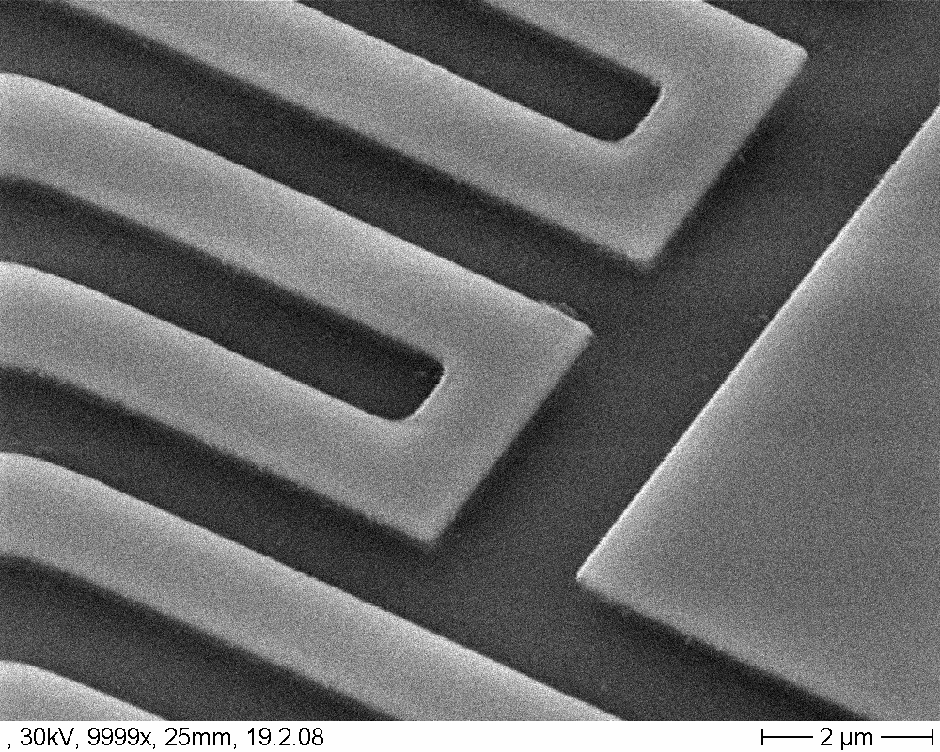
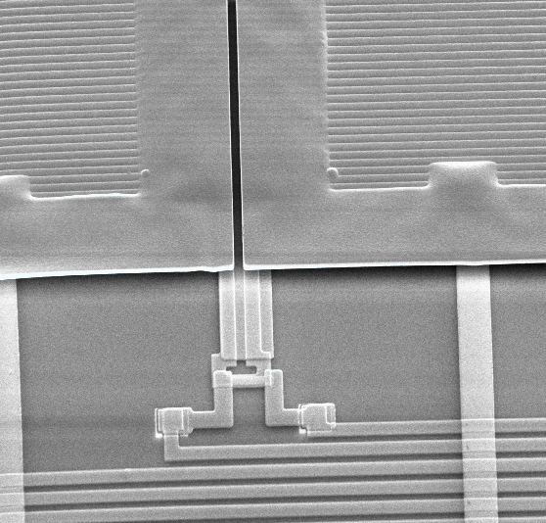
micro-fabrication of x-ray detectors
niobium meanders:
width 3 - 5 μm
thickness 400 nm
critical current 250 mA
2 x higher than required for optimum performance
no additional flux noise when charged
on-chip persistent current switch:
heater: sputtered AuPd
R = 20 Ω
switching current 1 – 2 mA
reliable injection of
persistent currents up to 0.95 I_{c}

Slide 13
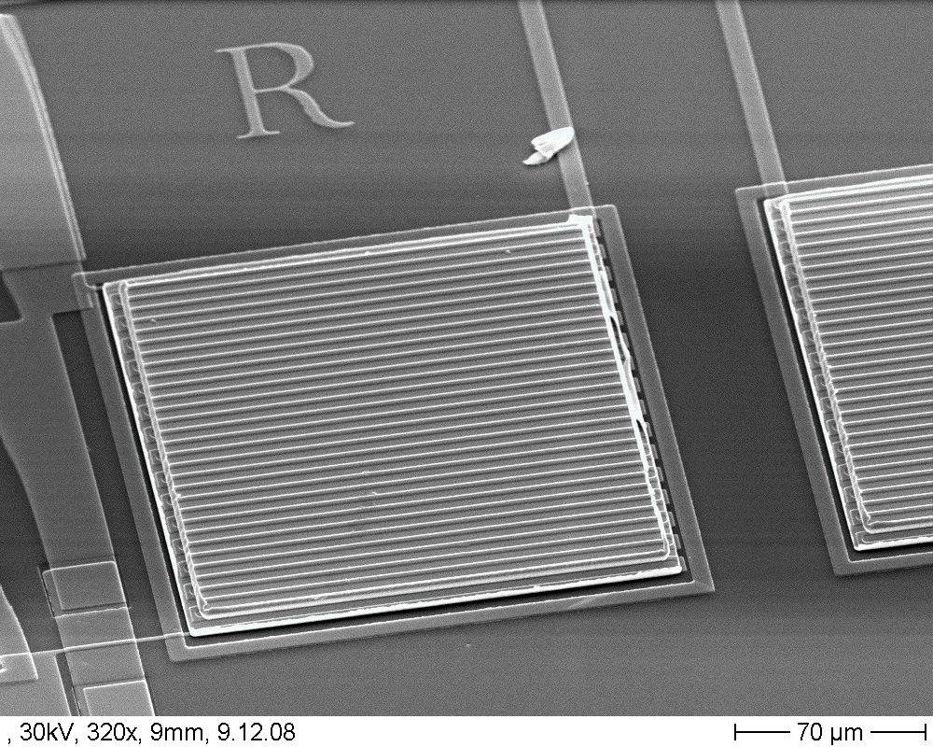
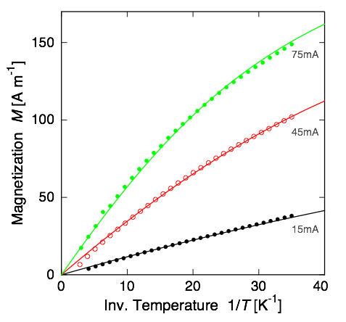
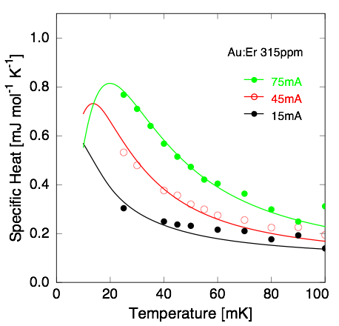
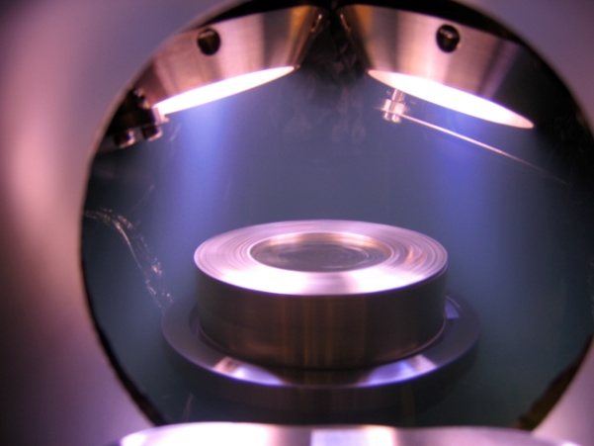
micro-fabrication of x-ray detectors
sputtered Au:Er T-sensors:
1 - 3 μm thick
co-sputtered from Au and Au:¹⁶⁶Er targets
Since recently:
Magnetization and specific heat
agree almost perfect with bulk values

Slide 14
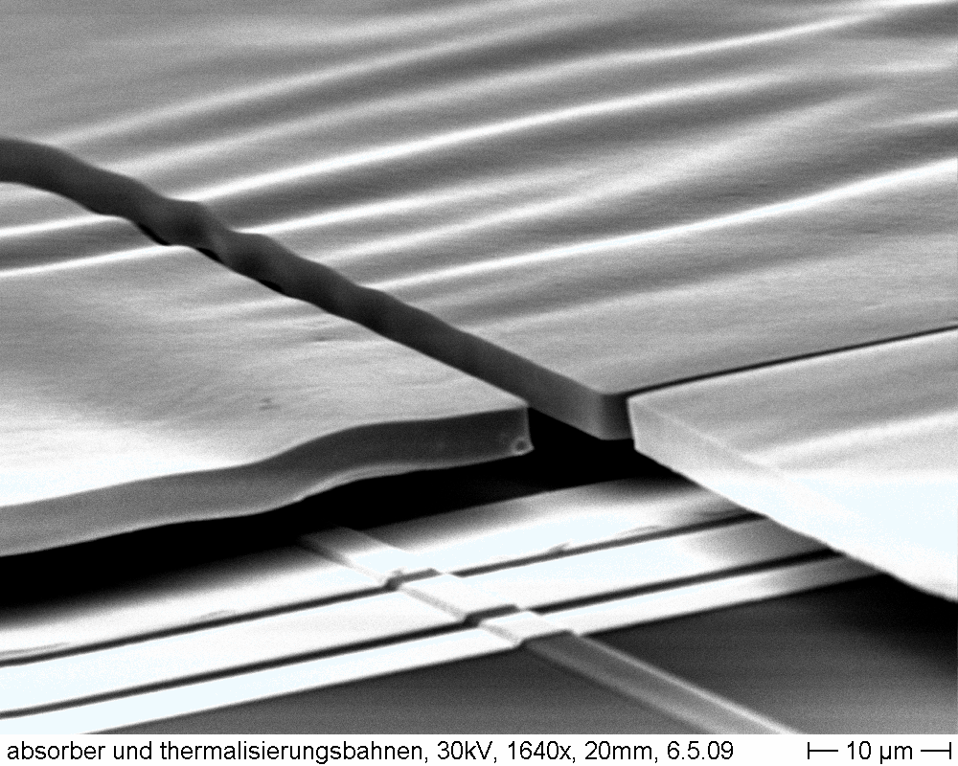
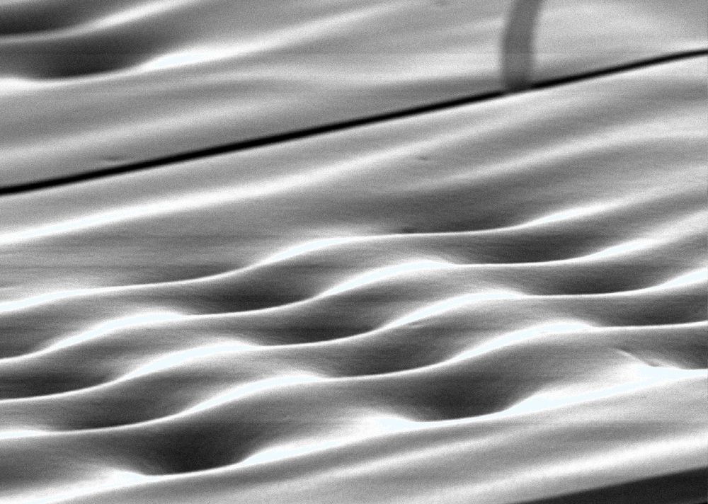
micro-fabrication of x-ray detectors
overhanging x-ray absorbers:
5 μm thick gold, RRR ≈ 15
electroplated into photoresist mold
connected to sensor through stems
to reduce loss of
initial energetic phonons to the solid substrate
effective contact area: < 5% of absorber area

Slide 15
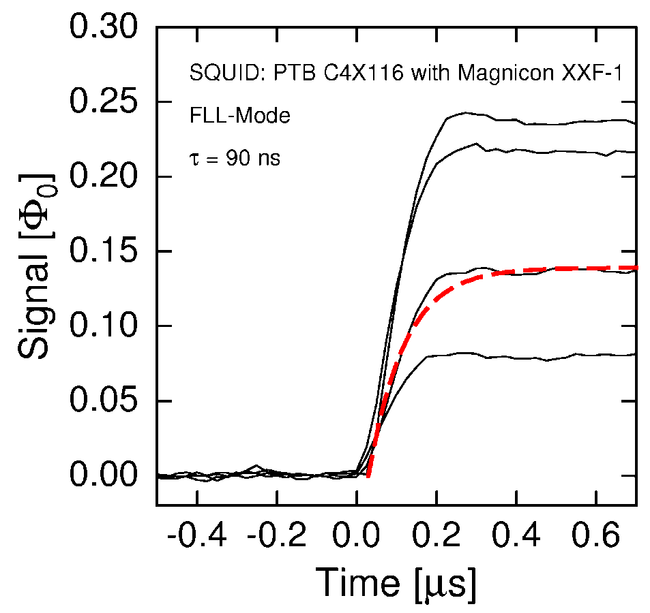
signal rise-time of micro-fabricated MMCs
rise time: 90 ns @ 30 mK,
as expected for the electron-spin-relaxation
from Korringa-constant for Er in Au

Slide 16
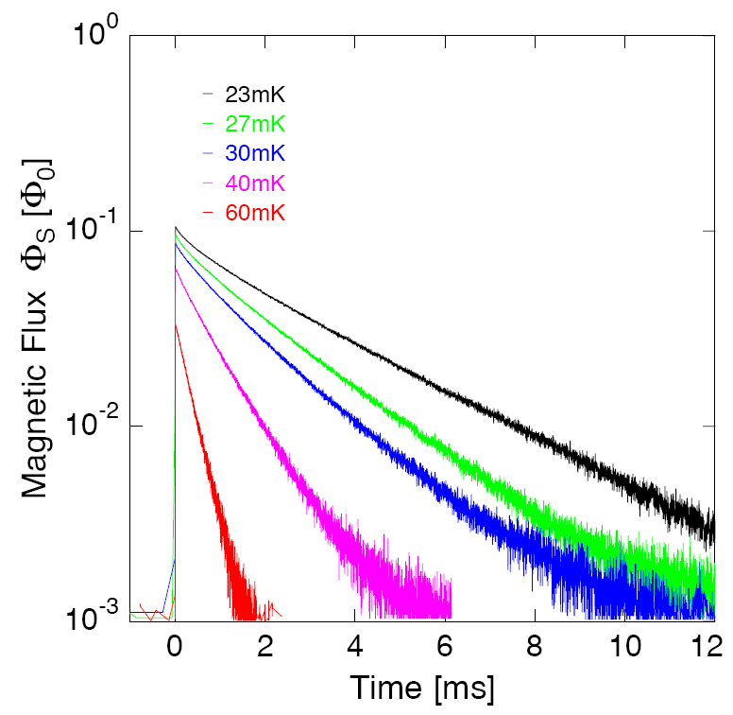
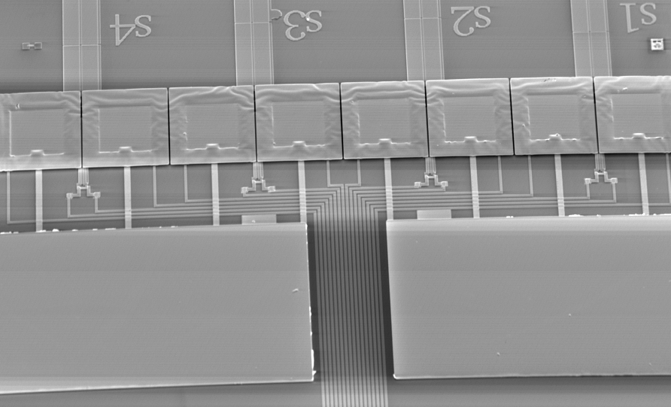
micro-fabrication of x-ray detectors
metallic thermal link to the bath:
sputtered Au film to adjust decay time
here: 1 ms – 3 ms
nearly single exponential decay
thermal bath
thermal bath

Slide 17
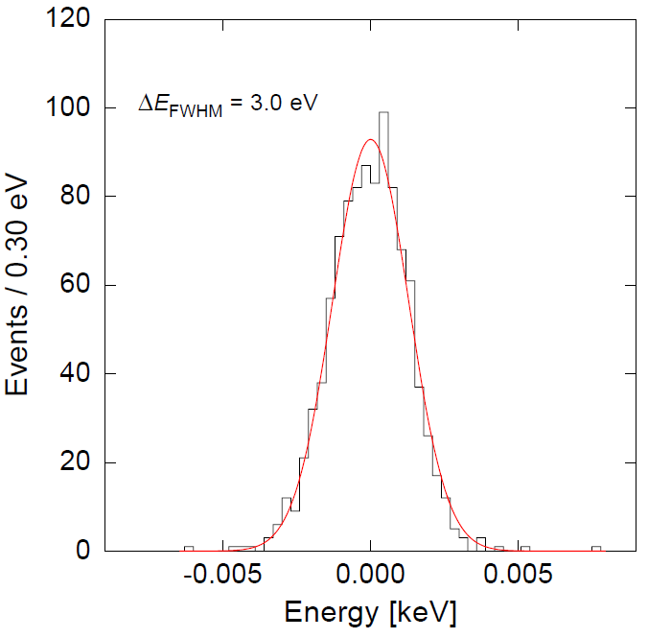
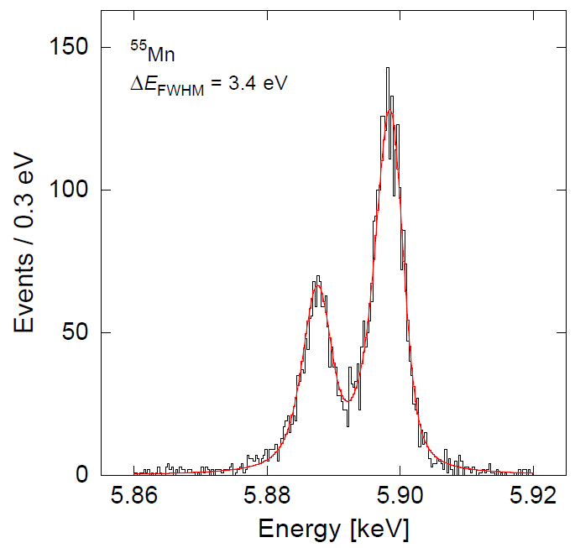
maXs-20: detector arrays for x-rays up to 20 keV
characterization with an ⁵⁵Fe-source
Un-triggered noise:
ΔE_{FWHM} = 3.0 eV @ 0 keV
ΔE_{FWHM} = 3.4 eV @ 6 keV
designed energy resolution of ΔE_{FWHM} = 2.5 eV
slightly spoiled by increased stray inductance (~ nH)

Slide 18
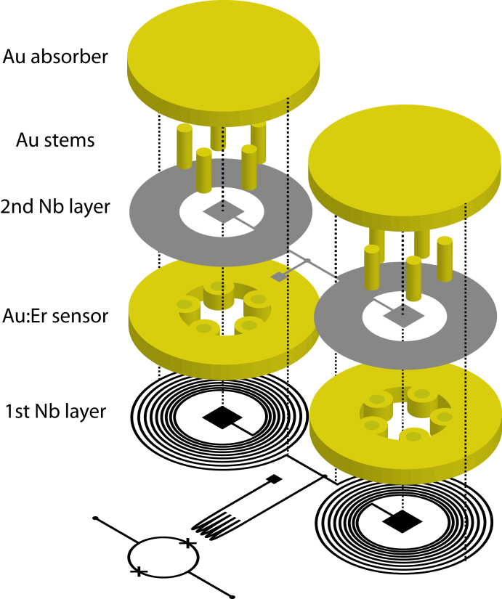
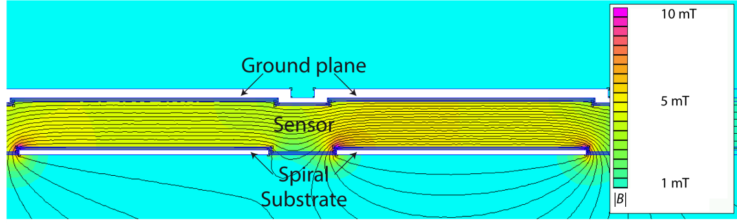
New: „sandwiched“ sensor for improved flux coupling
Planar spiral pickup coil
Sensor sandwiched
between spiral and sc. top plane
Magnetic filling factor close to unity
close to best flux coupling

Slide 19
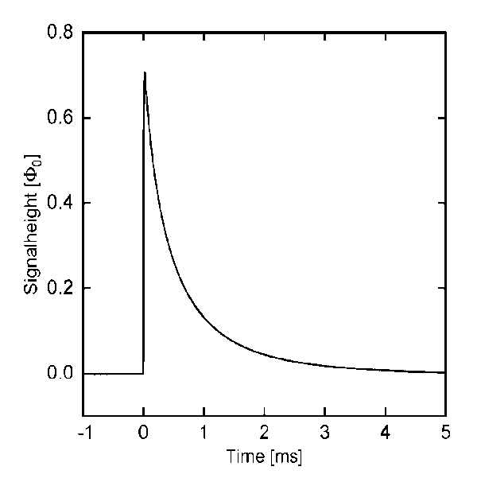
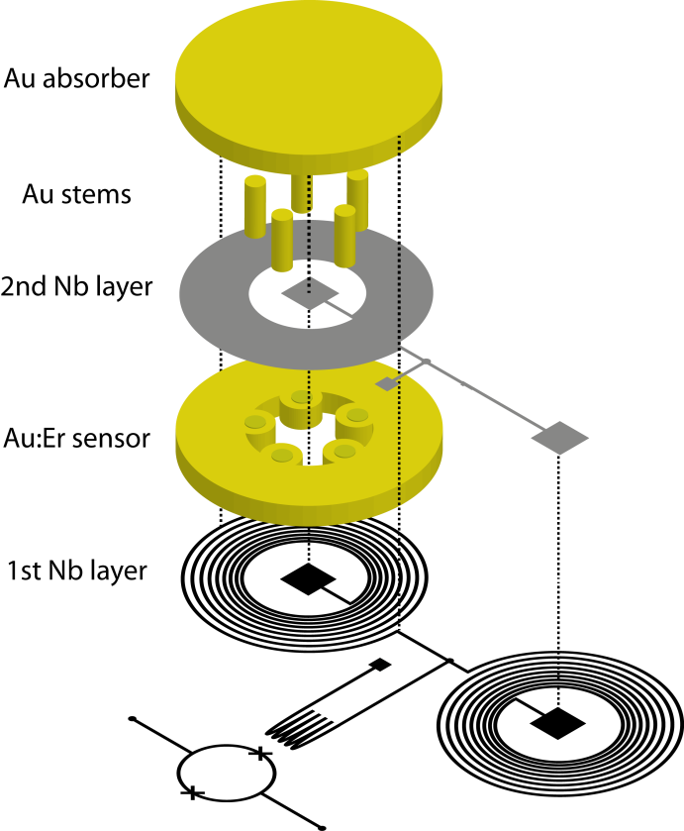

New: „sandwiched“ sensor for improved flux coupling
First prototype
1 pixel
absorber: 5μm thick gold, ∅ 150μm
signal decay time < 1 ms
defined by metallic link to thermal bath
$$70 μm$$

Slide 20
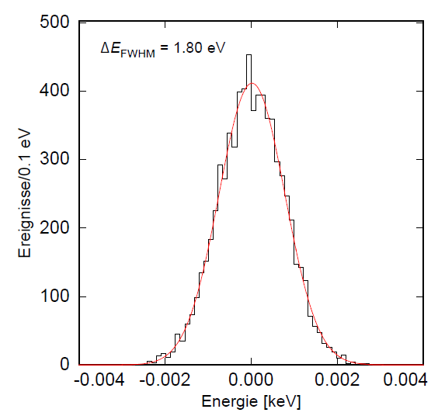
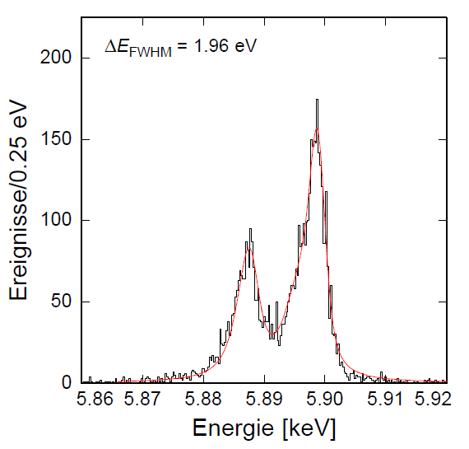
New: „sandwiched“ sensor for improved flux coupling
First characterization with an ⁵⁵Fe-source
⁵⁵Mn
ΔE_{FWHM} = 1.8 eV @ 0 keV
ΔE_{FWHM} = 2.0 eV @ 6 keV
Energy resolution will be pushed below ΔE_{FWHM} = 1.4 eV
by further reducing
stray inductances
some excess heat capacity
stem area to further reduce loss of athermal phonons

Slide 21
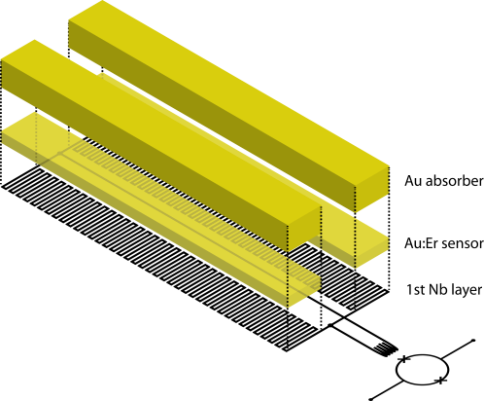
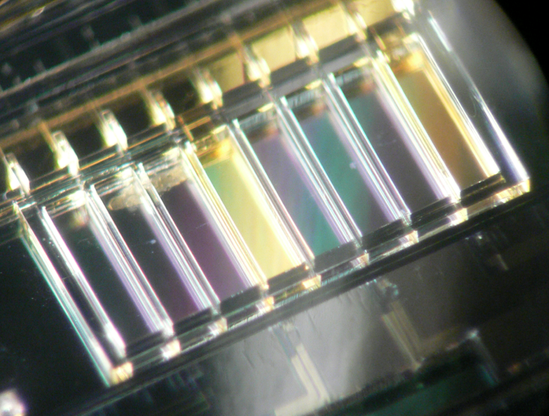

maXs-200: detector arrays for hard x-rays (at GSI/FAIR)
First array prototype
1x8 x-ray absorbers
2 mm x 0.5 mm
200 μm thick electroplated Au
80% QE at 100 keV
ΔE_{FWHM} < 50 eV
4 electronic channels
modular extension to longer arrays
photo resist
mold
electroplated
Au absorbers

Slide 22







maXs-200: detector arrays for hard x-rays (at GSI/FAIR)
First characterization with an ²⁴¹Am-source
²³⁷Np
ΔE_{FWHM} = 40 eV @ 0-10 keV
ΔE_{FWHM} = 60 eV @ 60 keV
Slight degradation towards higher energies due to
Poor temperature stability in this first experiment
Possible marginal position dependence,
to be fixed by stems between absorber and sensor

Slide 23

linearity of maXs-200
Non-linearity at 60 keV
0.1 %

Slide 24
large area MMC with position and energy sensitivity
For the detection of neutral molecular reaction products
at the cryogenic ion storage ring MPI-K, HD
(e.g. dissotiative recombination)
detector:
36 mm in diameter
16 absorber segments
16 temperature sensors
energy resolution 100eV – 200 eV
position resolution 200 μm – 1mm

Slide 25

large area MMC with position and energy sensitivity
pulse area
→ energy
rise time
→ position

Slide 26

large area MMC with position and energy sensitivity
micro-fabricated large area detector
absorbers supported by 200 micron-sized stems
wrinkles to reduce thermal stress

Slide 27

large area MMC with position and energy sensitivity
First test with LED light pulses
glass fibers
signal
Time [ms]
signal
Position dependence of signal shape
agrees perfectly with numerical FEM simulation
Time [ms]

Slide 28

New: μ-calorimeters with magnetic penetration thermometers (MPT)
Replace paramagnetic temperature sensor by
superconductor with low Tc (e.g.100mK)
&
Use T-dependent B-field penetration
as thermometer
Has all good properties of metallic magnetic calorimeters
    No intrinsic power dissipation
    No galvanic contact to sensor
    Wide range of operational temperatures
    Fast
Plus:
    Larger signal size due to larger α = d logΦ / d logT
      Reduced read out noise requirements
    Easier access to low heat capacity devices for UV and IR
First test devices: ΔE_{FWHM} = 15 eV, bulk Hf sensor (Heidelberg)
ΔE_{FWHM} = 4 eV, MoAu bi-layer (NASA GSFC)
Very promising!

Slide 29


Multiplexed read-out of detector arrays
Microwave SQUID multiplexing (K. Irwin, NIST)
each MMC coupled to an
un-shunted single junction SQUID
flux change de-tunes the resonance
of a coplanar λ/4 resonantor (4-8 GHz)
single HEMT amplifier and 2 coaxes
to read out 1000 detectors

Slide 30


summary & outlook
metallic magnetic calorimeters
suitable for high-res x-ray spectroscopy
versatile low temperature detectors
can cover wide range of applications
micro-farbrication works
first detector arrays fabricated
material properties close to bulk values
expected performance will be reached
next steps
demonstration of multiplexed read-out
to increase channel-count significantly
for AMoRE
we are happy to provide existing devices
and support the development of dedicated ones

Slide 31
Detectors for a veriety of applications

Slide 32
calorimeteric detectors are ...
X-ray photon
... a quite dull technique to detect photons
(photon converted to heat)
... bad detectors at room temperature
... a canonical ensemble
→ energy content fluctuates
e.g.
1 cm³ of Ge at 300K: ΔE_{FWHM} ≈ 1 GeV
at 50mK: ΔE_{FWHM} ≈ 1 eV
Thermometer
Weak thermal link
Absorber C
Thermal bath
(T < 100mK)
Important: Fast internal thermalization !
→ normal metal absorbers (but: higher specific heat)
→ typ. volume < mm³

Slide 33

linearity
Measured energy E [keV]
Typical non-linearity:
1-3% at 6 keV
∼ 1 %
ΔE [eV]
Photon energy E [keV]

